Slide 1
AL-FARABI KAZAKH NATIONAL UNIVERSITY
Department of Recreational geography and tourism
Transportation in Tourism
Assipova Zhanna
PhD, associate professor

Slide 2
Lecture 10
Urban Transportation

Slide 3
Urban Hierarchy
Hamlet | Small collection of homes – population 10-100
Village | Rural in character? Population less than 10,000
Urban area | Defined by land use? E.g. 75% built up; by function?
Town | Larger than a village but smaller than a city With town charter. Less than 100,000 population?
City | Legal status in some countries. Over 100,000?
Conurbation | Urban area incorporating adjacent centres e.g. former free-standing towns and villages. After Geddes 1915
Metropolis | Large urban agglomeration, usually over 1 million
Megacity | Urban metropolis over 10 million
Megalopolis | Chain of adjacent metropolitan areas. After Mumford 1938 The Culture of Cities
World or global city | A global centre for finance, culture, political influence (Sassen 1990s)
Eperopolis | ‘Continental city’ (Doxiadis, 1968)

Slide 4
Perspectives about the Urban Spatial Structure: From Dichotomy to Continuum
Dichotomy
Continuum
Urban
EMR
Rural
Urban
Rural
Large City
Towns
Secondary cities
Villages
MUR
EMR: Extended Metropolitan Region MUR: Mega-Urban Region
Notes:
Source: adapted from World Bank (2009) World Development Report 2009: Reshaping Economic Geography.

Slide 5
Demographic Transition

Slide 6
World’s Largest Cities, 1850

Slide 7
World’s Largest Cities, 1900

Slide 10
Population, Selected Units, 1880-2009

Slide 11
World Urban Population, 1950-2010 with Projections to 2030 (in billions)
Notes:
Source: Source: United Nations, Department of Economic and Social Affairs, Population Division (2012). World Urbanization Prospects: The 2011 Revision.

Slide 12
Metropolitan Areas of More than 10 Million Inhabitants, 2010
Notes:
Source: United Nations, Department of Economic and Social Affairs, Population Division. World Urbanization Prospects: The 2011 Revision. New York: United Nations.

Slide 13
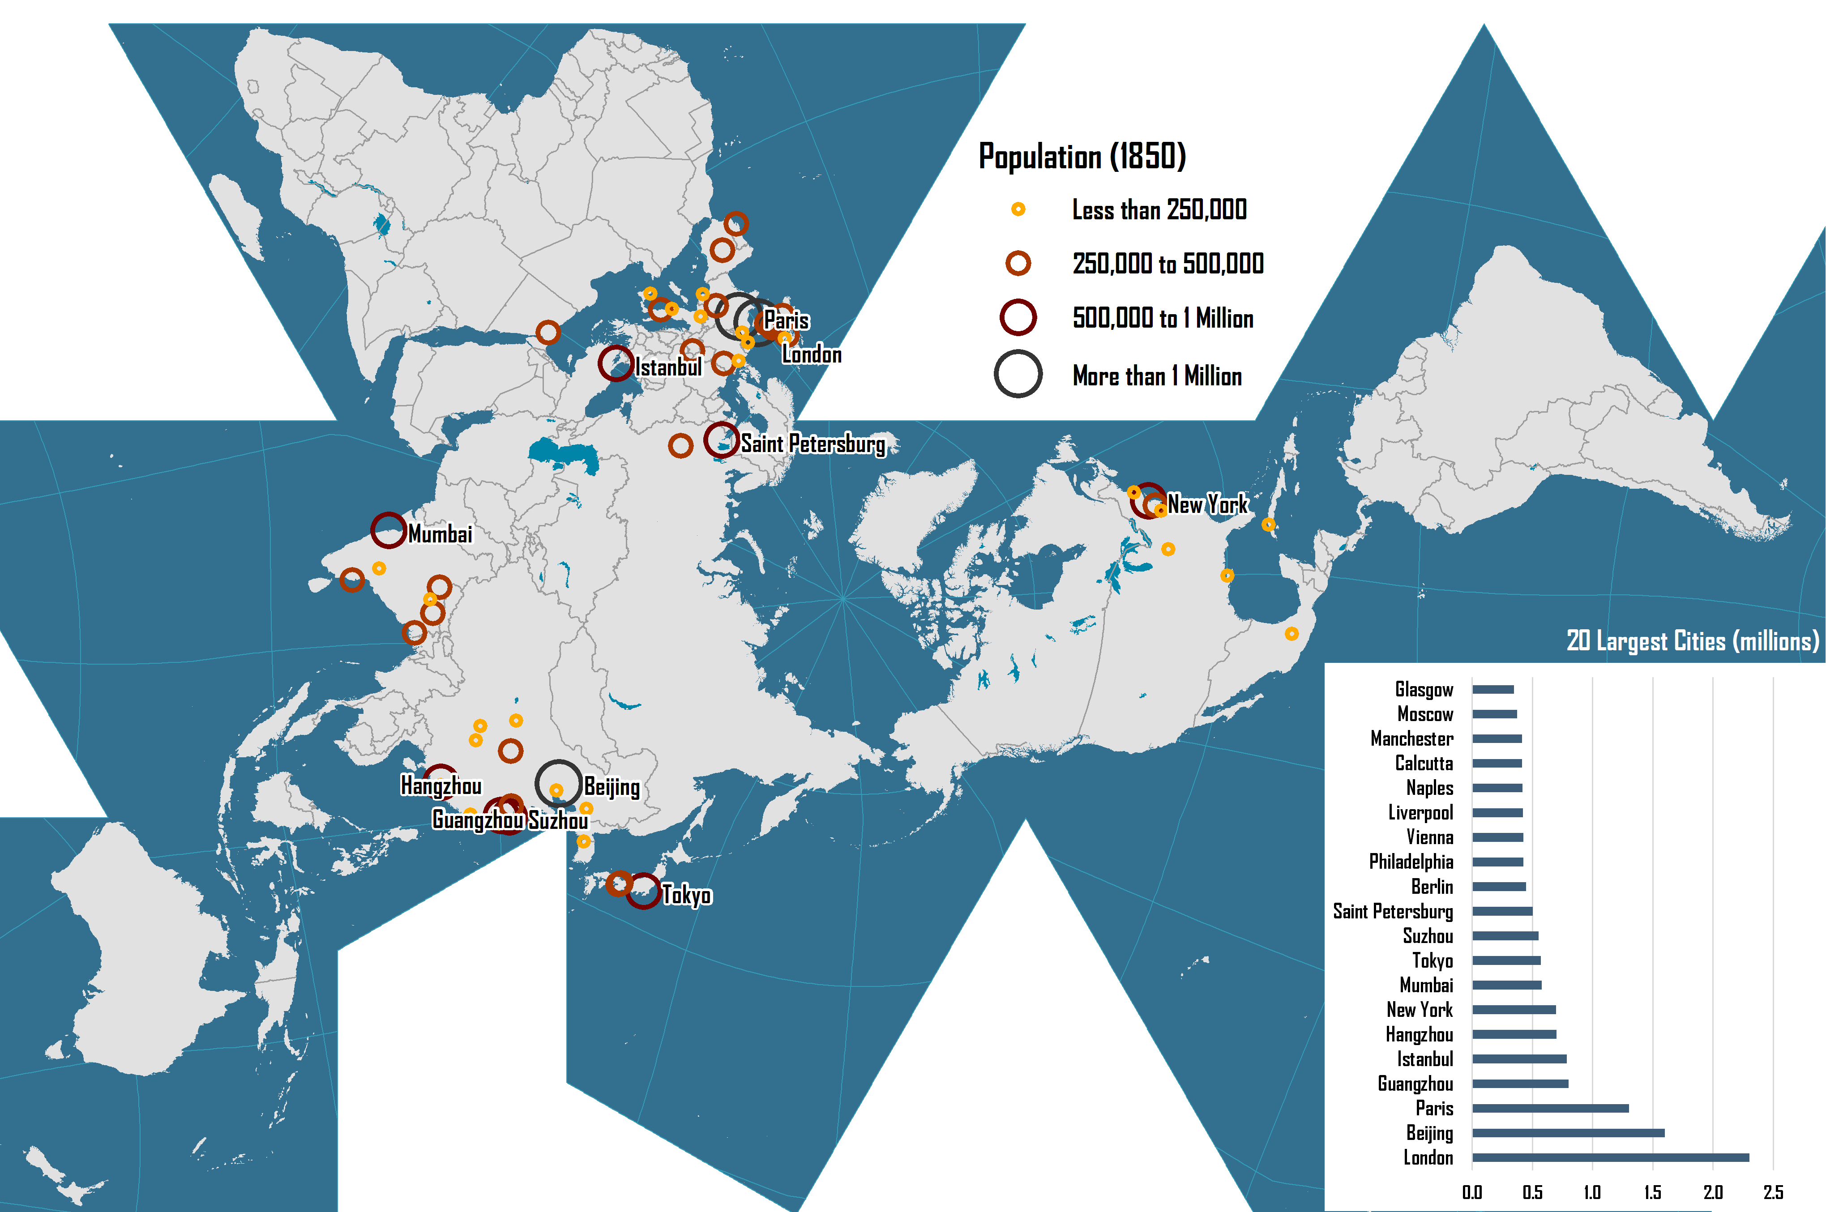
World’s Largest Cities, 1850

Slide 14
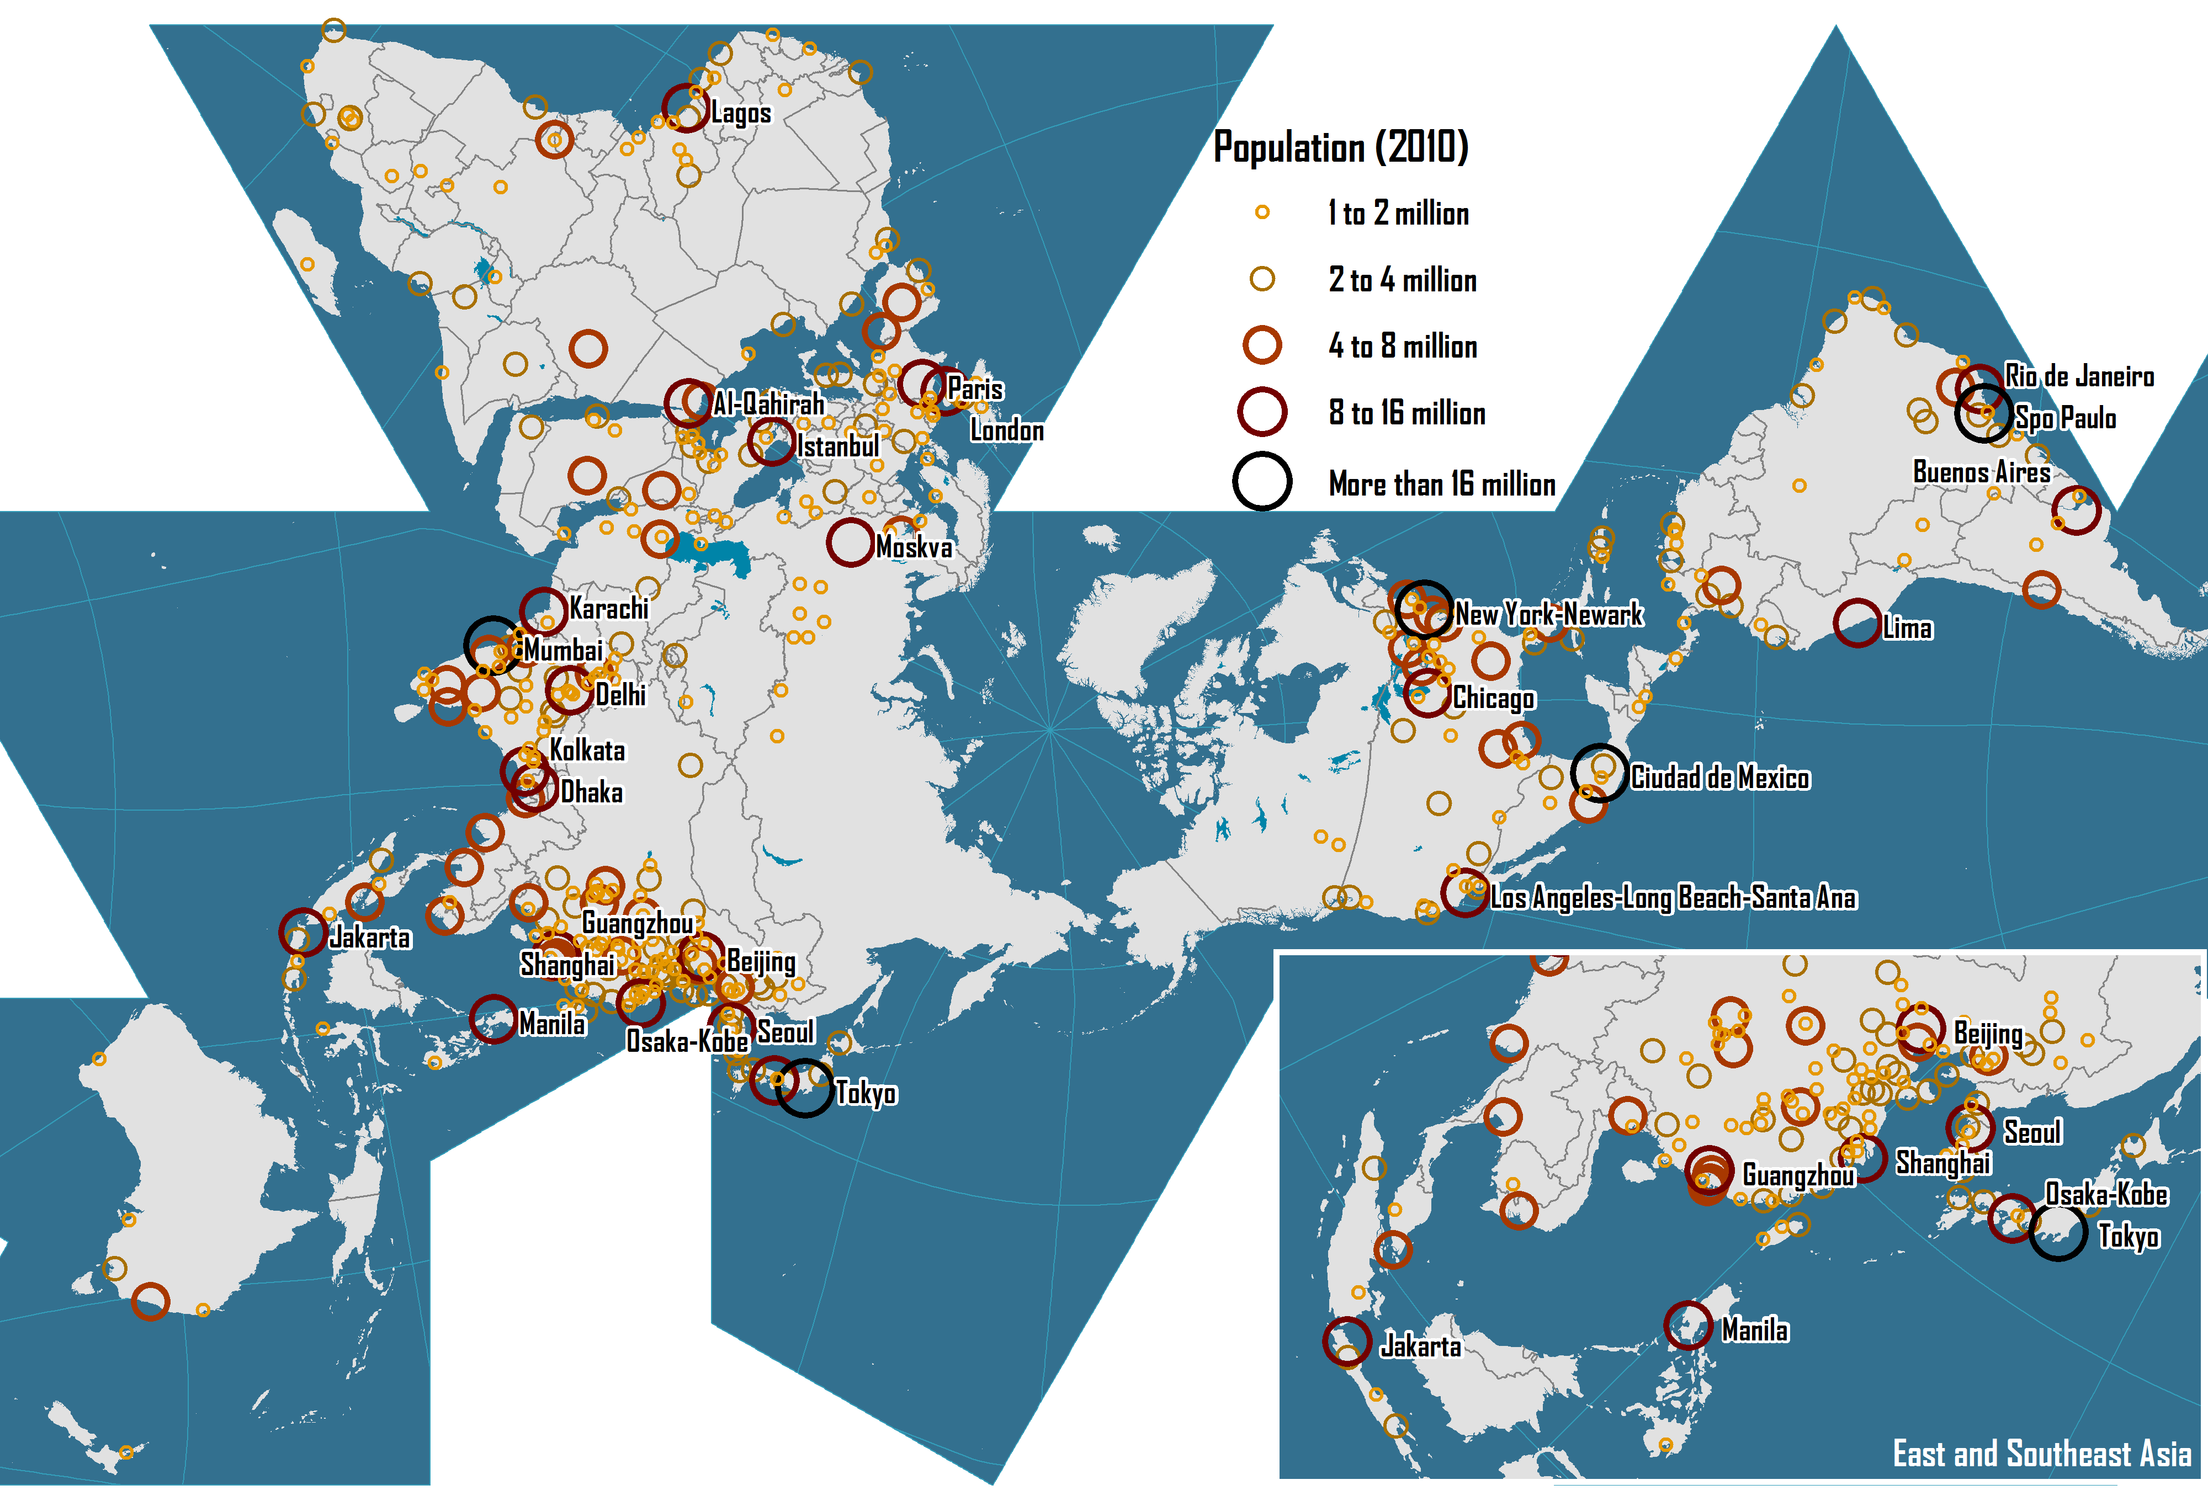
World’s Largest Cities, 2010

Slide 15
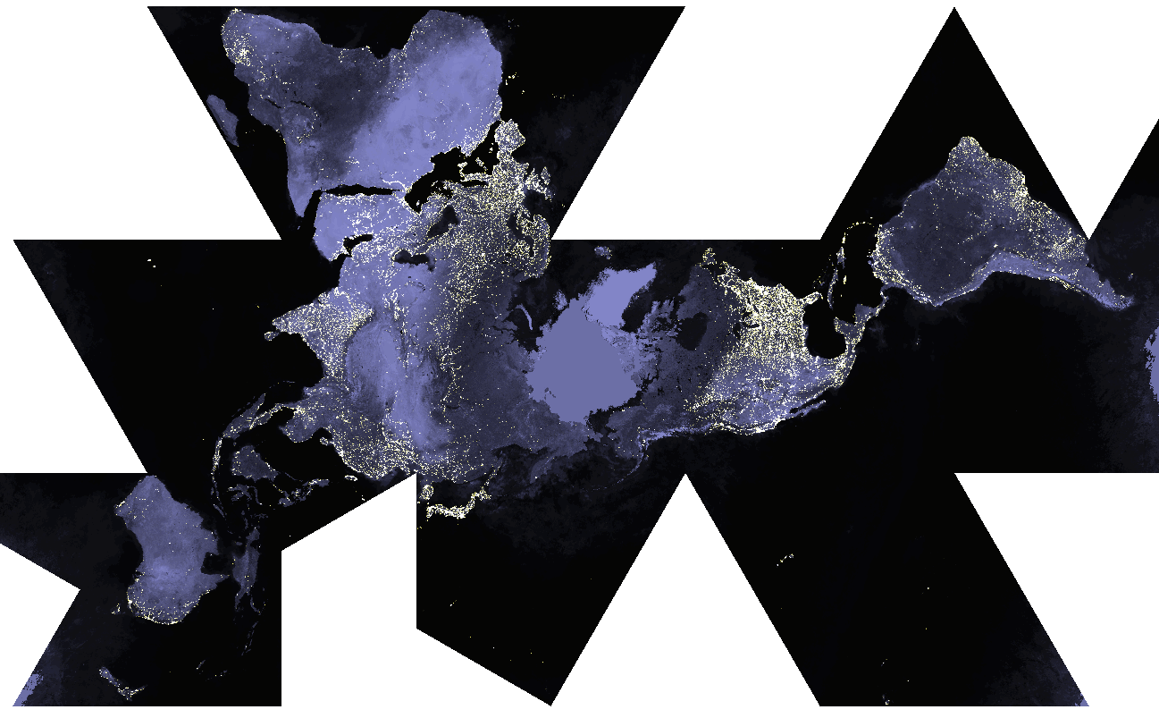
World at Night

Slide 16
Percentage of Urban Population by Region, 1950-2030
Notes:
Source: United Nations, Department of Economic and Social Affairs, Population Division. World Urbanization Prospects. http://esa.un.org/unpd/wup/

Slide 17
Urban Population by Region, 1950-2030 (in millions)
Notes:
Source: United Nations, Department of Economic and Social Affairs, Population Division. World Urbanization Prospects. http://esa.un.org/unpd/wup/

Slide 18
Transportation, Urban Form and Spatial Structure
Spatial
imprint
Infrastructures
Modes
Users
Transportation
Urban Form
Spatial
interaction
Urban Spatial Structure

Slide 19
Types of Urban Spatial Structures
Centralized
A
B
C
D
Decentralized
Clustered
Dispersed

Slide 20
One Hour Commuting According to Different Urban Transportation Modes
Streetcar line
Freeway
Walking
10 km
Streetcar
Cycling
Automobile
Automobile with freeways
Notes:
Source: Adapted from P. Hugill (1995), World Trade since 1431, Baltimore: The Johns Hopkins University Press, p. 213.

Slide 21
Evolution of the Spatial Structure of a City
A
B
C
Core activities
Peripheral activities
Major transport axis
Central activities
Central area

Slide 22
Possible Urban Movement Patterns
Organized
Primary flow
Secondary flow
Disorganized
Monocentric
Polycentric
Notes:
Source: adapted from A. Bertaud (2001) Metropolis: A Measure of the Spatial Organization of 7 Large Cities. http://alain-bertaud.com/images/AB_Metropolis_Spatial_Organization.pdf

Slide 23
Evolution of Transportation and Urban Form in European Cities (to be redesigned)
Built up area prior to introduction of mechanical transport
Development consequent on steam railways
Development consequent on tramways
Development consequent on motor buses
Development consequent on private car

Slide 24
Urban Transport Development Paths
Public
Main development paths
B
Transit Cities
Path divergence
Bus / Paratransit Cities
2
Complete Traffic Saturation
C
Bus Traffic Saturation
Ownership of Passenger Modes
Walking Cities
1
3
Non-Motorized Transport
A
Car Cities
Motorcycle Cities
Traffic Saturation
Private
Low
Urban Mobility Level
High
Notes:
Source: adapted from Barter, P.A. (2004) A Broad Perspective on Policy Integration for Low Emissions Urban Transport in Developing Asian Cities. Draft paper for the International
workshop Policy Integration towards Sustainable Energy Use for Asian Cities: Integrating Local Air Pollution and Greenhouse Gas Emissions Concerns. Institute for
Global Environmental Strategies, Kanagawa.

Slide 25
Population Density by Distance from City Center, Selected Cities
Notes:
Source: adapted from A. Bertaud. http://alain-bertaud.com

Slide 26
Density and Car Use in Selected Global Cities, 2010s
Notes:
Source: Millennium Cities Database for Sustainable Transport

Slide 27
Service Attributes of Urban Transportation Modes
Notes:
Source: adapted from R. Tolley and B. Turton (1995), p. 63.

Slide 28
Urban Modes and Distance Decay
Number of trips
Cycling and walking
Motorized
A
B
C
Distance
Notes:
Source: Adapted from WHO (1998) Walking and cycling in the city. Copenhagen, WHO Regional Office for Europe, 1998, p.5 (document ICP/EUD/NEAP 04 01 02).

Slide 29
Performance by Urban Transport Mode
Notes:
Source: adapted Tolley, R. and B. Turton (1995) Transport Systems, Policy and Planning: A Geographical Approach, Burnt Mill, Harlow, Essex: Longman. P. 184

Slide 30
Thank you for your attention!

