Slide 1

AL-FARABI KAZAKH NATIONAL UNIVERSITY
Department of Recreational geography and tourism
Transportation in Tourism
Assipova Zhanna
PhD, associate professor

Slide 2
Lecture 2
Air transportation

Slide 3
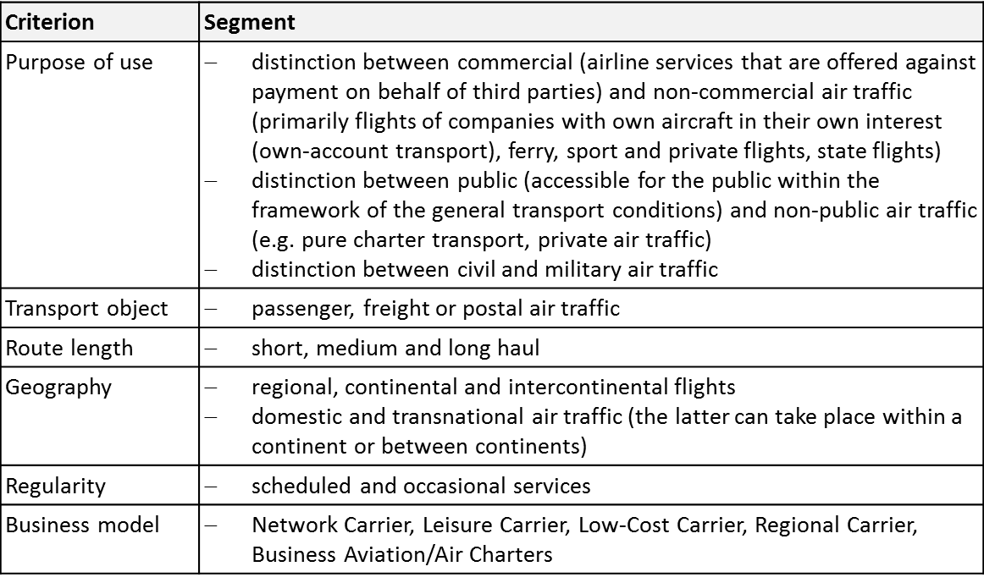
Selected Criterions of Air Traffic Classification
Source: Adapted from Conrady, Fichert & Sterzenbach, 2013

Slide 4
Business Models
Network Carriers: fundamental type of an airline business model
  aspects: global player, fleet, hub-and-spoke network, target group, product/ service offer, multi-channel distribution, frequent flyer programme, yield management
Leisure Carriers: founded specifically for the holiday air traffic and the package holiday business
Low-Cost Carriers: no single business model
  typical aspects: strategic flight planning, fleet, service concept, human resource management, administration, simple branding, simple pricing system, little competition, ancillary services & revenues
Regional Carriers:
  conduct scheduled flights in a point-to-point system between peripheral locations with low traffic density
  provide feeder flights between peripheral locations with low traffic density and the hubs of the Network Carriers
Business Avi­ation: any use of an aircraft by a corporation, a company, or another organization for the pur­pose of transporting its em­ployees and/or property not for compensation or hire and employ­ing professional pilots for the op­eration of their aircraft
Air Taxi: single seats are sold for flights that are operated according to the client needs

Slide 5

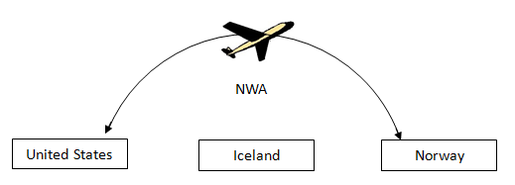
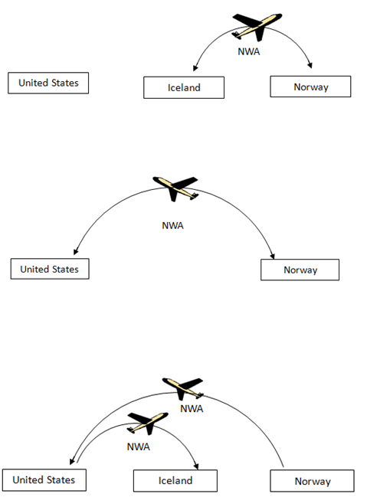
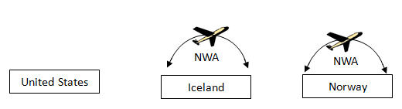
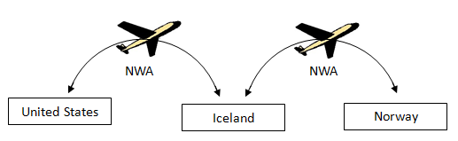
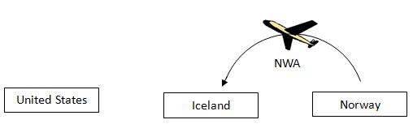
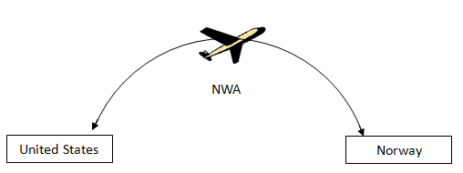

Institutional Framework
Nine Freedoms of the Air

Slide 6
Institutional Framework
Multi- & bilateral Agreements
Open-Skies-Agreement: e.g. between the US and Europe
  airlines can fly from any point in the EU to any point in the US
  before the agreement: only possible from the respective homelands
bilateral agreements:
  contracting states grant each other certain air traffic rights, mostly the 3rd to 5th freedom of the air
  more than 4,900 agreements
  the following questions must principally be re­solved:
    Which airlines are allowed to carry out air traffic between the two states?
    Which airports are allowed to be approached in international traffic?
    How often are the individual routes allowed to be operated and which capacities are allowed to be offered in international traffic?
    Which tariffs are allowed to be applied in international traffic?

Slide 7
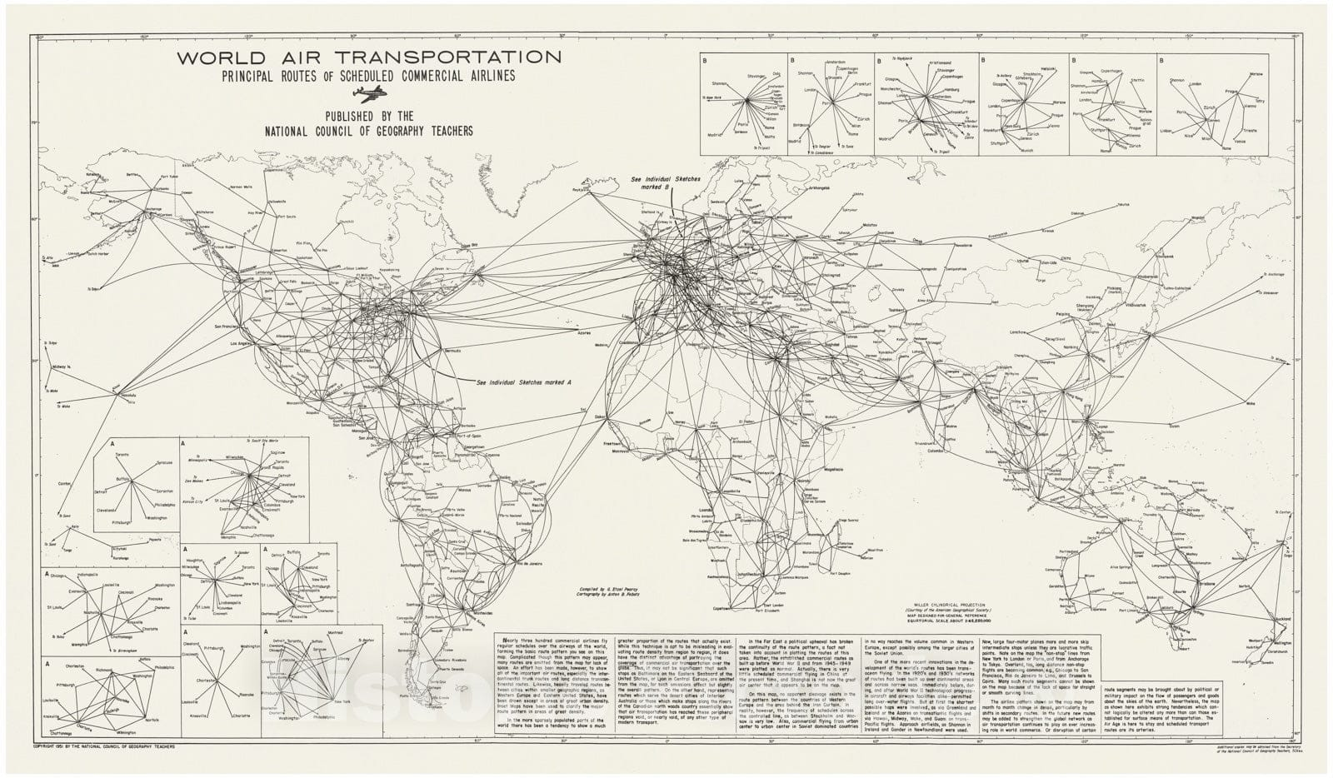

Slide 8
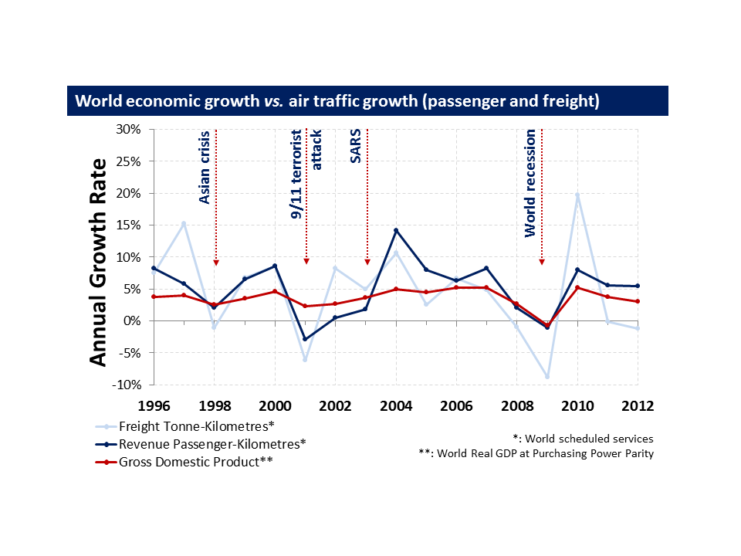

Slide 9
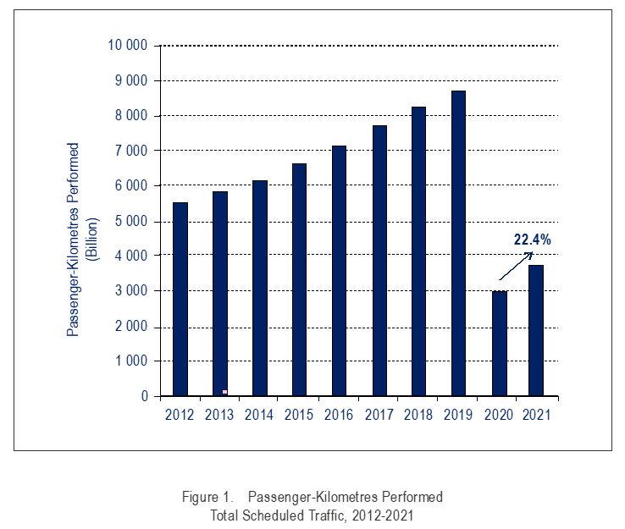

Slide 10
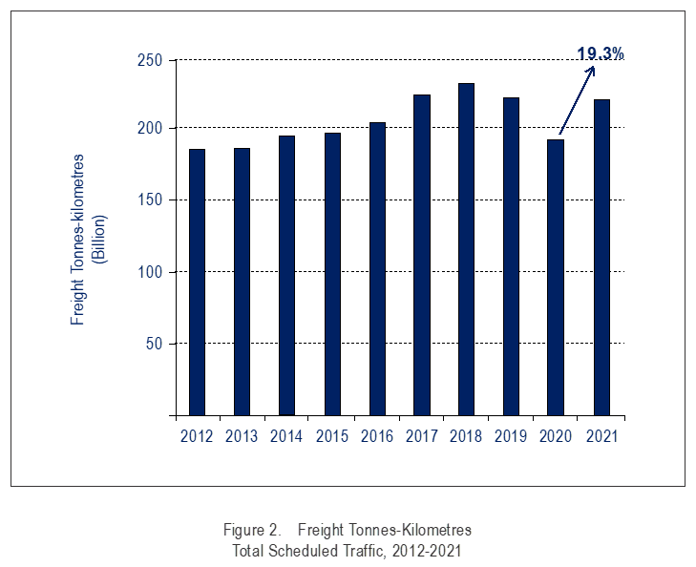

Slide 11
Passenger traffic (total scheduled revenue passenger-kilometres performed
Total increase: 22.4 per cent, equating to 3 626 billion RPKs
Change by region:​ | ​
Europe:​ | 25.4 per cent of world traffic, posting an increase of 31.3 per cent
Africa:​ | 2.0 per cent of world traffic, posting an increase of 21.1 per cent​
Middle East:​ | 7.2 per cent of world traffic, posting an increase of 11.6 per cent
Asia and Pacific:​ | 27.1 per cent of world traffic, posting a decline of 13.6 per cent
North America:​ | 32.0 per cent of world traffic, posting an increase of 72.6 per cent
Latin America and Caribbean: ​ | 6.5 per cent of world traffic, posting an increase of 43.7 per cent

Slide 12
Demand
Top 10 Domestic Air Transport Markets in 2011, measured in source-destination pas­sengers (million)
Source: Adapted from DLR, 2012

Slide 13
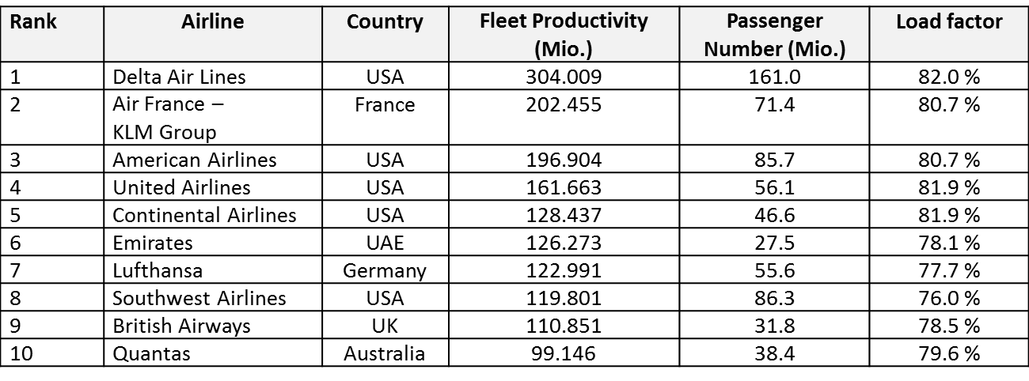
Supply
The 10 Largest Airlines Worldwide
Source: Airline Business, 2010

Slide 14
Thank you for your attention!

