Slide 1
Language resources
al-Farabi KazNU
Module: LANGUAGE CORPUS AS LR
Lecture № 6
Corpus and NLP Applications
2021

Slide 2
Application of NLP
The number of useful applications in this area is growing rapidly today:
search (written or oral);
showing relevant online promotion;
automatic (or assisted) translation;
sentiment analysis for marketing tasks;
speech recognition and chat bots ,
voice assistants (automated customer assistance, ordering goods and services);
Question-answer (QA) systems

Slide 3
Deep Learning in NLP
Deep learning is an area of ​​machine learning:
Large amounts of training data;
Computing power : multi-core CPU and GPU;
New models and algorithms with enhanced capabilities and improved performance, with flexible training on intermediate representations;
context-based learning methods, new methods of regulation and optimization.

Slide 4
Vector representation (text embeddings)
Vector notation is a method of representing strings as vectors with values. A dense vector is constructed for each word so that words found in similar contexts have similar vectors.
Vector representation is considered the starting point for most NLP tasks and makes deep learning effective on small datasets.
The vector representation techniques Word2vec and GloVe , created by Google (Mikolov) Stanford (Pennington, Socher, Manning) most popular and often used for NLP problems.
.

Slide 5
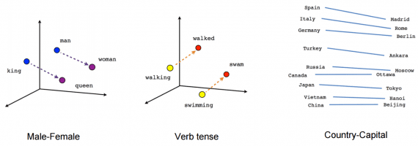
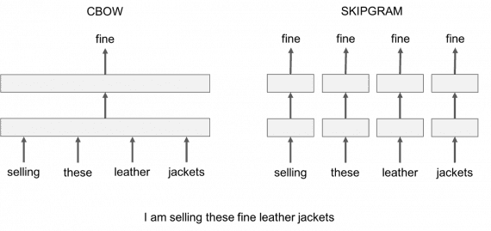
Word2Vec

Slide 6
machine translation
Machine translation is the transformation of text in one natural language into text equivalent in content in another language. This is done by a program or machine without human intervention.
Google Translate translates 100 billion words a day.
Facebook uses machine translation to automatically translate texts in posts and comments to break down language barriers and allow people from different parts of the world to communicate with each other.
eBay uses machine translation technology to enable cross-border trade and connect buyers and sellers from different countries.
Microsoft is applying AI-powered translation to end users and developers on Android, iOS and Amazon Fire, regardless of internet access.
Systran became the first software provider to launch a neural machine translation engine into 30 languages ​​in 2016.

Slide 7
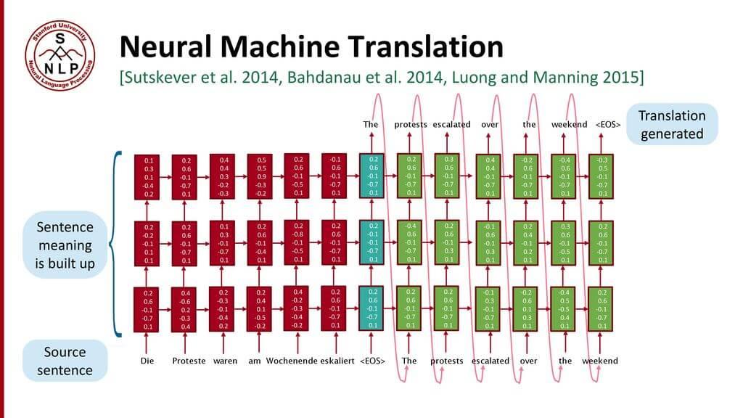

Slide 8
Neural network-based translation methods
End-to-end learning : parameters in NMT (Neural Machine Translation) are simultaneously optimized to minimize the loss function at the output of the neural network.
Distributed Representations : NMT makes better use of similarities in words and phrases.
Better research of context : NMT works more context - source and partial target text to translate more accurately.
More fluent text generation : Deep learning text translation is far superior to the parallel corpus method.

Slide 9
References:
1. Bashmakov I.A., Bashmakov A.I. Intelligent information systems. M.: MGTU im. N.E. Bauman, 2005, pp. 77–90.
2. Ovchinnikova I.G., Uglanova I.A. Computer modeling of verbal communication: teaching method. allowance. Moscow: Flinta: Nauka, 2009. P. 60–76.
3. Igor A. Bolshakov and Alexander Gelbukh. Computational linguistics: Models, Resources, Applications IPN-UNAM-FCE, 2004, 186 pp.

Slide 10
Questions?
...

