Slide 1
Fuel Cells
Fyodor Malchik

Slide 2
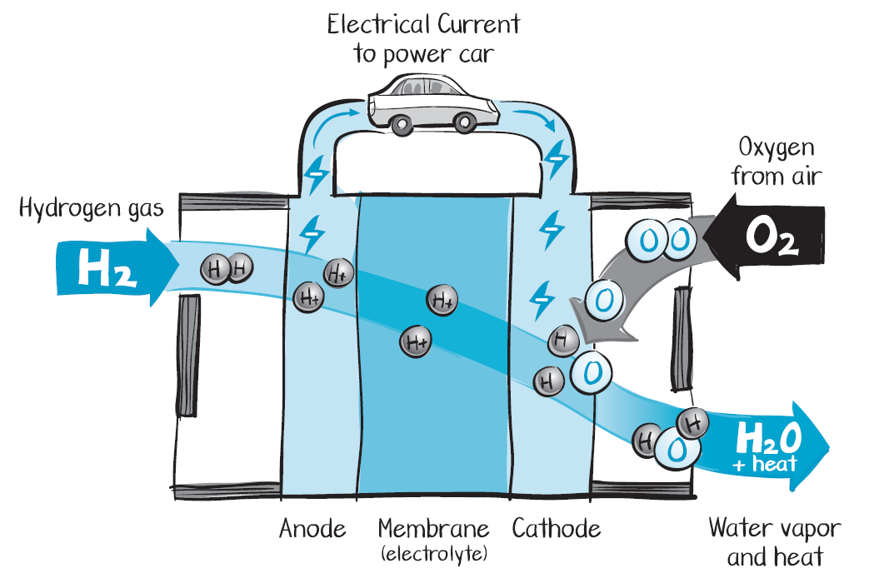

What is a fuel cell?
Takes hydrogen in and puts electricity and water vapor out
Produces electricity without combustion
Notes:
Today the technology around generating efficient and sustainable energy is rapidly evolving and hydrogen and fuel cells are among the most versatile examples of this.
Similar to a battery, a fuel cell is a device that produces electricity from chemical fuels, in just one step.
Unlike batteries, fuel cells don’t run down or need recharging.
As long as there is a constant source of fuel and oxygen, fuel cells will continue to generate power.
And they don’t burn the fuel – the electricity is produced directly.
When you use hydrogen, the only products besides the electricity are water vapor and heat,
So fuel cells produce clean power.

Slide 3
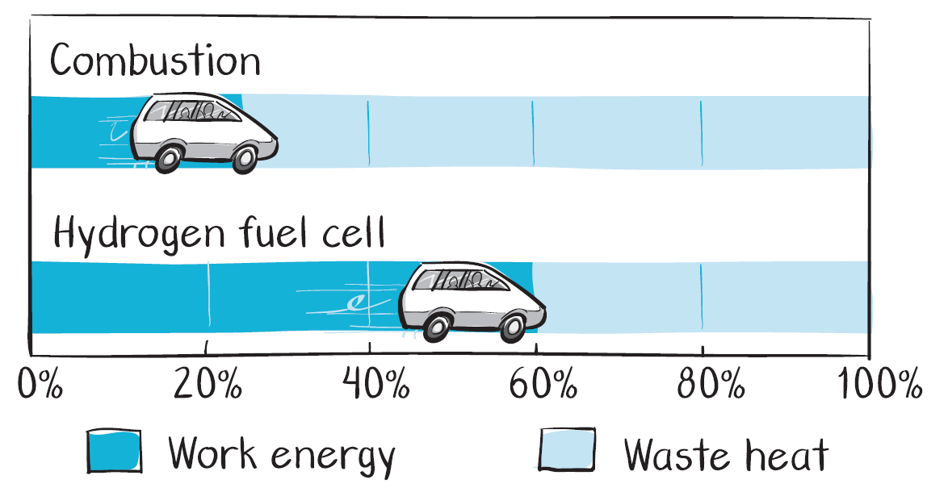

Fuel Cells are more energy efficient
Twice as efficient as a gasoline car and water out of tailpipe
Notes:
Regular cars burn the fuel in a process called combustion, which is not a very efficient way to use energy.
With combustion, over 80% of energy going into powering gasoline cars becomes waste heat and only a 20% goes into running the car.
Fuel cells have just one chemical step involved with no combustion or burning taking place, so they are really efficient and that means you can use more of the energy in the fuel.
With today’s fuel cell system, over 60% of the energy going into powering the fuel cell car is actually used to run the car and less than 40% becomes waste heat.
A kilogram of hydrogen has the same amount of energy as a gallon of gasoline, but in a fuel cell car, that kilogram of hydrogen will take you about twice as far as a gallon of gas will get you in a traditional gasoline car.
To put it in other words, fuel cell cars you essentially get double the fuel economy than you would with traditional gasoline cars.
You also do not have any pistons or conventional transmission and oil changes in a fuel cell car.

Slide 4
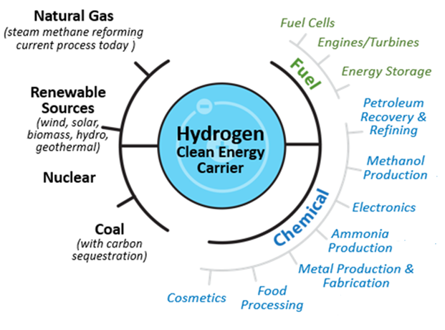
What is hydrogen?
Lightest of all gases and a versatile, clean and flexible energy carrier
Produced from diverse domestic resources and used in many applications
Notes:
Hydrogen is the simplest element known, the lightest of all gases, and the most abundant element in the universe.
It is an ideal energy carrier, not an energy source, that can cleanly store energy and can be produced from diverse domestic resources as you’ll see in the next slides.
Hydrogen has been used widely and for decades as an industrial commodity with approximately ten million metric tonnes produced every year in the U.S.
It is used as a chemical in multiple sectors including petroleum refining, fertilizer production, food processing, and it is even used in cosmetics!
It can be used as a fuel in fuel cells for transportation, stationary and portable power; in engines and turbines and also as a mechanism to store energy.
This set of slides will focus mostly on the benefits of hydrogen when used in a fuel cell or as a energy storage mechanism.

Slide 5
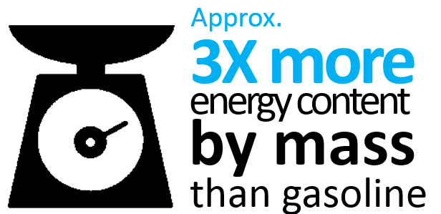
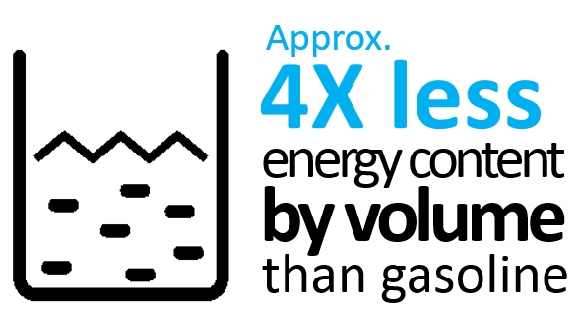
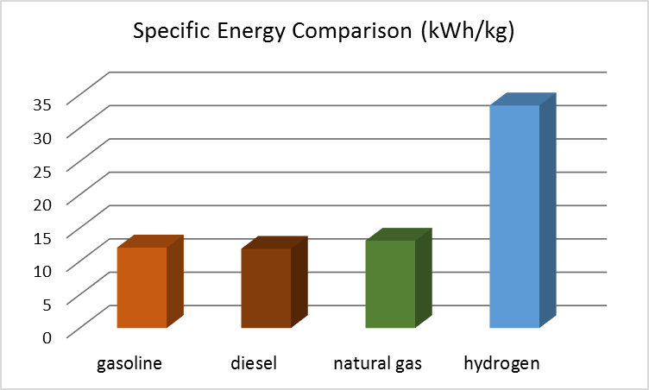
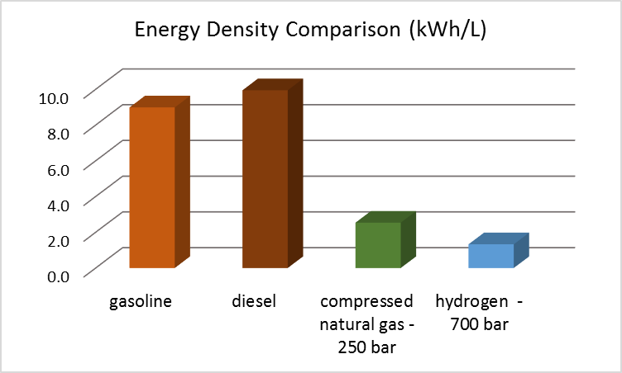
Hydrogen’s Energy Content
High Energy by Mass, Low Energy by Volume
Notes:
Here is one of the key features of hydrogen as a fuel:
Hydrogen has the highest energy content of all known conventional fuels (by weight).
It has almost 3 times more energy content by mass than gasoline.
But it is the other way around when you look at energy density by volume.
Hydrogen has approximately 4 times less energy content by volume than gasoline;
Which means you need a lot of space to store it;
And this makes storing hydrogen difficult specially in applications where space is premium.
However even though the energy by volume is worse and it takes energy to produce, deliver and store hydrogen, the fuel cell is so efficient that it partially makes up for those losses.

Slide 6












Why Hydrogen and Fuel Cells?
Efficient
Uses domestic fuels
Internal combustion engine in a car
20% - 30%
Natural gas
Renewable sources (wind, solar, biomass, etc.)
Nuclear
Coal
Fuel cell in a car
60%
Efficiency
Convenient
Clean
Quiet
Refuels in minutes
No noise in operation
Zero tailpipe emissions
Versatile and easily scalable
Transportation
Stationary
Notes:
Why fuel cells and hydrogen?
Fuel cells are efficient
As we saw earlier, fuel cells are more efficient than internal combustion in vehicles.
And in stationary power applications efficiency can be even higher.
When we incorporate fuel cells into a combined heat and power system for stationary power we can get efficiencies of 80% and even more in some cases.
Fuel cells use more of our domestic energy resources and less oil so we can be less dependent on foreign countries
And this is because hydrogen can be generated from so many resources that are available and abundant here in the U.S. such as natural gas, biomass, waste products, coal and just water.
Fuel cells are convenient, quiet and clean
For example fueling a fuel cell car just takes minutes!
Since they have no moving parts, they operate quietly- which by the way is one of the reasons why they are being considered for silent missions in the military.
And the only products that come out of a fuel cell are electricity, heat and water. No pollution or other dirty byproducts come out of the tailpipe of a fuel cell car.
Fuel cells are versatile as they can scale up easily and meet a variety of power needs- large or small!
You can stack individual fuel cells to increase the amount of power they can provide.
The taller the stack the more power you have.
Large fuel cell stacks can create electricity for houses and buildings, medium fuel cell stacks can power vehicles while small stacks can power your laptop or cell phone.

Slide 7
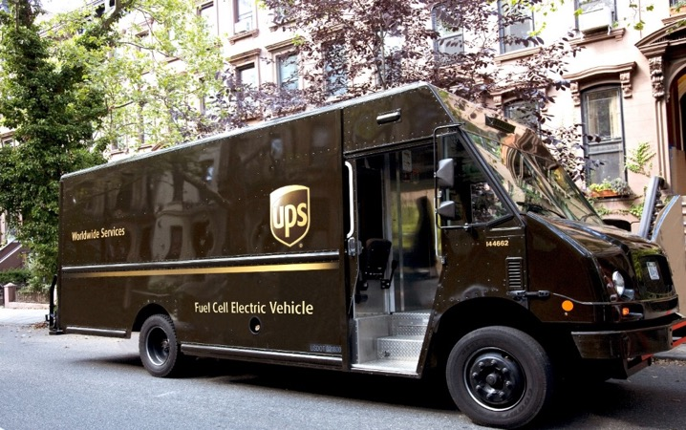
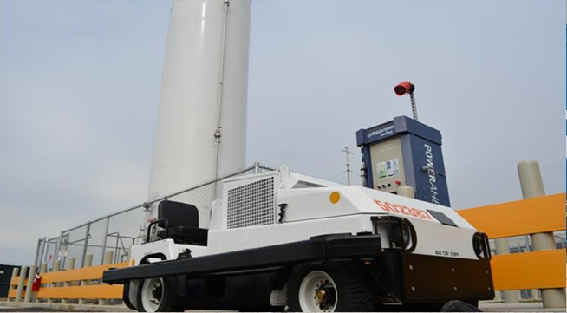
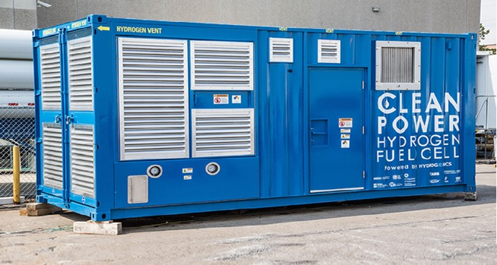
Real World Applications – In the U.S.
First fuel cell tow truck fleet at
airport in Memphis
Photo Credit: UPS
Fuel cell delivery and parcel trucks starting deliveries in CA and NY
World’s first fuel cell for
maritime ports in Hawaii
Photo Credit: FedEx
Photo Credit: Sandia National Laboratories
Notes:
There is a lot of activity in hydrogen and fuel cells right now,
And these are just a few examples of new and exciting developments taking place supported by the Energy Department’s Fuel Cell Technologies Office.
The UPS and FedEx are incorporating testing fuel cells in their delivery trucks since as a way to potentially double the driving range compared to battery electric counterparts.
These fuel cell delivery trucks are running in Sacramento and Albany as part of a demonstration phase.
Another example is the world’s first fuel cell cargo truck fleet that is being demonstrated at an airport in Memphis,
And the world’s first fuel cell for maritime ports was demonstrated in Honolulu Harbor in Hawaii in collaboration with the maritime administration.

Slide 8

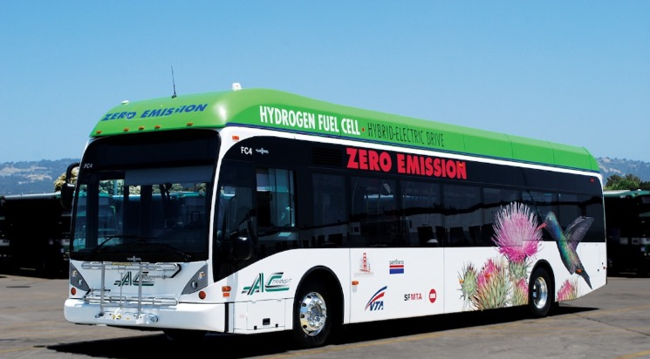
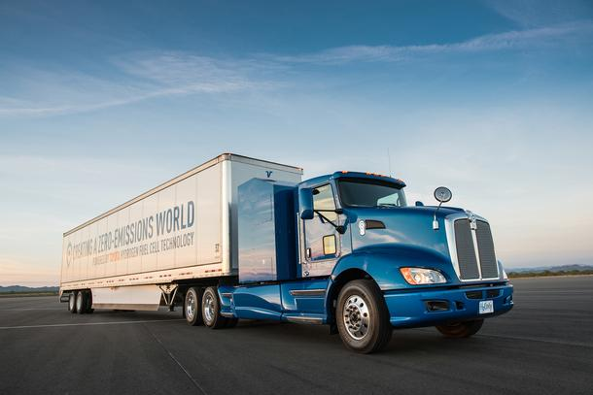

Real World Applications – In the U.S.
Real World Applications – In the U.S.
Fuel cell powered lights at
Super Bowl in CA
Fuel cell buses in California surpass
19M passengers
Photo Credit: NREL
Industry demonstrates first heavy duty fuel cell truck in CA
ZH2: U.S. Army and GM collaboration
First of its kind
Photo Credit: Toyota
Photo Credit: General Motors
Notes:
The list goes on and on:
Many of you may have watched the Superbowl without realizing that some of the lights and other equipment used during this event were powered by fuel cells instead of a noisy polluting diesel generator.
In California alone, fuel cell buses have carried over 19 million passengers and one of the fuel cell buses surpassed a 25,000 hour milestone for durability, exceeding the DOE target.
Industry unveiled the first fuel cell powered heavy duty truck prototype that will be tested at a California port and emits nothing other than water vapor; and
The U.S. Army and General Motors collaborated to develop the Colorado ZH2, a near silent hydrogen-powered military vehicle that can produce stationary power as well as drinkable water for field use.

Slide 9


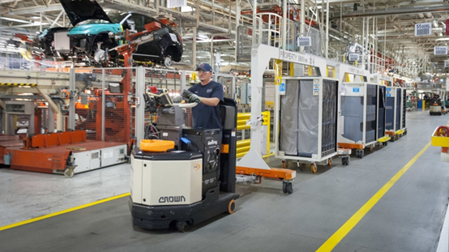
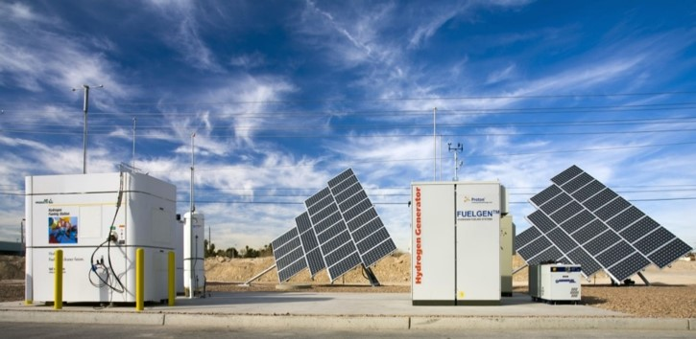
Real World Applications – In the U.S.
Real World Applications – In the U.S.
Fuel cells provided backup power during Hurricane Sandy in the U.S. Northeast
Fuel cells used to power
World Trade Center in NYC
Increasing orders of fuel cell forklifts by warehouses and stores in the U.S.
Backup power installed all over the country for cell phone towers, railroads and utilities
Photo Credit: BMW Manufacturing
Photo Credit: NREL
Notes:
There are many more ways in which we are starting to use fuel cells in everyday life.
In natural emergencies and in sectors where uninterrupted electrical power is essential, many people are turning to fuel cells.
This was the case during Hurricane Sandy, where multiple fuel cells were used in the Northeast as back up power.
Many of you might be aware that the World Trade Center in NYC is relies on fuel cells to power some of its operations;
And many more units are being installed all over the country for cell phone towers, data centers, hospitals, and other critical loads.
Other niche markets for fuel cells are forklifts since they can provide zero emissions with quick refueling and minimize work downtime.
The Energy Department’s Fuel Cell Technologies Office is tracking over 21,000 fuel cell forklifts purchased or on order by warehouses and big stores in the U.S.

Slide 10
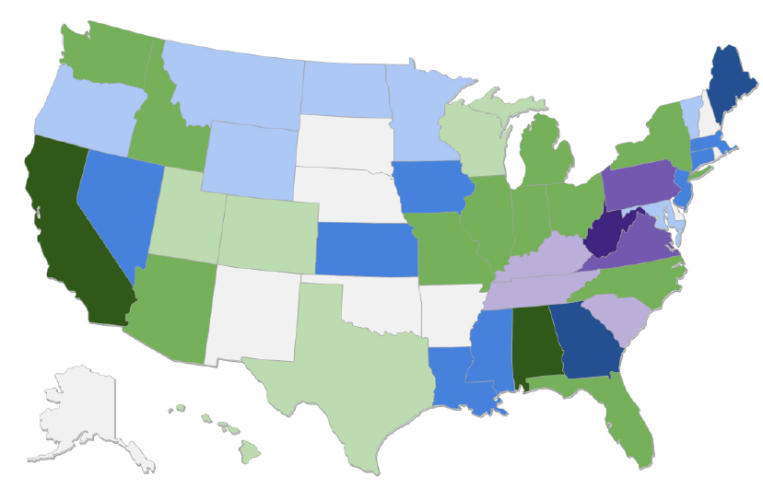
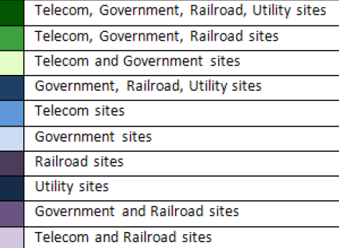
Fuel cells operating all over the U.S.
Fuel cells used for backup power in more than 40 states
Over 240MW
in stationary fuel cell power installed
Over 8,000 backup power units deployed or on order
Source: DOE State of the States: Fuel Cells in 2016 Report
Notes:
We are more dependent on electricity than we were generations ago so a failure of supply today can have major consequences.
Loss of electrical power now means interruption of vital digital communications networks, advanced medical therapies, financial transactions and bank operations, critical transport mechanisms, refrigeration and other essential services.
Our dependence on electricity creates a demand for non-stop electric power.
This is why fuel cells for back up power are starting to operate all over the U.S. and in other countries.
In the U.S., fuel cell installations of more than 240 MW provide stationary power in more than 40 states;
And DOE is tracking over 8,000 back up power units deployed or on order by industry.

Slide 11



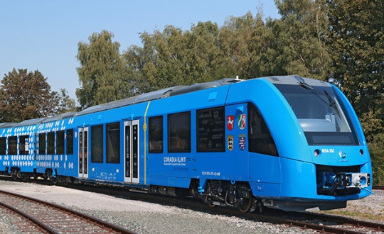
Real World Applications – Abroad
Real World Applications – Abroad
World’s first 4-seater fuel cell plane takes off at German Airport
Fuel cell cab fleet launched in Paris, France
Photo Credit: Christoph Schmidt/dpa via AP and phys.org.
Photo Credit: Hyundai
A town in in Fukuoka, Japan
running on hydrogen
World’s first hydrogen fuel cell train
in Germany
Photo Credit: Fukuoka Pref.
Photo Credit: Hydrogenics and Alstom
Notes:
But we are not the only ones doing this.
Fuel cell and hydrogen applications are becoming accepted and used in other parts of the world including Germany, Japan, Korea, China, France, UK, among others.
Germany is demonstrating the world’s first fuel cell-powered train and planning to have it transport passengers in 2018. It can travel 500 miles and carry 300 passengers.
Aircraft engineers, also in Germany, have successfully tested the world’s first 4 seater plane that uses hydrogen and fuel cells to fly.
Japan has major plans for hydrogen and started several years ago in the town of Fukuoka with a demonstration of hydrogen for various applications.
Japan also has over 250,000 small fuel cells being used for residential applications.
And if you stop by Paris, don’t be surprised if one of the cabs you ride on is powered by fuel cells since they recently launched a small fleet of fuel cell cabs.

Slide 12

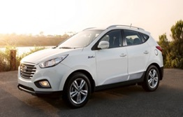
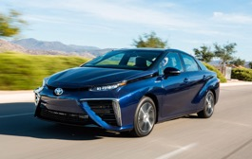
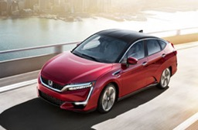

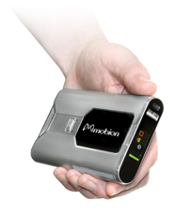


Fuel Cell Market Growth
Fuel Cell Power Shipped Worldwide (MW)
Transportation
Photo credit: Hyundai, Toyota and Honda
Stationary
Portable
Source: Navigant Research (2011-2013) & E4tech (2014-2016)
Photo credit: NREL
Photo credit: NREL
650 MW
70,000
Approximately
$2 Billion
fuel cell power shipped worldwide
fuel cell units
shipped worldwide
fuel cell revenue
Source: DOE, E4tech
Notes:
We continue to see growth in fuel cell systems shipped annually.
Mostly in transportation, and mostly in a type of fuel cell called proton exchange membrane (also known as polymer electrolyte fuel cells) or PEM fuel cells over the last year.
With 650 megawatts of fuel cell power and over 70,000 fuel cell units shipped worldwide along with a $2B in fuel cell market revenue in 2017;
This is a very exiting time for the fuel cell industry!

Slide 13

U.S. Fuel Cell Car Sales
More than
Fuel Cell Car Sales Growing
5,000
fuel cell cars
sold or leased in the U.S.
First time fuel cell electric mobility ranks
#1 trend
in 2018 automotive executives survey
Aug 2014
Aug 2018
KPMG, Global Automotive Executive Survey 2018
Note: Cumulative number of vehicles sold/leased. Source: hybridcars.com
Notes:
For the first time in history, we have commercial fuel cell electric vehicles on the road in the U.S., running on hydrogen, with completely zero petroleum and zero emissions coming from the tailpipe!
Hyundai, Toyota, and Honda now have fuel cell vehicles on the road and other companies like Daimler, GM and BMW plan to release theirs soon.
The number of fuel cell cars hitting the road in the U.S. is increasing as we speak.
As you can see in this graph, the number of fuel cell cars in the U.S. has increased rapidly, especially in the past year.
Over 5,000 fuel cell cars have been sold or leased as of August 2018.
And we are seeing positive reactions and attitudes towards the technology.
Take a look at these results from the latest annual survey KPMG which explores how approximately 1,000 senior executives from the world’s leading automo­tive companies see the global automotive sector growing, changing and reacting to challenges and opportunities
This year and for the first time in the history of this survey, fuel cell electric mobility is rated as the #1 trend, having grown in importance from its #5 ranking in the previous year.

Slide 14


A Simple Example: Gasoline vs. Fuel Cell Car
20
Miles
=
X
15
Gallon
300 miles
Gallon
Tank
15
X
4
Dollars
$60
Gallons
=
Gallon
Gasoline Car
Note: Illustrative example, does not reflect current gasoline prices
60
Miles
Kg (gge)
=
X
5
300 miles
Kg (gge)
Tank
Kg
Dollars
$50
5
X
10
=
Tank
Kg (gge)
Fuel Cell Car
GGE: gallon of gasoline equivalent
Note: 1 kg of hydrogen has the same amount of energy as 1 gallon of gasoline
Notes:
One of the questions that is often asked is “how much will I have to pay to fuel a car like this?”
The shorter answer is that because the fuel cell is so much more efficient that the internal combustion engine, fueling a fuel cell car can cost around the same as fueling a gasoline car,
Although most fuel cell cars on the road now come with free fuel for three years or for a certain amount of miles.
Here is a simple exercise to give you a ballpark number for the cost of refueling a fuel cell car based on current conditions and to show you how that would compare to the cost of refueling a gasoline car:
For this example, we are assuming our gasoline car has a fuel economy of 20 miles per gallon and a tank that holds 15 gallons of gasoline.
A full tank in this car will give you a 300 mile range.
Assuming the price of gasoline is around $4 per gallon, filling up this car would cost you around $60.
So driving 300 miles in the gasoline car will cost you $60.
If we run the same exercise with the fuel cell car, the number you get is comparable.
In this example we are assuming our fuel cell car has a fuel economy of 60 miles per gallon of gasoline equivalent (or kilogram of hydrogen) and a tank that holds 5 gallons of gasoline equivalent.
These numbers are representative of the fuel economy of the fuel cell cars on the road today.
A full tank in this fuel cell car will give you 300 mile range– or the same driving range that you’d get with our gasoline car example.
Assuming the price of hydrogen is $10 per gallon of gasoline equivalent (or kg), filling up this fuel cell car would cost you around $50.
Therefore driving 300 miles in the fuel cell car will cost you $50.
The price of hydrogen can be up to 50% higher at some newer stations though and we still need to reduce cost.

Slide 15

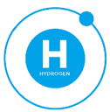

DOE Hydrogen and Fuel Cells Program
Applied research, development and innovation in emerging hydrogen and fuel cell technologies leading to:
Energy security
Energy resiliency
Strong domestic economy
Early R&D Focus
Early R&D Areas
Early R&D Impact
60% Lower Fuel Cell Cost
$/KW
$124/KW
At high-volume
Fuel Cells
Hydrogen
$50/KW
At 100K/yr.
PGM- free catalysts
Durable MEAs
Electrode performance
Production pathways
Delivery components
Advanced materials for storage
2006
Today
Greater Fuel Cell Durability
4X
more hours
of fuel cell lifetime since 2006
80% Lower Electrolyzer Cost
PGM = Platinum group metals
MEA = Membrane Electrode Assembly
for H₂ production since 2002
Notes:
The U.S. Department of Energy’s (DOE) Fuel Cell Technologies Office (FCTO) within the DOE’s Office of Energy Efficiency and Renewable Energy is focused on early research and development (R&D) in hydrogen and fuel cell technologies leading to energy security and resiliency and paving the way to a strong domestic economy.
Early R&D areas span fuel cells and hydrogen R&D, which enable advancements in catalysts, electrodes, H2 production and delivery pathways, and advanced materials for H2 storage.
Through early R&D, FCTO has enabled technological breakthroughs reducing the cost, improving the performance and accelerating the market entry of hydrogen and fuel cells, including:
Cut the cost of automotive fuel cells (at high volume) by 60% since 2006 to roughly $50/KW today (at 100,000 units per year).
Quadrupled the lifetime of a fuel cell since 2006 to more than 120,000 miles or 4,100 hours.
Cut the cost of electrolyzers– a technology to produce hydrogen- by over 80% since 2002.
Enabled over 700 U.S. patents and about 30 technologies developed by industry in the market.

Slide 16
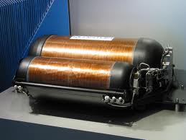
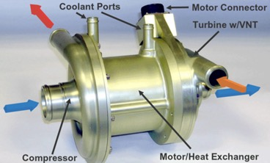
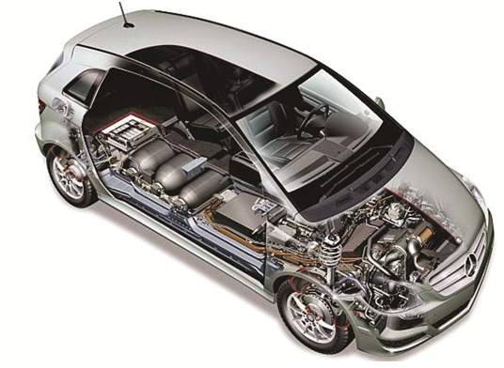
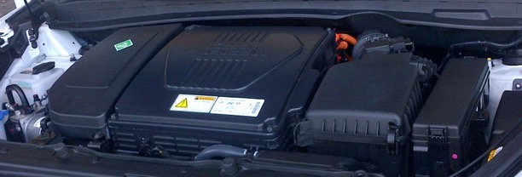

Examples of Technology Enabled by DOE
700 bar pressure vessels
Air Compressors
Humidifiers
5 nm
Fuel Cell Stack Systems
DOE: Department of Energy
Notes:
The DOE focuses on R&D work that addresses key technological challenges, improves the performance and reduces the cost of key hydrogen and fuel cell components.
For example, DOE-funded R&D has contributed to advances in the technology being used in fuel cell cars such as fuel cell catalysts and membrane electrode assemblies (MEAs);
the 700 bar composite overwrapped pressure vessels used to store hydrogen in the car;
And other critical engine system technologies in a fuel cell car, including the electric powered air compressor and the humidifier.

Slide 17
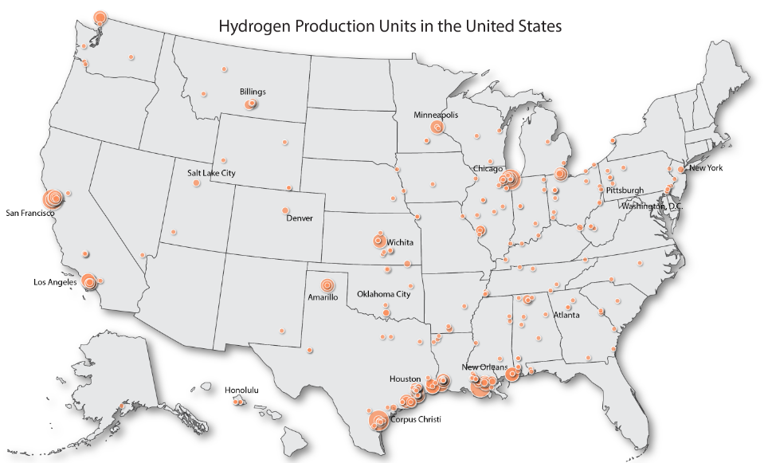
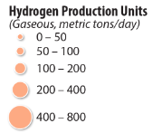
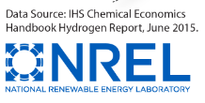
Hydrogen is an industrial commodity
U.S. annual hydrogen production
Largest Users in the U.S.
10 million metric tons
Petroleum Processing
68%
Fertilizer Production
21%
Notes:
Hydrogen is a standard industrial chemical commodity today.
In the United States, we produce approximately 10 million metric tons of hydrogen every year.
Most of that hydrogen is used in the petrochemical industry for petroleum refining, followed by the fertilizer industry for ammonia production.
Today, most hydrogen comes from natural gas.
This pathway provides hydrogen at roughly $2/gallon of gasoline equivalent (or kg), but delivering, compressing and dispensing it to cars can add an additional $3 to $5 per kilogram even at high volumes.

Slide 18
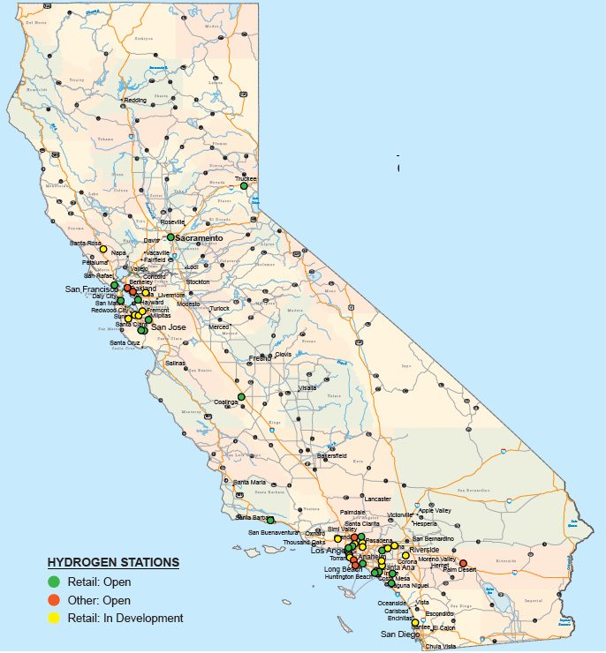
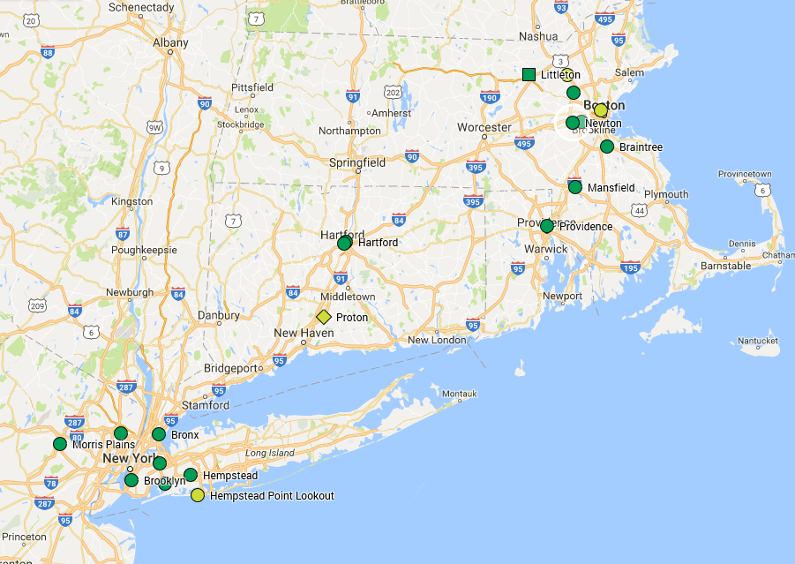

H₂ stations now open in selected U.S. regions
California
Over 30 open retail
Funding for 200
Open - Retail
Open Non-Retail
In Progress
Hub
Northeast
Approx. 12 to 25 stations planned
Others with interest: Hawaii, Ohio, Texas, Colorado, South Carolina, and others
Notes:
There has been steady progress on hydrogen stations.
There are 36 retail and publicly available hydrogen stations in California (as of July 2018),
And many more are coming in the Northeast with industry funding.
Most stations are clustered in urban areas like San Francisco and Los Angeles where many fuel cell car owners live.

Slide 19
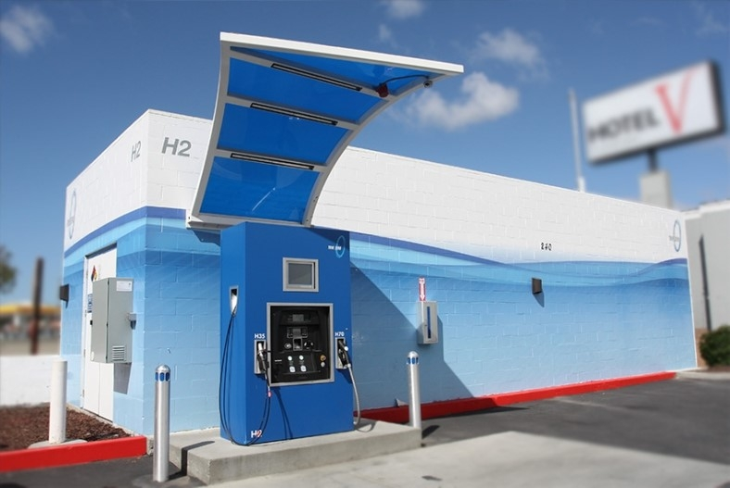
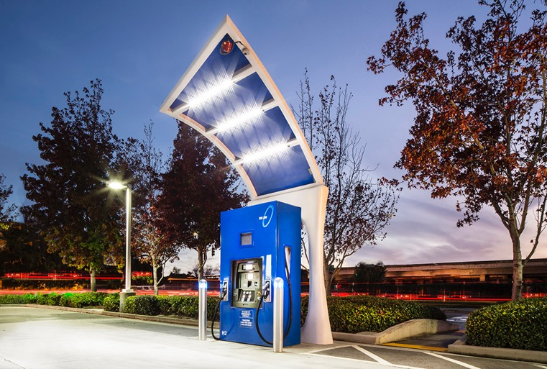
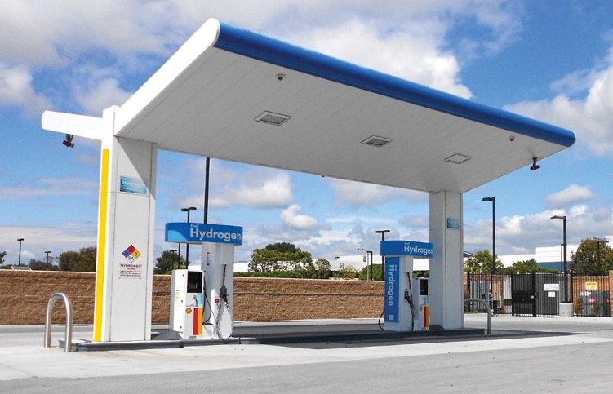
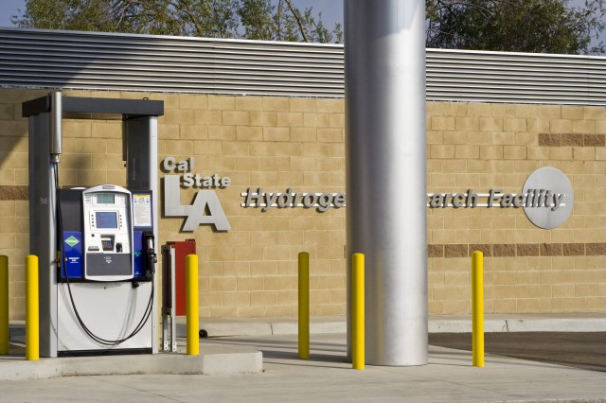
H₂ stations look similar to regular gas stations
Photo courtesy: CaFCP
Notes:
Here are just a few examples of what those stations in California look like.
The ones you see here are stations in South San Francisco (upper right), Hayward (upper left), Los Angeles (lower right), and Torrance (lower left).

Slide 20
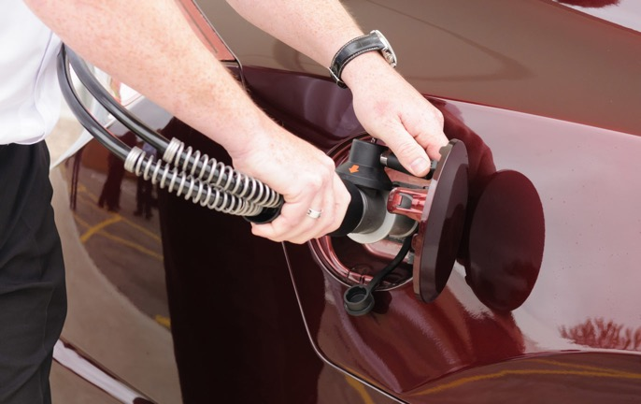
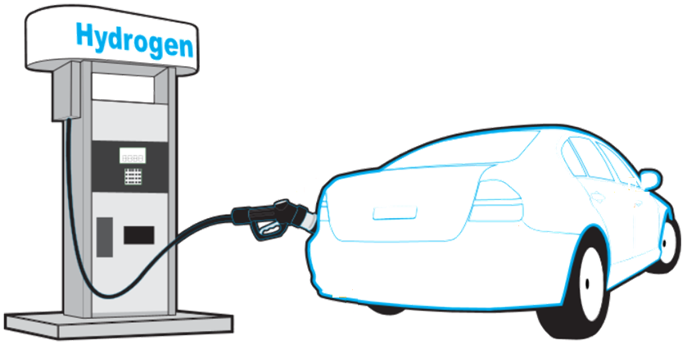

What does hydrogen refueling look like?
Takes minutes
Similar dispenser to gasoline
Safe and familiar process
Notes:
And this is what refueling a fuel cell car looks like.
You can refuel a fuel cell car much like you would refuel your gasoline car.
Just drive up, open the tank, fill, and go.
Just like with traditional gasoline vehicles, it typically takes a few minutes to fill your tank and it is just as safe!

Slide 21

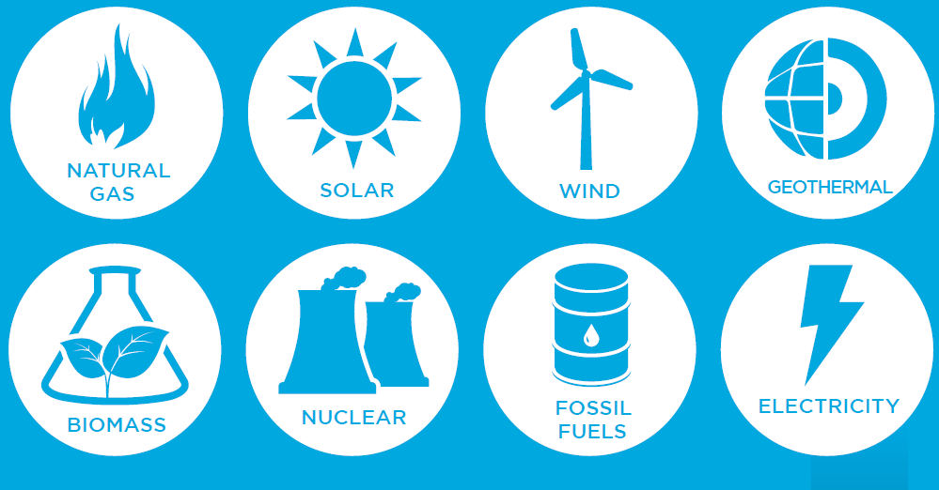
Many Energy Sources for Hydrogen
Domestic energy sources can be used to produce hydrogen
Most of today’s hydrogen comes from natural gas
Learn more at:
http://www.energy.gov/eere/fuelcells/hydrogen-resources
Notes:
The hydrogen you use as fuel in a fuel cell car can be produced from multiple energy sources that are abundant in the U.S.
Including fossil fuels such as natural gas and coal;
Nuclear power;
And renewable resources like wind, solar, geothermal and biomass.

Slide 22


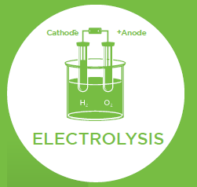



Many Ways to Produce Hydrogen
Most of today’s hydrogen is produced through
Steam Methane Reforming
Electricity separates water into oxygen and hydrogen
Microbes or enzymes break down plants and produce hydrogen
Energy from direct sunlight and sun heat splits molecules
Steam and hydrocarbons come together under high temperature
Learn more at:
http://www.energy.gov/eere/fuelcells/hydrogen-production-processes
Notes:
You can use any energy source we saw earlier and couple it with the processes you see here to produce hydrogen
For example, most of today’s hydrogen is produced from natural gas through a process called steam methane reforming.
This is where steam and hydrocarbons come together under high temperature to produce hydrogen.
You can also use power from renewable sources to generate electricity, which you then couple with water to produce hydrogen through a process called electrolysis.
In electrolysis, you apply an electric current to water and split it into oxygen and hydrogen.
You can also bypass the electricity step and use direct sunlight to produce hydrogen in a process called photoelectrochemical hydrogen production.
Or you can rely on microbes that consume biomass to produce hydrogen gas.

Slide 23





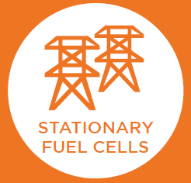
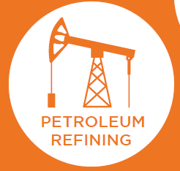

Multiple Uses for Hydrogen
Hydrogen can be used in many sectors
throughout the economy
Including other mobile applications like buses, trucks and forklifts
Good for limiting renewable power curtailing and stabilizing grid
Interest from cell phone towers, data centers, hospitals and supermarkets
Largest use of hydrogen produced today
Second largest use of hydrogen produced today
Learn more at:
https://energy.gov/eere/fuelcells/fuel-cell-technologies-educational-publications
Notes:
As we saw earlier, most of the hydrogen we produce in the U.S. is used for petroleum refining, followed by industries in the chemical space.
However, applications in transportation, stationary power and energy storage are emerging rapidly.
Hydrogen can be used in fuel cells for transportation applications like passenger cars, buses, trucks and forklifts;
And for stationary power for buildings and facilities across the country including cell phone towers, data centers, hospitals, supermarkets and many more.
Like a battery, hydrogen has the ability to store energy and it can do so in large quantities and for a long time.
So you could use any excess energy from renewable power that the grid cannot take and store it as hydrogen until you need to use it.

Slide 24
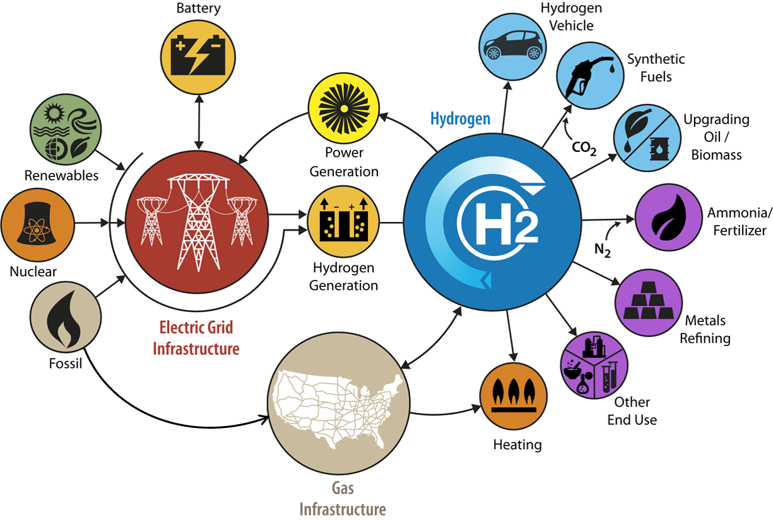
Putting it all together: H₂@Scale Vision
Conventional Storage
Notes:
When you put all of the benefits hydrogen can bring by being incorporated into our energy system together, you end up with the H2@Scale Vision.
H2@Scale lays a framework for the potential wide-scale production and utilization of hydrogen.
By implementing the H2@Scale vision we can address high level energy-related issues such as enabling grid resiliency, energy security, cross-sector efficiency improvements, and emissions reductions.
The U.S. Department of Energy is working to bring the H2@Scale vision to life by bringing industry and national laboratories together
And enabling them to work collaboratively on key issues that prevent the the wide-scale integration of hydrogen into our energy system.

Slide 25
H₂@Scale:
Enabling a reliable, affordable, secure and clean energy future
ADDITIONAL BENEFITS
Security
Flexibility
Jobs
Health
Resiliency
Notes:
H2@Scale’s ultimate objective is to enable a reliable, affordable, secure and clean energy future for everyone.

Slide 26

Hydrogen for Education - Resources
Sign up to receive news and latest developments
https://energy.gov/eere/fuelcells/fuel-cell-technologies-office-newsletter
Learn more with DOE’s educational resources, videos and more!
  http://www.energy.gov/eere/fuelcells/students-and-educators
  http://energy.gov/eere/videos/energy-101-fuel-cell-technology
Share the knowledge and give an Increase your H2IQ presentation!
https://www.energy.gov/eere/fuelcells/increase-your-h2iq
https://energy.gov/eere/fuelcells/
Visit H₂Tools.org
A hydrogen safety resources portal
Notes:
There are multiple resources available on the DOE FCTO website.
And if you would like to receive the latest news and developments, you can sign up for FCTO newsletter using the link in this slide
By signing up you’ll also receive FCTO’s “Fact of the Month” about this exciting technology and have fun hydrogen and fuel cell facts to share with your friends, classmates, colleagues and family!
Take a moment to explore some of the educational resources listed on this slide.

Slide 27
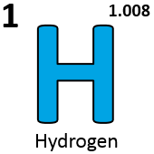
Take part in it!
Celebrate Hydrogen & Fuel Cell Day on 10/8 or October 8 (Held on its very own atomic- weight-day)
Learn more: energy.gov/eere/fuelcells
Notes:
How can you help?
Help to spread the word about anything you’ve learned or find interesting about this exciting technology during Hydrogen and Fuel Cell Day on 10/08 since the atomic weight of hydrogen is 1.008.
The first ever Hydrogen and Fuel Cell Day (held on its very own atomic-weight-day) was in 2015;
And it honors the dedication and hard work of all those involved in the development and success of hydrogen and fuel cell technologies
The day and week is peppered with hundreds of events, announcements and social media activity across the nation.
Last year, the hydrogen and fuel cell day message was viewed over social media almost half a million times. Help us hit a million this year!
In addition to public education about hydrogen and fuel cells, thousands of people are now aware that the atomic mass of the simplest and most abundant element in the universe is 1.008!

