Slide 1
AL-FARABI KAZAKH NATIONAL UNIVERSITY
Department of Recreational geography and tourism
Transportation in Tourism
Assipova Zhanna
PhD, associate professor

Slide 2
Lecture 7
Speciality Ground Transportation

Slide 3
Speciality Ground Transportation
Speciality ground transportation
Walking
hiking
trekking
backpacking
sight jogging
Animals
dog sledding
donkey taxis
horseback
RV
Automobile experiences
theme parks
GoCar
world class driving
racing adventures
off-road trekking
Cycles
Rickshaw
Segways

Slide 4
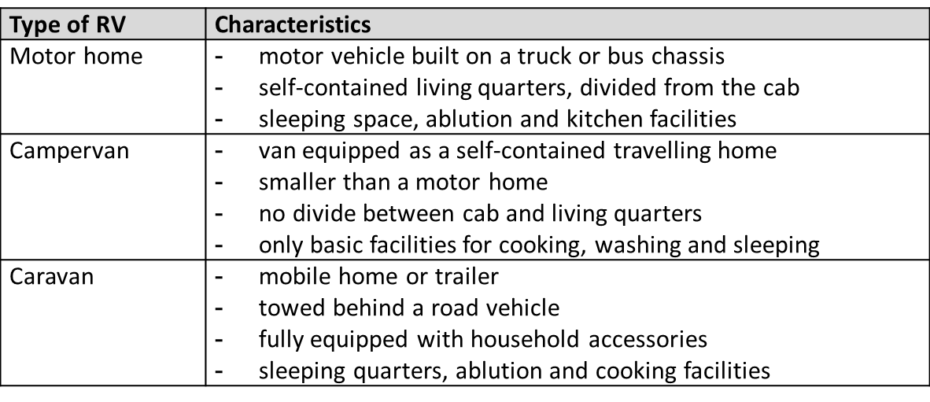
Recreational Vehicles
RV: a motorized or towable vehicle that combines transportation and temporary living quarters for travel, recreation and camping. RVs do not include mobile homes, off-road vehicles, snowmobiles or conversion vehicles (Recreation Vehicle Industry Association, 2012a).
Types of recreational vehicle

Slide 5
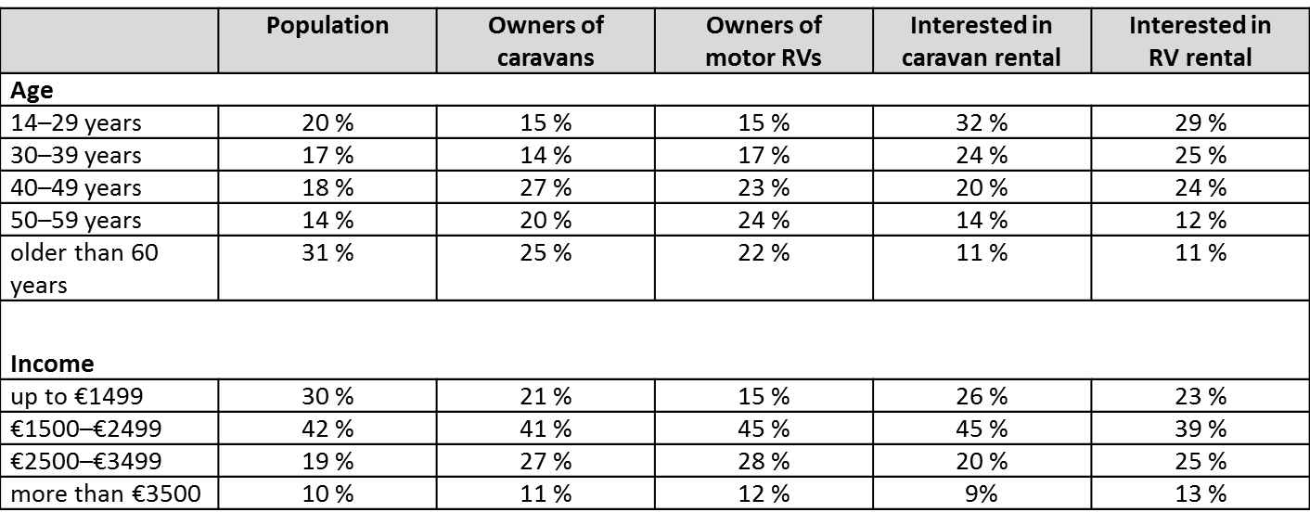
Demand
Age and income groups of RV travellers in Europe
Source: Adapted from CIVD, 2010

Slide 6
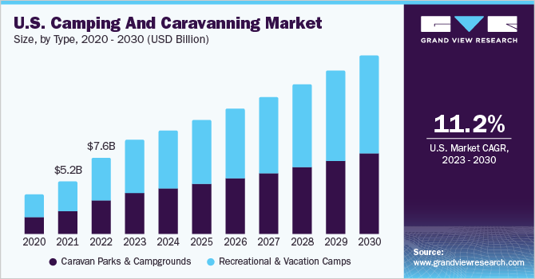

Slide 7
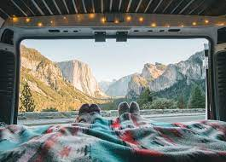
Recreational vehicle
Typical amenities of an RV include a kitchen, a bathroom, and one or more beds. RVs can range from utilitarian – containing only sleeping quarters and basic cooking facilities – to luxurious, with features like air conditioning (AC), water heaters, televisions and satellite receivers, and quartz countertops, for example

Slide 8
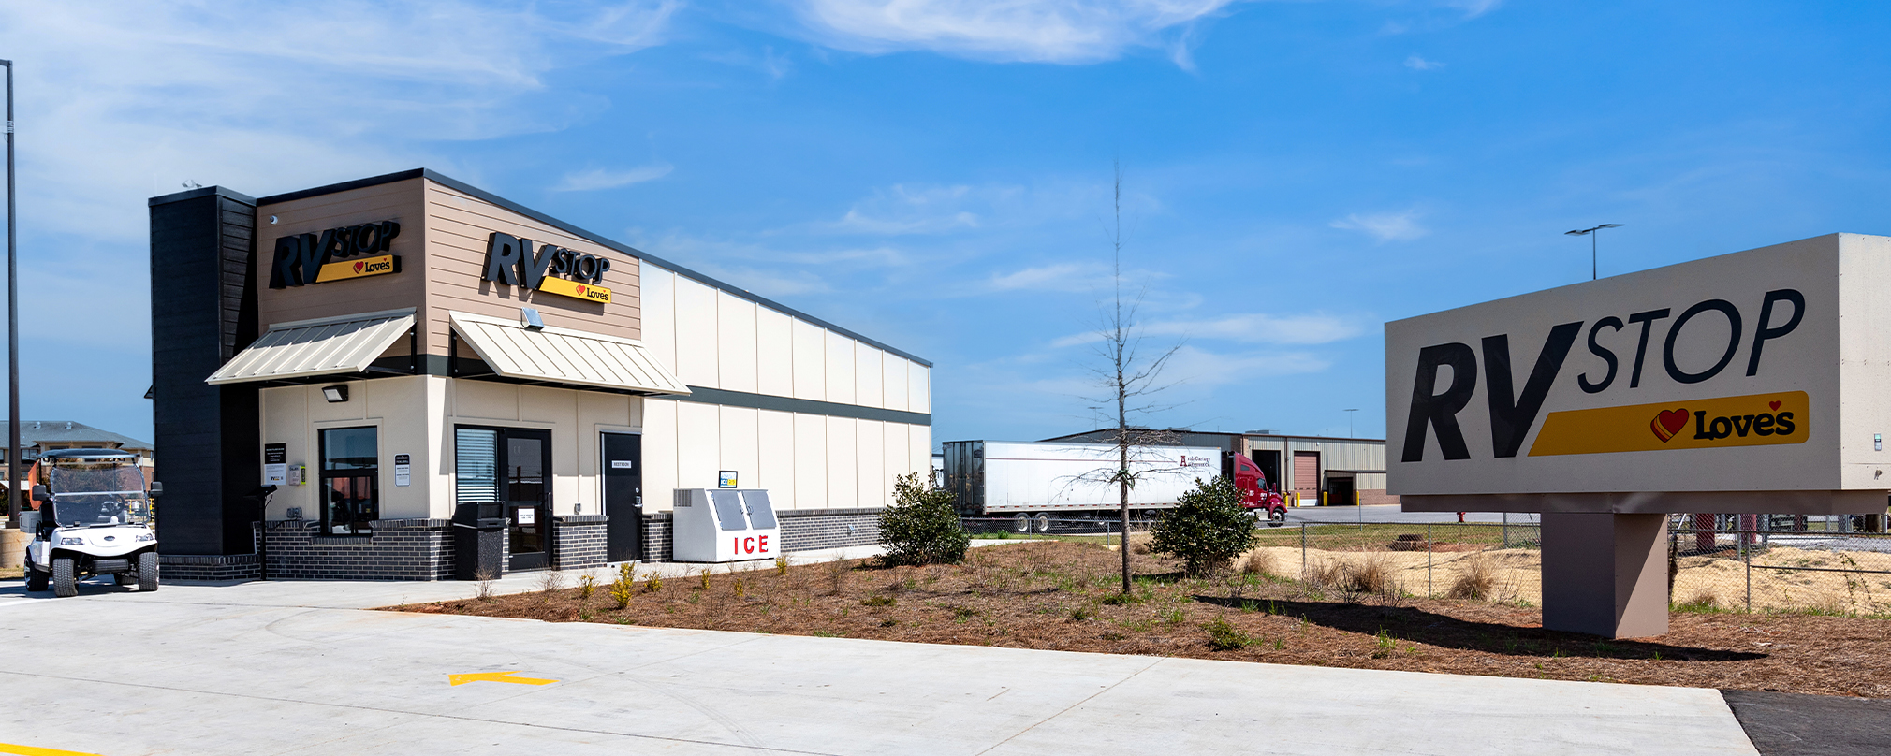
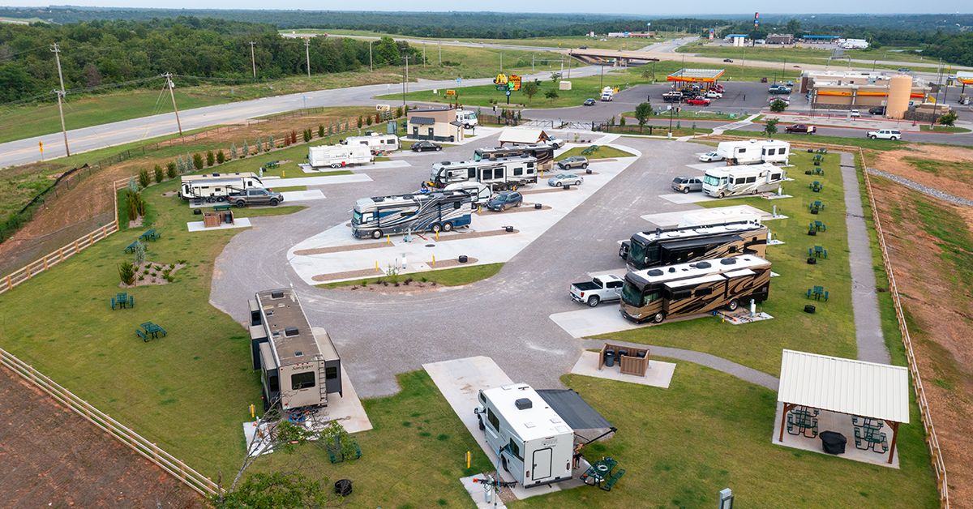
RV Stops

Slide 9
Demand
Registrations of new recreational vehicles worldwide in 2010
Source: CVID, 2011

Slide 10
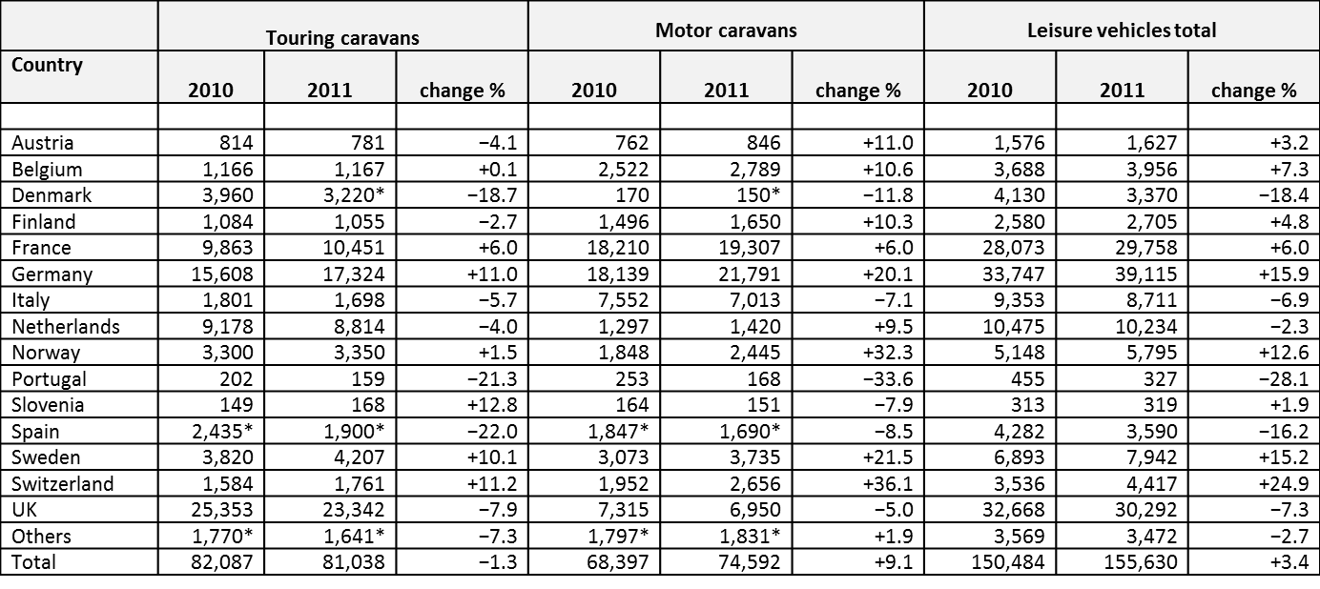
Supply
Registrations of new recreational vehicles in Europe in 2011
* Estimated
Source: European Caravan Federation

Slide 11
Thank you for your attention!

