Slide 1
Lecture 8
Memory management. Main memory

Slide 2
Introduction
Memory is central to the operation of a modern computer system. Memory consists of a large array of bytes, each with its own address. The CPU fetches instructions from memory according to the value of the program counter. These instructions may cause additional loading from and storing to specific memory addresses

Slide 3
Main memory and the registers built into each processing core are the only general-purpose storage that the CPU can access directly. There are machine instructions that take memory addresses as arguments, but none that take disk addresses. Therefore, any instructions in execution, and any data being used by the instructions, must be in one of these direct-access storage devices. If the data are not in memory, they must be moved there before the CPU can operate on them. Registers that are built into each CPU core are generally accessible within one cycle of the CPU clock.

Slide 4
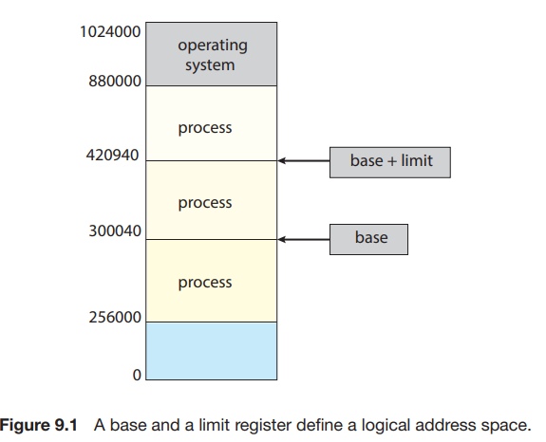
The base register holds the smallest legal physical memory address; the limit register specifies the size of the range. For example, if the base register holds 300040 and the limit register is 120900, then the program can legally access all addresses from 300040 through 420939 (inclusive).

Slide 5
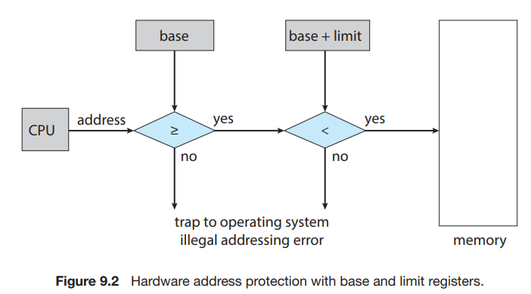
This scheme prevents a user program from (accidentally or deliberately) modifying the code or data structures of either the operating system or other users. The base and limit registers can be loaded only by the operating system, which uses a special privileged instruction. Since privileged instructions can be executed only in kernel mode, and since only the operating system executes in kernel mode, only the operating system can load the base and limit registers. This scheme allows the operating system to change the value of the registers but prevents user programs from changing the registers’ contents.

Slide 6
Most systems allow a user process to reside in any part of the physical memory. Thus, although the address space of the computer may start at 00000, the first address of the user process need not be 00000.
Classically, the binding of instructions and data to memory addresses can be done at any step along the way:
• Compile time.
Load time.
• Execution time

Slide 7
Logical vs. Physical Address Space
  Logical address – generated by the CPU; also referred to as virtual address
  Physical address – address seen by the memory unit
Logical and physical addresses are the same in compile-time and load-time address-binding schemes; logical (virtual) and physical addresses differ in execution-time address-binding scheme
Logical address space is the set of all logical addresses generated by a program
Physical address space is the set of all physical addresses generated by a program

Slide 8
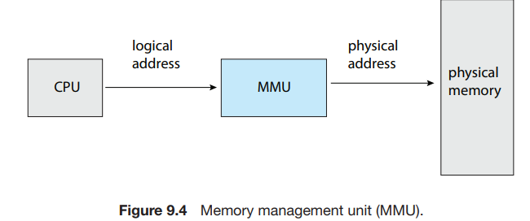
An address generated by the CPU is commonly referred to as a logical address, whereas an address seen by the memory unit— that is, the one loaded into the memory-address register of the memory—is commonly referred to as a physical address.
The run-time mapping from virtual to physical addresses is done by a hardware device called the memory-management unit (MMU) (Figure 9.4).

Slide 9
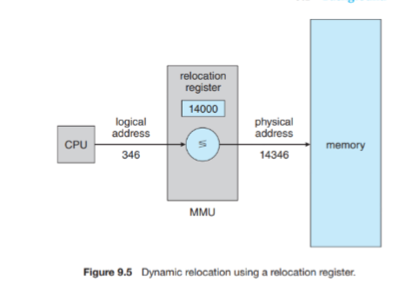
The base register is now called a relocation register. The value in the relocation register is added to every address generated by a user process at the time the address is sent to memory (see Figure 9.5). For example, if the base is at 14000, then an attempt by the user to address location 0 is dynamically relocated to location 14000; an access to location 346 is mapped to location 14346. The user program never accesses the real physical addresses. The program can create a pointer to location 346, store it in memory, manipulate it, and compare it with other addresses—all as the number 346. Only when it is used as a memory address (in an indirect load or store, perhaps) is it relocated relative to the base register. The user program deals with logical addresses. The memory mapping hardware converts logical addresses into physical addresse

Slide 10
Dynamic loading
To obtain better memory-space utilization, we can use dynamic loading. With dynamic loading, a routine is not loaded until it is called. All routines are kept on disk in a relocatable load format. The main program is loaded into memory and is executed.
The advantage of dynamic loading is that a routine is loaded only when it is needed. This method is particularly useful when large amounts of code are needed to handle infrequently occurring cases, such as error routines. In such a situation, although the total program size may be large, the portion that is used (and hence loaded) may be much smaller.

Slide 11
Dynamic Linking
Static linking – system libraries and program code combined by the loader into the binary program image
Dynamic linking –linking postponed until execution time
Small piece of code, stub, used to locate the appropriate memory-resident library routine
Stub replaces itself with the address of the routine, and executes the routine
Operating system checks if routine is in processes’ memory address
  If not in address space, add to address space
Dynamic linking is particularly useful for libraries
System also known as shared libraries
Consider applicability to patching system libraries
  Versioning may be needed

Slide 12
Swapping
A process can be swapped temporarily out of memory to a backing store, and then brought back into memory for continued execution
  Total physical memory space of processes can exceed physical memory
Backing store – fast disk large enough to accommodate copies of all memory images for all users; must provide direct access to these memory images
Roll out, roll in – swapping variant used for priority-based scheduling algorithms; lower-priority process is swapped out so higher-priority process can be loaded and executed
Major part of swap time is transfer time; total transfer time is directly proportional to the amount of memory swapped
System maintains a ready queue of ready-to-run processes which have memory images on disk

Slide 13
Swapping (Cont.)
Does the swapped out process need to swap back into same physical addresses?
Depends on address binding method
  Plus consider pending I/O to / from process memory space
Modified versions of swapping are found on many systems (i.e., UNIX, Linux, and Windows)
  Swapping normally disabled
  Started if more than threshold amount of memory allocated
  Disabled again once memory demand reduced below threshold

Slide 14
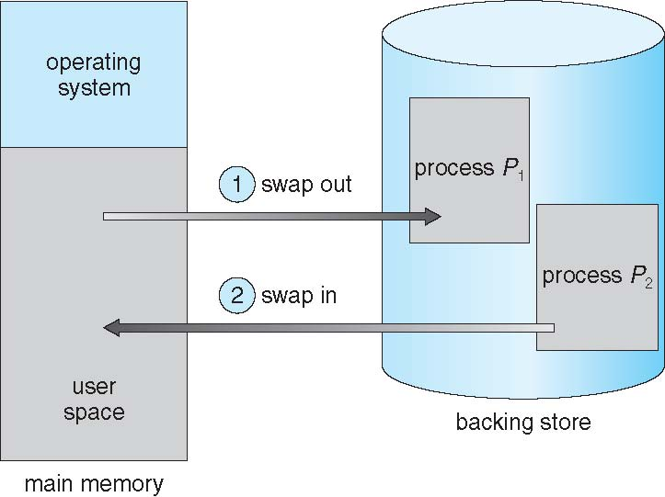
Schematic View of Swapping

Slide 15
Swapping on Mobile Systems
Not typically supported
  Flash memory based
    Small amount of space
    Limited number of write cycles
    Poor throughput between flash memory and CPU on mobile platform
Instead use other methods to free memory if low
  iOS asks apps to voluntarily relinquish allocated memory
    Read-only data thrown out and reloaded from flash if needed
    Failure to free can result in termination
  Android terminates apps if low free memory, but first writes application state to flash for fast restart
  Both OSes support paging as discussed below

Slide 16
Main memory is comprised of two partitions: – Operating system – User processes • The operating system can be at the high end or low end of memory – the location of the interrupt vector is largely responsible for where the operating system will reside.

Slide 17
Contiguous Allocation
Main memory must support both OS and user processes
Limited resource, must allocate efficiently
Contiguous allocation is one early method
Main memory usually into two partitions:
  Resident operating system, usually held in low memory with interrupt vector
  User processes then held in high memory
  Each process contained in single contiguous section of memory

Slide 18
Memory allocation
One of the simplest methods of allocating memory is to assign processes to variably sized partitions in memory, where each partition may contain exactly one process. In this variable partition scheme, the operating system keeps a table indicating which parts of memory are available and which are occupied. Initially, all memory is available for user processes and is considered one large block of available memory, a hole. Eventually, as you will see, memory contains a set of holes of various sizes.

Slide 19
When a process terminates, it releases its block of memory, which is then placed back in the set of holes. If the new hole is adjacent to other holes, these adjacent holes are merged to form one larger hole. This procedure is a particular instance of the general dynamic storage allocation problem, which concerns how to satisfy a request of size n from a list of free holes. There are many solutions to this problem. The first-fit, best-fi , and worst-fi strategies are the ones most commonly used to select a free hole from the set of available holes.

Slide 20
First fit. Allocate the first hole that is big enough. Searching can start either at the beginning of the set of holes or at the location where the previous first-fit search ended. We can stop searching as soon as we find a free hole that is large enough.
• Best fi . Allocate the smallest hole that is big enough. We must search the entire list, unless the list is ordered by size. This strategy produces the smallest leftover hole.
• Worst fit. Allocate the largest hole. Again, we must search the entire list, unless it is sorted by size. This strategy produces the largest leftover hole, which may be more useful than the smaller leftover hole from a best-fit approach

Slide 21
Memory Allocation Algorithms
Classification of Memory Allocation Methods
Memory allocation methods
Without using external memory
Using external memory
Fixed partitions
Page allocation
Dynamic partitions
Segmental distribution
Relocatable sections
Segment-page distribution

Slide 22
Fragmentation
External Fragmentation – total memory space exists to satisfy a request, but it is not contiguous
Internal Fragmentation – allocated memory may be slightly larger than requested memory; this size difference is memory internal to a partition, but not being used

Slide 23
Paging
Paging is a memory management scheme that eliminates the need for a contiguous allocation of physical memory. The process of retrieving processes in the form of pages from the secondary storage into the main memory is known as paging. The basic purpose of paging is to separate each procedure into pages.
The mapping between logical pages and physical page frames is maintained by the page table, which is used by the memory management unit to translate logical addresses into physical addresses. The page table maps each logical page number to a physical page frame number. By using a Page Table, the operating system keeps track of the mapping between logical addresses (used by programs) and physical addresses (actual locations in memory).

Slide 24
Memory isn’t always available in a single block: Programs often need more memory than what is available in a single continuous block. Paging breaks memory into smaller, fixed-size pieces, making it easier to allocate scattered free spaces.
Processes size can increase or decrease: programs don’t need to occupy continuous memory, so they can grow dynamically without the need to be moved.

Slide 25
Paging is a method used by operating systems to manage memory efficiently. In paging, the physical memory is divided into fixed-size blocks called page frames, which are the same size as the pages used by the process. The process’s logical address space is also divided into fixed-size blocks called pages, which are the same size as the page frames.
When a process requests memory, the operating system allocates one or more page frames to the process and maps the process’s logical pages to the physical page frames. When a program runs, its pages are loaded into any available frames in the physical memory.

Slide 26
The mapping from virtual to physical address is done by the Memory Management Unit (MMU) which is a hardware device and this mapping is known as the paging technique.
The Physical Address Space is conceptually divided into a number of fixed-size blocks, called frames.
The Logical Address Space is also split into fixed-size blocks, called pages.
Page Size = Frame Size

Slide 27
Paging
Physical address space of a process can be noncontiguous; process is allocated physical memory whenever the latter is available
  Avoids external fragmentation
  Avoids problem of varying sized memory chunks
Divide physical memory into fixed-sized blocks called frames
  Size is power of 2, between 512 bytes and 16 Mbytes
Divide logical memory into blocks of same size called pages
Keep track of all free frames
To run a program of size N pages, need to find N free frames and load program
Set up a page table to translate logical to physical addresses
Backing store likewise split into pages
Still have Internal fragmentation

Slide 28
The address generated by the CPU is divided into
Page number(p): Number of bits required to represent the pages in Logical Address Space or Page number
Page offset(d): Number of bits required to represent a particular word in a page or page size of Logical Address Space or word number of a page or page offset.
A Physical Address is divided into two main parts:
Frame Number(f): Number of bits required to represent the frame of Physical Address Space or Frame number frame
Frame Offset(d): Number of bits required to represent a particular word in a frame or frame size of Physical Address Space or word number of a frame or frame offset.

Slide 29
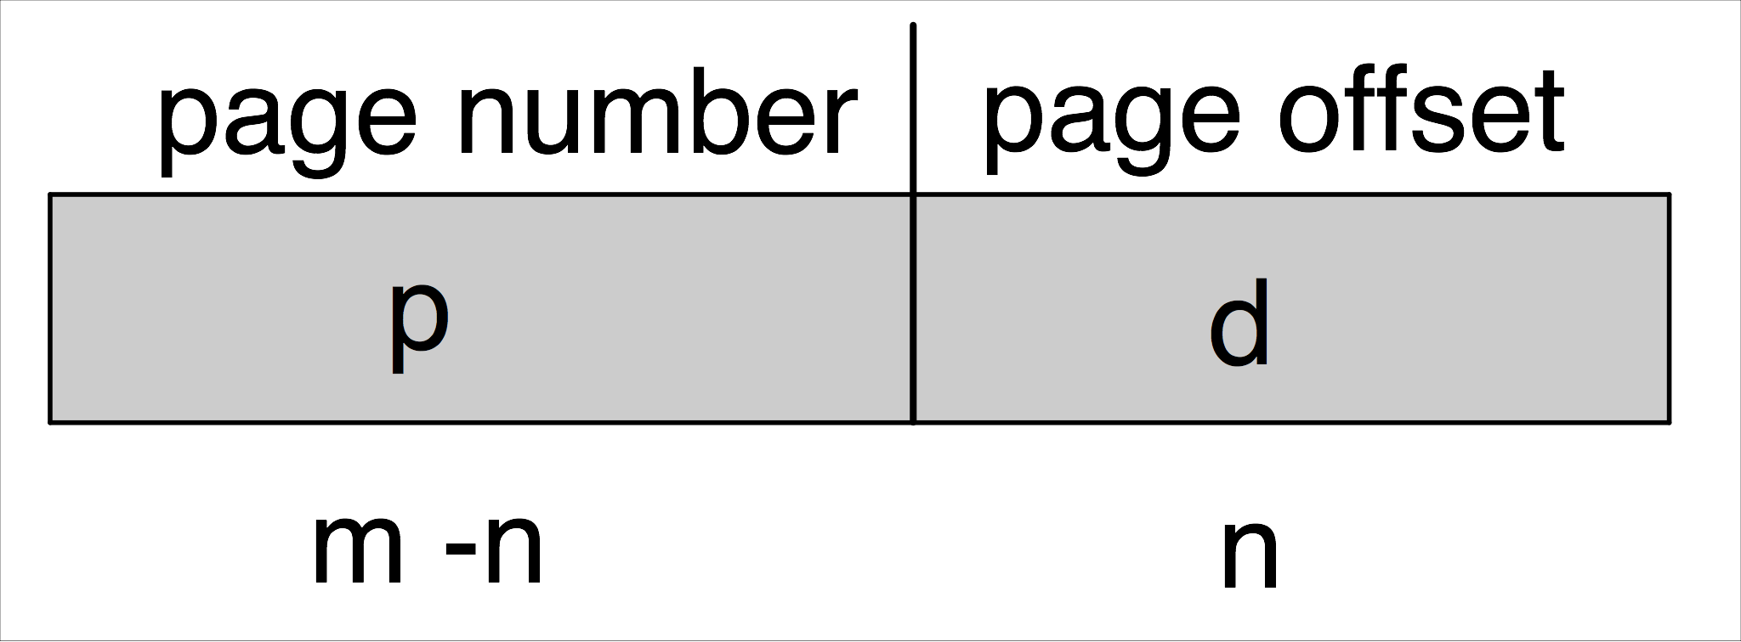
Address Translation Scheme
Address generated by CPU is divided into:
  Page number (p) – used as an index into a page table which contains base address of each page in physical memory
  Page offset (d) – combined with base address to define the physical memory address that is sent to the memory unit
  For given logical address space 2^{m} and page size 2^{n}

Slide 30
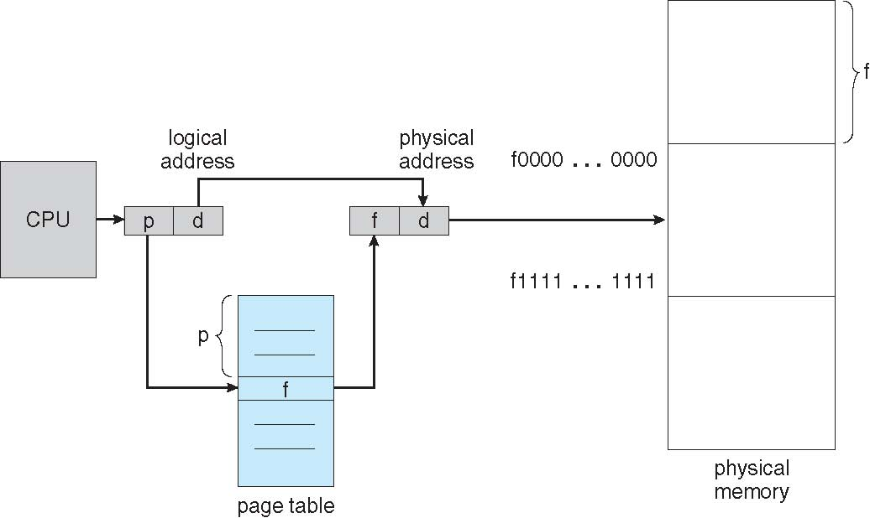
Paging Hardware

Slide 31
The following outlines the steps taken by the MMU to translate a logical address generated by the CPU to a physical address:
Extract the page number p and use it as an index into the page table.
Extract the corresponding frame number f from the page table.
3. Replace the page number p in the logical address with the frame number f. As the offset d does not change, it is not rep

Slide 32
Advantages of Paging
Eliminates External Fragmentation: Paging divides memory into fixed-size blocks (pages and frames), so processes can be loaded wherever there is free space in memory. This prevents wasted space due to fragmentation.
Efficient Memory Utilization: Since pages can be placed in non-contiguous memory locations, even small free spaces can be utilized, leading to better memory allocation.
Supports Virtual Memory: Paging enables the implementation of virtual memory, allowing processes to use more memory than physically available by swapping pages between RAM and secondary storage.
Ease of Swapping: Individual pages can be moved between physical memory and disk (swap space) without affecting the entire process, making swapping faster and more efficient.
Improved Security and Isolation: Each process works within its own set of pages, preventing one process from accessing another’s memory space.

Slide 33
Disadvantages of Paging
Internal Fragmentation: If the size of a process is not a perfect multiple of the page size, the unused space in the last page results in internal fragmentation.
Increased Overhead: Maintaining the Page Table requires additional memory and processing. For large processes, the page table can grow significantly, consuming valuable memory resources.
Page Table Lookup Time: Accessing memory requires translating logical addresses to physical addresses using the page table. This additional step increases memory access time, although Translation Lookaside Buffers (TLBs) can help reduce the impact.
I/O Overhead During Page Faults: When a required page is not in physical memory (page fault), it needs to be fetched from secondary storage, causing delays and increased I/O operations.
Complexity in Implementation: Paging requires sophisticated hardware and software support, including the Memory Management Unit (MMU) and algorithms for page replacement, which add complexity to the system.

Slide 34
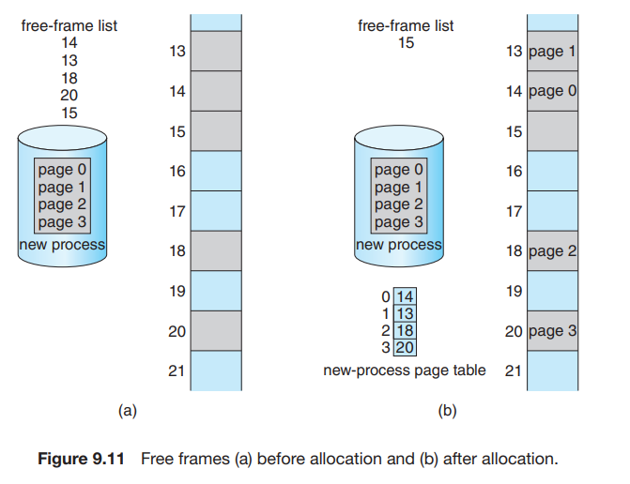
An important aspect of paging is the clear separation between the programmer’s view of memory and the actual physical memory. The programmer views memory as one single space, containing only this one program. In fact, the user program is scattered throughout physical memory, which also holds other programs. The difference between the programmer’s view of memory and the actual physical memory is reconciled by the address-translation hardware. The logical addresses are translated into physical addresses. This mapping is hidden from the programmer and is controlled by the operating system. Notice that the user process by definition is unable to access memory it does not own. It has no way of addressing memory outside of its page table, and the table includes only those pages that the process owns

Slide 35
Since the operating system is managing physical memory, it must be aware of the allocation details of physical memory—which frames are allocated, which frames are available, how many total frames there are, and so on. This information is generally kept in a single, system-wide data structure called a frame table. The frame table has one entry for each physical page frame, indicating whether the latter is free or allocated and, if it is allocated, to which page of which process (or processes).

Slide 36
Implementation of Page Table
Page table is kept in main memory
Page-table base register (PTBR) points to the page table
Page-table length register (PTLR) indicates size of the page table
In this scheme every data/instruction access requires two memory accesses
  One for the page table and one for the data / instruction
The two memory access problem can be solved by the use of a special fast-lookup hardware cache called associative memory or translation look-aside buffers (TLBs)

Slide 37
Implementation of Page Table (Cont.)
Some TLBs(translation look-aside buffers) store address-space identifiers (ASIDs) in each TLB entry – uniquely identifies each process to provide address-space protection for that process
  Otherwise need to flush at every context switch
TLBs typically small (64 to 1,024 entries)
On a TLB miss, value is loaded into the TLB for faster access next time
  Replacement policies must be considered
  Some entries can be wired down for permanent fast access

Slide 38
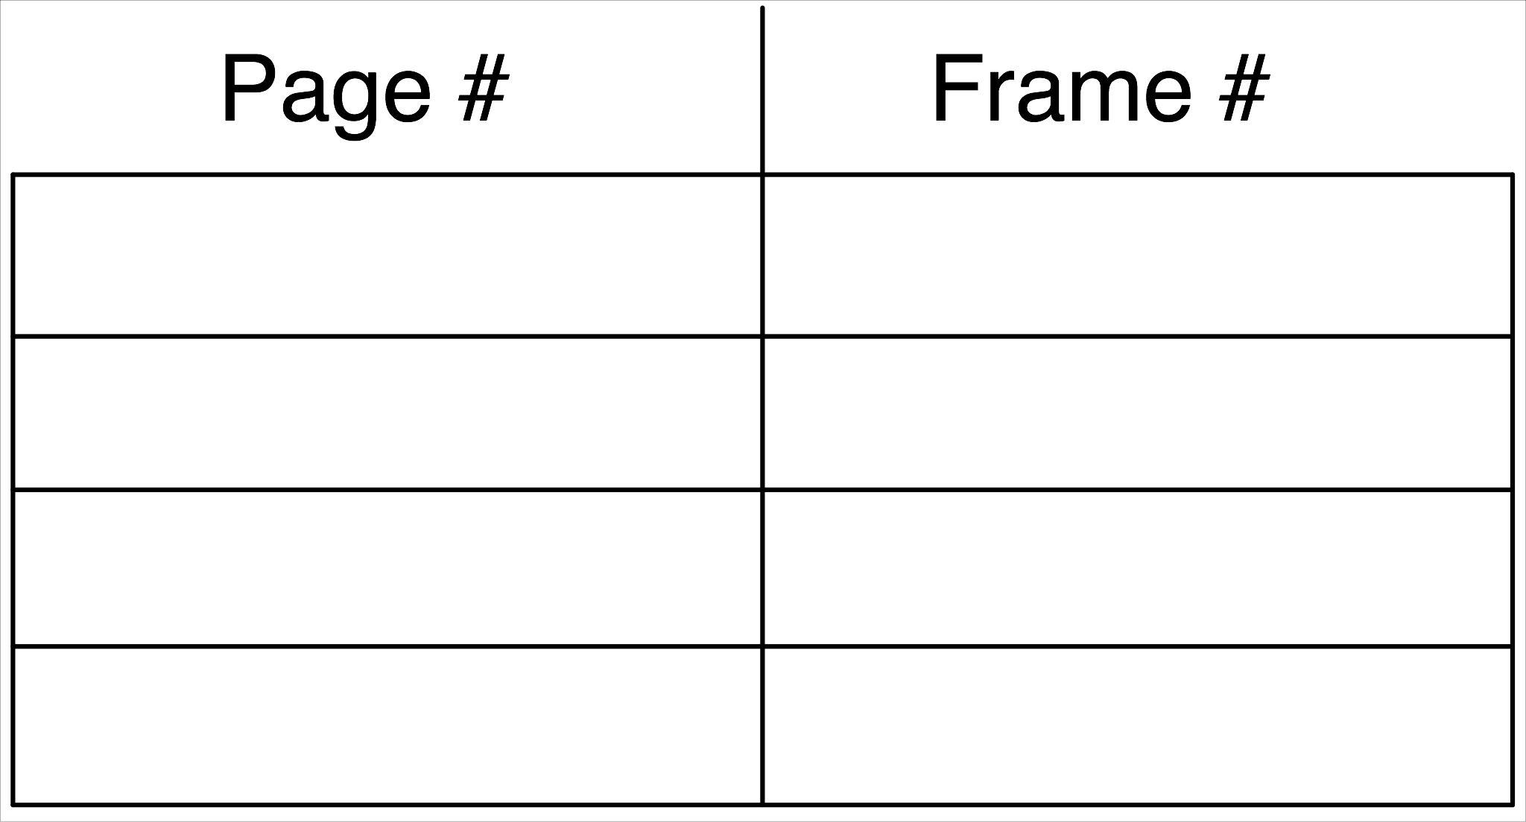
Associative Memory
Associative memory – parallel search
Address translation (p, d)
  If p is in associative register, get frame # out
  Otherwise get frame # from page table in memory

Slide 39
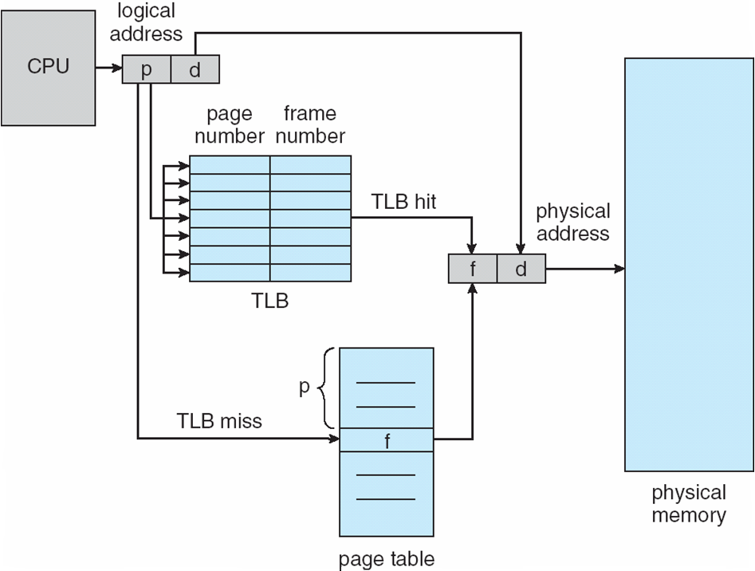
Paging Hardware With TLB

Slide 40
There are two more schemes for organizing memory management: segmented and segment-page. Segments, unlike pages, can have a variable size. In a segmented organization, the virtual address is two-dimensional and consists of two fields - the segment number and the address within the segment.
With a segmented-page memory organization, a two-level translation of the virtual address into the physical address is carried out. In this case, the logical address consists of three fields: the segment number of the logical memory, the page number within the segment, and the address on the page.

Slide 41
Protection
Memory protection in a paged environment is accomplished by protection bits associated with each frame. Normally, these bits are kept in the page table.
One additional bit is generally attached to each entry in the page table: a valid–invalid bit. When this bit is set to valid, the associated page is in the process’s logical address space and is thus a legal (or valid) page. When the bit is set to invalid, the page is not in the process’s logical address space. Illegal addresses are trapped by use of the valid –invalid bit. The operating system sets this bit for each page to allow or disallow access to the page

Slide 42
Memory Protection
Memory protection implemented by associating protection bit with each frame to indicate if read-only or read-write access is allowed
  Can also add more bits to indicate page execute-only, and so on
Valid-invalid bit attached to each entry in the page table:
  “valid” indicates that the associated page is in the process’ logical address space, and is thus a legal page
  “invalid” indicates that the page is not in the process’ logical address space
  Or use page-table length register (PTLR)
Any violations result in a trap to the kernel

Slide 43
Structure of the Page Table
Memory structures for paging can get huge using straight-forward methods
  Consider a 32-bit logical address space as on modern computers
  Page size of 4 KB (2¹²)
  Page table would have 1 million entries (2³² / 2¹²)
  If each entry is 4 bytes -> 4 MB of physical address space / memory for page table alone
    That amount of memory used to cost a lot
    Don’t want to allocate that contiguously in main memory
Hierarchical Paging
Hashed Page Tables
Inverted Page Tables

Slide 44
Hierarchical Page Tables
Break up the logical address space into multiple page tables
A simple technique is a two-level page table
We then page the page table

Slide 45
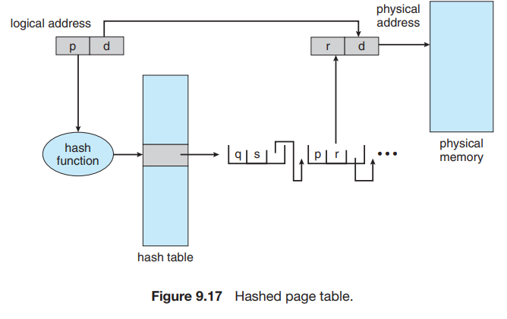
Hashed Page Tables
Each element consists of three fields: (1) the virtual page number, (2) the value of the mapped page frame, and (3) a pointer to the next element in the linked list. The algorithm works as follows: The virtual page number in the virtual address is hashed into the hash table. The virtual page number is compared with field 1 in the first element in the linked list. If there is a match, the corresponding page frame (field 2) is used to form the desired physical address. If there is no match, subsequent entries in the linked list are searched for a matching virtual page number. This scheme is shown in Figure 9.17

Slide 46
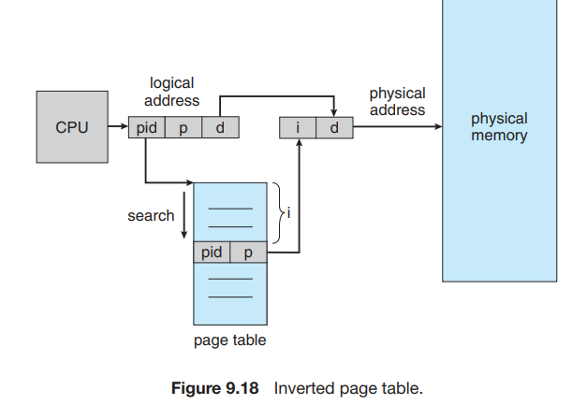
Inverted Page Tables
An inverted page table has one entry for each real page (or frame) of memory. Each entry consists of the virtual address of the page stored in that real memory location, with information about the process that owns the page. Thus, only one page table is in the system, and it has only one entry for each page of physical memory. Figure 9.18 shows the operation of an inverted page table

