Slide 1
Lecture 5
CPU scheduling

Slide 2
CPU scheduling is the basis of multi programmed operating systems. By switching the CPU among processes, the operating system can make the computer more productive.
Notes:
In this chapter, we introduce basic CPU-scheduling concepts and present several CPU-scheduling algorithms, including real-time systems. We also consider the problem of selecting an algorithm for a particular system. In Chapter 4, we introduced threads to the process model. On modern operating systems it is kernel-level threads—not processes— that are in fact being scheduled by the operating system. However, the terms "process scheduling" and "thread scheduling" are often used interchangeably. In this chapter, we use process scheduling when discussing general scheduling concepts and thread scheduling to refer to thread-specific ideas.

Slide 3
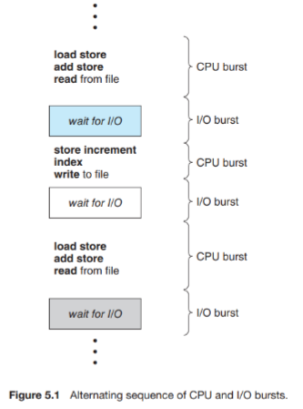
The success of CPU scheduling depends on an observed property of processes: process execution consists of a cycle of CPU execution and I/O wait. Processes alternate between these two states. Process execution begins with a CPU burst. That is followed by an I/O burst, which is followed by another CPU burst, then another I/O burst, and so on. Eventually, the final CPU burst ends with a system request to terminate execution (Figure 5.1).
Notes:
Scheduling of this kind is a fundamental operating-system function. Almost all computer resources are scheduled before use. The CPU is, of course, one of the primary computer resources. Thus, its scheduling is central to operating-system design.

Slide 4
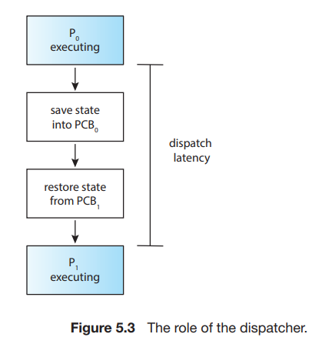
Dispatcher
Another component involved in the CPU-scheduling function is the dispatcher. The dispatcher is the module that gives control of the CPU’s core to the process selected by the CPU scheduler. This function involves the following:
• Switching context from one process to another
• Switching to user mode
• Jumping to the proper location in the user program to resume that program
The dispatcher should be as fast as possible, since it is invoked during every context switch. The time it takes for the dispatcher to stop one process and start another running is known as the dispatch latency and is illustrated in Figure 5.3.

Slide 5
Scheduling Criteria
Different CPU-scheduling algorithms have different properties, and the choice of a particular algorithm may favor one class of processes over another. In choosing which algorithm to use in a particular situation, we must consider the properties of the various algorithms. Many criteria have been suggested for comparing CPU-scheduling algorithms. Which characteristics are used for comparison can make a substantial difference in which algorithm is judged to be best.
The criteria include the following:
• CPU utilization. We want to keep the CPU as busy as possible. Conceptually, CPU utilization can range from 0 to 100 percent. In a real system, it should range from 40 percent (for a lightly loaded system) to 90 percent (for a heavily loaded system). (CPU utilization can be obtained by using the top command on Linux, macOS, and UNIX systems.)
• Throughput. If the CPU is busy executing processes, then work is being done. One measure of work is the number of processes that are completed per time unit, called throughput. For long processes, this rate may be one process over several seconds; for short transactions, it may be tens of processes per second.

Slide 6
Turnaround time. From the point of view of a particular process, the important criterion is how long it takes to execute that process. The interval from the time of submission of a process to the time of completion is the turnaround time. Turnaround time is the sum of the periods spent waiting in the ready queue, executing on the CPU, and doing I/O.
• Waiting time. The CPU-scheduling algorithm does not affect the amount of time during which a process executes or does I/O. It affects only the amount of time that a process spends waiting in the ready queue. Waiting time is the sum of the periods spent waiting in the ready queue.
• Response time. In an interactive system, turnaround time may not be the best criterion. Often, a process can produce some output fairly early and can continue computing new results while previous results are being output to the user. Thus, another measure is the time from the submission of a request until the first response is produced. This measure, called response time, is the time it takes to start responding, not the time it takes to output the response.
Notes:
It is desirable to maximize CPU utilization and throughput and to minimize turnaround time, waiting time, and response time. In most cases, we optimize the average measure. However, under some circumstances, we prefer to optimize the minimum or maximum values rather than the average. For example, to guarantee that all users get good service, we may want to minimize the maximum response time.

Slide 7
First-Come, First-Served Scheduling
By far the simplest CPU-scheduling algorithm is the first-come first-serve (FCFS) scheduling algorithm. With this scheme, the process that requests the CPU first is allocated the CPU first. The implementation of the FCFS policy is easily managed with a FIFO queue. When a process enters the ready queue, its PCB is linked onto the tail of the queue. When the CPU is free, it is allocated to the process at the head of the queue. The running process is then removed from the queue. The code for FCFS scheduling is simple to write and understand.

Slide 8
Shortest-Job-First Scheduling
A different approach to CPU scheduling is the shortest-job-firs (SJF) scheduling algorithm. This algorithm associates with each process the length of the process’s next CPU burst. When the CPU is available, it is assigned to the process that has the smallest next CPU burst. If the next CPU bursts of two processes are the same, FCFS scheduling is used to break the tie. Note that a more appropriate term for this scheduling method would be the shortest-next-CPU-burst algorithm, because scheduling depends on the length of the next CPU burst of a process, rather than its total length. We use the term SJF because most people and textbooks use this term to refer to this type of scheduling.

Slide 9
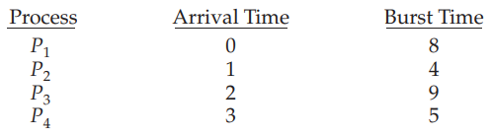
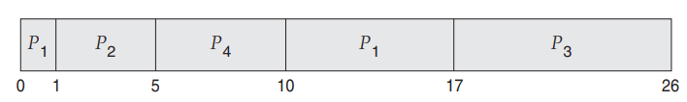
As an example, consider the following four processes, with the length of the CPU burst given in milliseconds:
If the processes arrive at the ready queue at the times shown and need the indicated burst times, then the resulting preemptive SJF schedule is as depicted in the following Gantt chart:
Process P1 is started at time 0, since it is the only process in the queue. Process P2 arrives at time 1. The remaining time for process P1 (7 milliseconds) is larger than the time required by process P2 (4 milliseconds), so process P1 is preempted, and process P2 is scheduled. The average waiting time for this example is [(10 − 1) + (1 − 1) + (17 − 2) + (5 − 3)]/4 = 26/4 = 6.5 milliseconds. Non preemptive SJF scheduling would result in an average waiting time of 7.75 milliseconds.

Slide 10
Round-Robin Scheduling
The round-robin (RR) scheduling algorithm is similar to FCFS scheduling, but preemption is added to enable the system to switch between processes. A small unit of time, called a time quantum or time slice, is defined. A time quantum is generally from 10 to 100 milliseconds in length. The ready queue is treated as a circular queue. The CPU scheduler goes around the ready queue, allocating the CPU to each process for a time interval of up to 1 time quantum. To implement RR scheduling, we again treat the ready queue as a FIFO queue of processes. New processes are added to the tail of the ready queue. The CPU scheduler picks the first process from the ready queue, sets a timer to interrupt after 1 time quantum, and dispatches the process
Notes:
One of two things will then happen. The process may have a CPU burst of less than 1 time quantum. In this case, the process itself will release the CPU voluntarily. The scheduler will then proceed to the next process in the ready queue. If the CPU burst of the currently running process is longer than 1 time quantum, the timer will go off and will cause an interrupt to the operating system. A context switch will be executed, and the process will be put at the tail of the ready queue. The CPU scheduler will then select the next process in the ready queue.

Slide 11
Priority Scheduling
The SJF algorithm is a special case of the general priority-scheduling algorithm. A priority is associated with each process, and the CPU is allocated to the process with the highest priority. Equal-priority processes are scheduled in FCFS order. An SJF algorithm is simply a priority algorithm where the priority (p) is the inverse of the (predicted) next CPU burst. The larger the CPU burst, the lower the priority, and vice versa. Note that we discuss scheduling in terms of high priority and low priority. Priorities are generally indicated by some fixed range of numbers, such as 0 to 7 or 0 to 4,095. However, there is no general agreement on whether 0 is the highest or lowest priority. Some systems use low numbers to represent low priority; others use low numbers for high priority. This difference can lead to confusion. In this text, we assume that low numbers represent high priority.

Slide 12
Multilevel Queue Scheduling
With both priority and round-robin scheduling, all processes may be placed in a single queue, and the scheduler then selects the process with the highest priority to run. Depending on how the queues are managed, an O(n) search may be necessary to determine the highest-priority process. In practice, it is often easier to have separate queues for each distinct priority, and priority scheduling simply schedules the process in the highest-priority queue. This is illustrated in Figure 5.7. This approach—known as multilevel queue— also works well when priority scheduling is combined with round-robin: if there are multiple processes in the highest-priority queue, they are executed in round-robin order. In the most generalized form of this approach, a priority is assigned statically to each process, and a process remains in the same queue for the duration of its runtime.

Slide 13
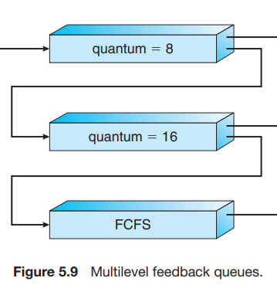
For example, consider a multilevel feedback queue scheduler with three queues, numbered from 0 to 2 (Figure 5.9). The scheduler first executes all processes in queue 0. Only when queue 0 is empty will it execute processes in queue 1. Similarly, processes in queue 2 will be executed only if queues 0 and 1 are empty. A process that arrives for queue 1 will preempt a process in queue 2. A process in queue 1 will in turn be preempted by a process arriving for queue 0. An entering process is put in queue 0. A process in queue 0 is given a time quantum of 8 milliseconds. If it does not finish within this time, it is moved to the tail of queue 1. If queue 0 is empty, the process at the head of queue 1 is given a quantum of 16 milliseconds. If it does not complete, it is preempted and is put into queue 2. Processes in queue 2 are run on an FCFS basis but are run only when queues 0 and 1 are empty. To prevent starvation, a process that waits too long in a lower-priority queue may gradually be moved to a higher-priority queue.

