Slide 1

AL-FARABI KAZAKH NATIONAL UNIVERSITY
Department of Recreational geography and tourism
Transportation in Tourism
Assipova Zhanna
PhD, associate professor

Slide 2
Lecture 4
Automobiles

Slide 3
Automobiles
passenger car: road motor vehicle for the carriage of passengers and comprising not more than eight seats in addition to the driver’s seat
(Glossary of Transport Statistics, 2009)
taxi: licensed passenger car for hire with driver without predetermined routes (Glossary of Transport Statistics, 2009)
rental car: a car available for hire from a company that rents automobiles, vans and trucks for short time periods for a fee. The rental period generally ranges from a few hours to a few weeks (Martinez, 2008)
forms of passenger car usage:
    car sharing
    car pooling
    car leasing

Slide 4
Institutional Framework
Europe: Unfair Commercial Practices Directive 2005/29/EC
    for rental car operations
    main characteristics of the product
    price inclusive of taxes
    arrangements for payment, delivery, performance and the complaint handling policy
USA: laws within respective states
    price disclosure
    taxes
    liability
    GPS monitoring
  Canada and Mexico: no governmental regulation

Slide 5
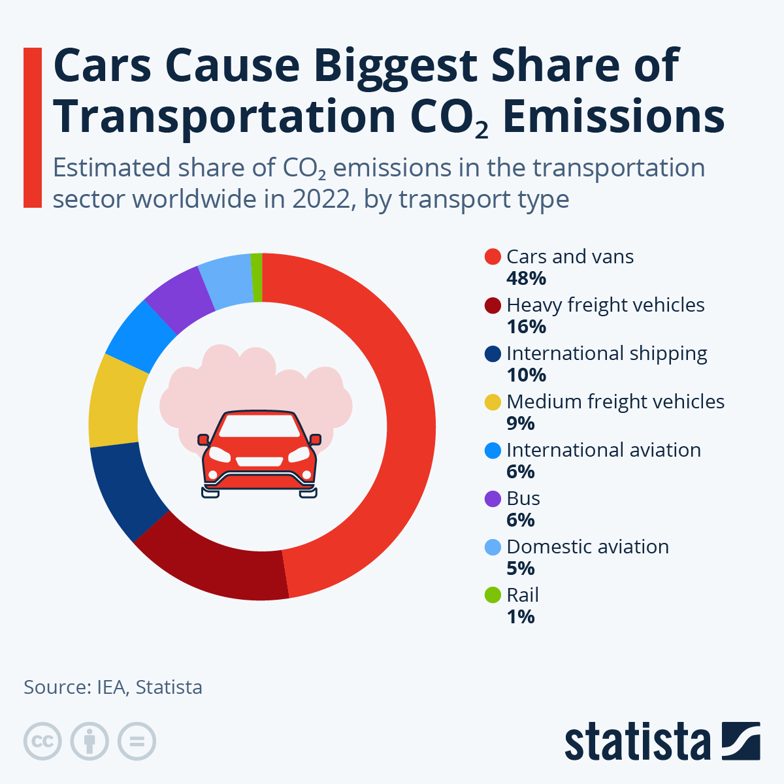

Slide 6
Demand
Passenger Transport by Private Cars
Source: OECD, 2011

Slide 7
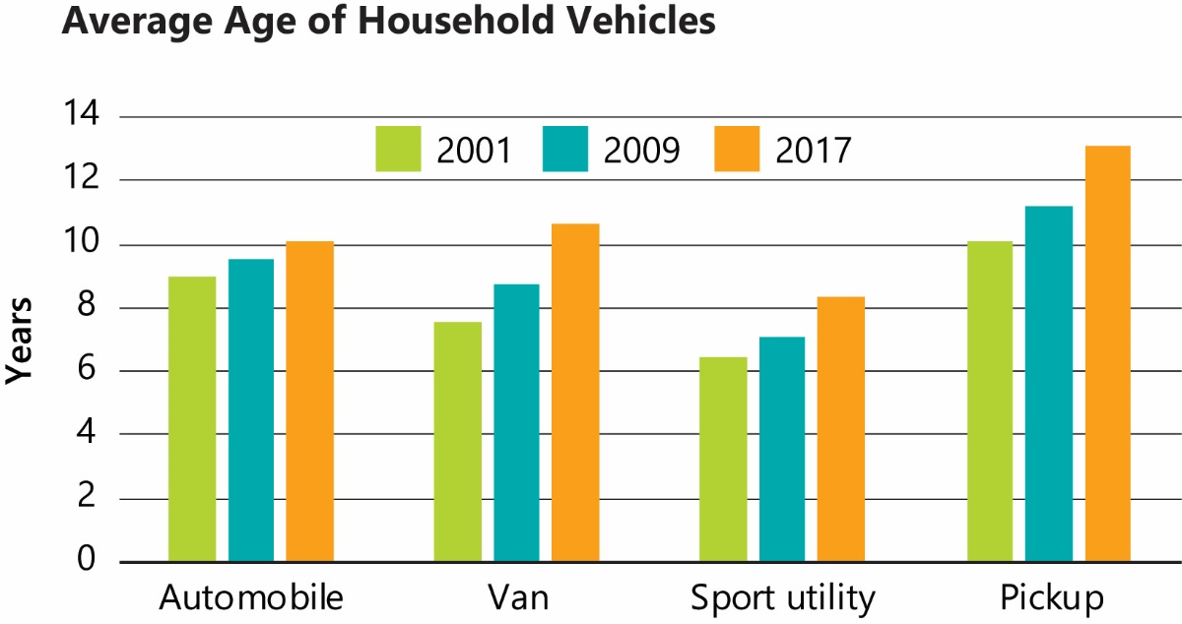

Slide 8
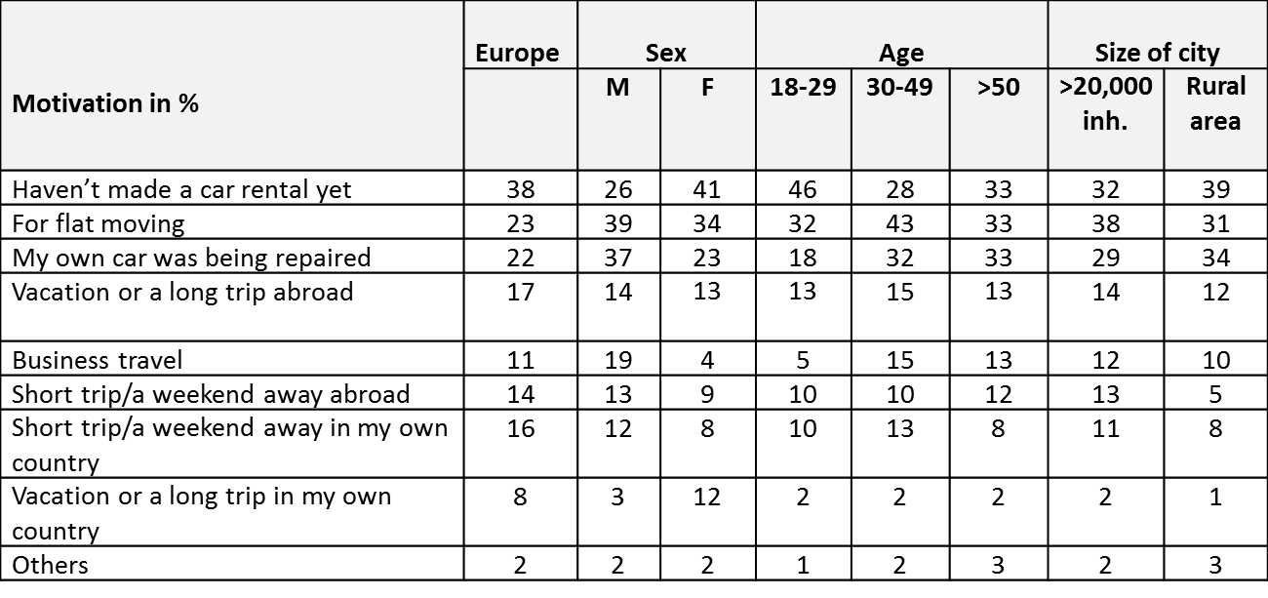
Demand
Motivations for Car Rental in Europe
Source: Adapted from Europcar Autovermietung GmbH, 2008a

Slide 9
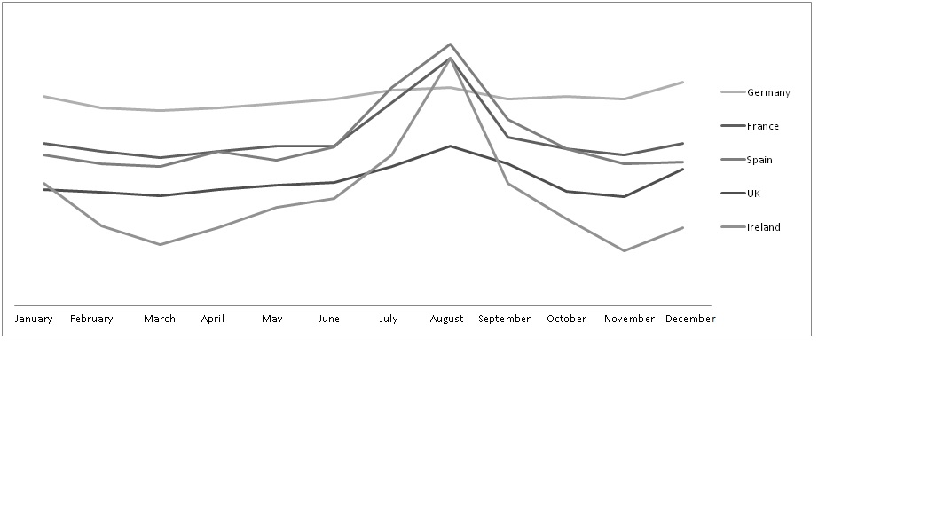
Demand
Seasonal Spread of Car Rental Demand in Europe
Source: Hertz for Car Rental Council of Ireland, 2010

Slide 10
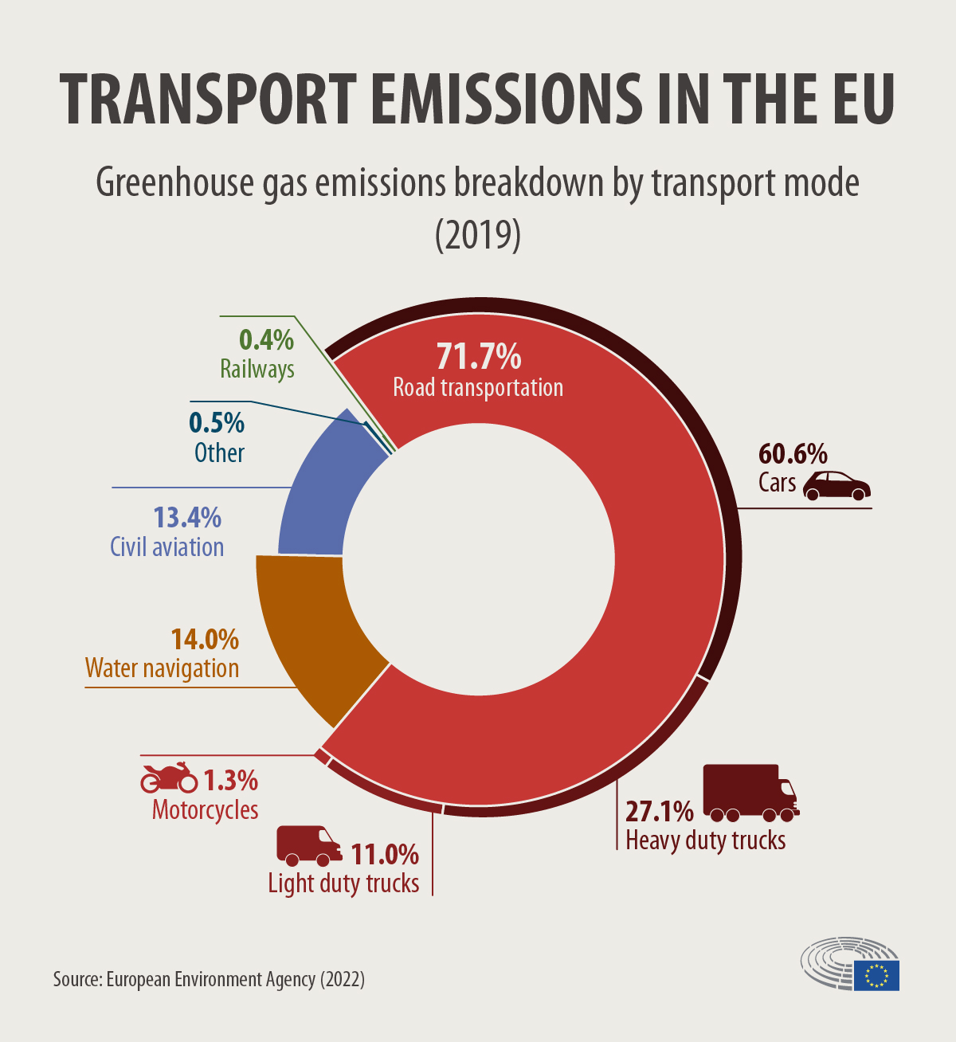

Slide 11
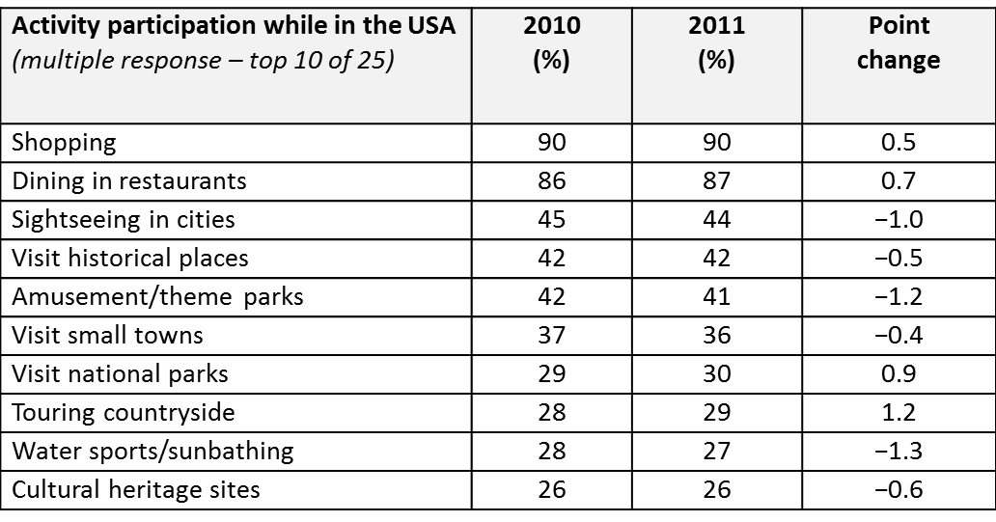
Demand
Activity participation of car renters while in the USA
Source: Office of Travel and Tourism Industries, 2012a

Slide 12
Supply
European Market Shares of Rental Car Companies
Source: Statista, 2012

Slide 13
Supply
US Market Shares of Rental Car Companies
Source: Adapted from Reuters, 2012

Slide 14
Thank you for your attention!

