Slide 1
al-Farabi KazNU LANGUAGE RESOURCES Module. Introduction to Language Resources Lecture 2. Basic principles for LR infrastructure
2021

Slide 2
Types of language resources
1) Text corpus - a selection of texts of a certain genre, the subject of which corresponds to the given software. The corpus can contain linguistic markup, which is information obtained automatically during text analysis or manually assigned by an expert. The main purpose of the corpus is to automate the creation of other linguistic resources.
2) Universal and subject dictionaries containing a list of minimal language units, terms and stable terminological phrases used in the description of information relevant to IP, as well as genre vocabulary described by lexical templates for extracting vocabulary presented in a non-standard text. Within the framework of dictionaries, a set of universal and / or specific linguistic knowledge for a given sublanguage is determined: morphological classes, rules for the formation of verbose terms, etc.
3) A set of descriptions of genre structures of the text in conjunction with the logical presentation of the text form the models of documents correlated with one or another type of text resources stored in the IS.

Slide 3
Types of language resources
4) The semantic dictionary, which forms semantic features and relationships in the lexicon, includes target thesauri (for example, reference and information thesaurus, thesauri for text analysis, to support information retrieval, for translation, etc.), as well as a dictionary of management models, which limits syntactic compatibility and checks the consistency of grammatical and semantic features of terms (vertices of syntactic groups) in accordance with the rules of coordination and control
5) Knowledge about the alignment of existing linguistic knowledge with subject knowledge specified by the ontology of IP. For this purpose, terms are grouped into semantic groups, which, in turn, are also consistent with the elements of the ontology either directly or in accordance with a certain schema (schema of fact).
6) The results of semantic indexing of all texts are placed in the document storage and form a single information network of objects. The repository must support the ability to find and identify objects, and adhere to a specific strategy for resolving inconsistencies.

Slide 4
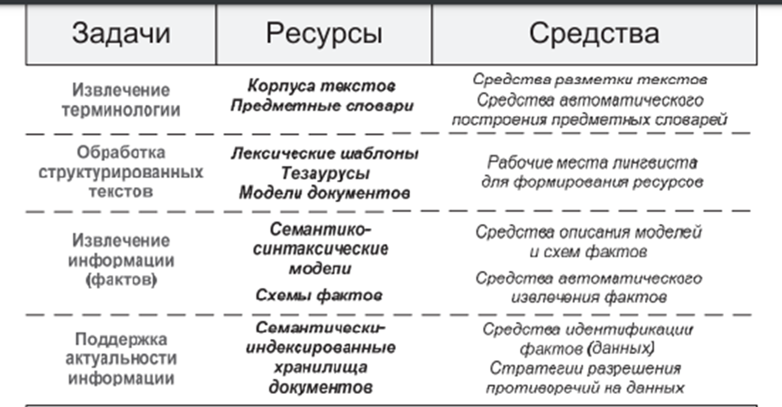
Linguistic needs

Slide 5
References:
Wang Liancen. Linguo-methodical design of educational terminological databases (for foreign students of pedagogical specialties): diss. Cand. ped. n. / Lianzen Wang. M .: Moscow State University. M.V. Lomonosov. 2014.196 p.
https://bstudy.net/620524/ekonomika/ponyatie_komponenty_infrastruktury_predpriyatiya
https://cyberleninka.ru/article/n/razrabotka-lingvisticheskogo-obespecheniya-informatsionnyh-sistem-na-osnove-ontologicheskih-modeley-znaniy
https://ru.wikipedia.org
http://dlib.rsl.ru

Slide 6
Questions?
...

Slide 7
conclusion

