Slide 1
Lecture 12
Input/output systems. Synchronous and asynchronous I/O

Slide 2
Introduction
I/O devices (AKA I/O peripherals) provide means to exchange information between a computer and external environments.
Input devices accept incoming data and convert it into binary data that is understandable to a digital computer
Notes:
.

Slide 3
Based on their interaction with their surrounding environment, I/O device categories are as follows:
Human readable devices
  These devices communicate with the computer user.
  Examples include the display monitor, printer, keyboard, and mouse.
Machine-readable devices
  These devices communicate with special-purpose electronic equipment
  Examples include hard disks, DVDs, USB sticks, sensor devices
Communication devices
These devices communicate with other intelligent devices
  Examples include network cards and modems

Slide 4
Organization of the I/O functions
CPU and I/O devices need to communicate to be able to execute I/O commands, control I/O operations, and transfer I/O data. I/O devices differ concerning their methods of event trigger and data transfer. Event trigger involves allowing the CPU to detect the data arrival at the I/O device. Data transfer is moving data to/from the I/O device to the main memory. A computer CPU can detect the arrival of new data on the I/O device using one of the following methods: polling and interrupts.

Slide 5
Polling I/O: In this method, the process of periodically checking the status of the device by reading a status register that is accessible and that can be updated by the I/O devices when it receives new data. Examples: keyboard and mouse PS/2 ports.
Interrupts I/O: in this method, an interrupt is signaled to the microprocessor from a device that requests CPU attention. Examples: disk driver and network interface card

Slide 6
The communication between the computer CPU and I/O device can take place through one of the following methods.
Special Instruction I/O: this method uses program instructions to allow data transfer to/from the I/O devices.
Memory-mapped I/O: In this method, some memory buffer is shared with the I/O devices and data transfer takes place by asynchronously reading or writing from/to this memory buffer. I/O devices interrupt the CPU when I/O operation is completed.
Direct memory access (DMA) I/O: Direct memory access (DMA) method uses a hardware device to avoid or reduce the overhead caused by memory-mapped I/O device interrupts. In the DMA method, the computer CPU grants I/O module the authority to read/write memory data without involvement.

Slide 7
The functionality of I/O devices is provided at three levels: user, kernel, and hardware.
User Level: an interface to allow users and users programs to perform input and output. For example, a printing interface (or print window) through document writing software.
Kernel Level: a device driver at the kernel level that can interact with the device controller at the hardware level.
Hardware: the actual hardware and hardware controller that allow the hardware to interact with the environment.

Slide 8
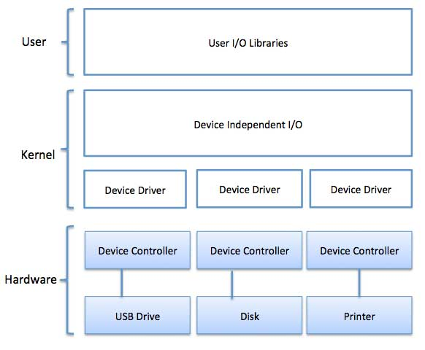

Slide 9
Device drivers are software modules that can be plugged into an OS to handle a particular device. Operating System takes help from device drivers to handle all I/O devices. Device drivers encapsulate device-dependent code and implement a standard interface in such a way that code contains device-specific register reads/writes. Device driver, is generally written by the device's manufacturer and delivered along with the device on a CD-ROM.

Slide 10
A device driver performs the following jobs −
To accept request from the device independent software above to it.
Interact with the device controller to take and give I/O and perform required error handling
Making sure that the request is executed successfully

Slide 11
I/O device driver encapsulates device-dependent code in a standard interface to the operating system kernel to help interact with the device controller and handle its functionality. Examples of the I/O device services include the following.
Scheduling: managing I/O device requests.
Buffering: maintaining shared memory areas with the I/O devices.
Caching: maintaining a region of fast memory (cache) that holds copies of device data.
Spooling: maintaining an output buffer for a device.
Error Handling: handlers for device errors.

Slide 12
I/O Buffering techniques
I/O device buffering allows asynchronous data transfer between the I/O device and computer memory. Without a buffer, the operating must directly access the device when it needs and consequently the running process must be suspended during input and output operations. To support I/O buffering, the operating system provides the following techniques.

Slide 13
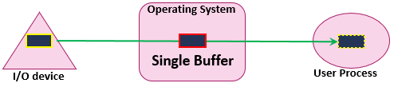
Single Buffer
A single buffer is enough storage for a single block, line, or character based on the device type.
Data transfer is performed as block-at-a-time , line-at-a-time, byte-at-a-time style.
I/O receives data and puts the first data block (or line or byte) in the system buffer. Then the process associated with the I/O operation transfers the buffer to its userspace and then requests another block.
Two blocks can be transferred simultaneously, when a data block is processed by the process, the next block is being read in.
To copy the data from the single buffer to user space, the operating system swaps the processes.
For input operations, the user process is suspended or blocked during input, waiting for the CPU to transfer the entire buffer to userspace.
For output operations, the user process can place a data block in the buffer and continue processing. It is only suspended if it has another block to send after the buffer is emptied.

Slide 14
Two system buffers are assigned to the I/O operations.
The operating system can swap between the two buffers: i.e., a process can transfer data to/from one buffer while the other buffer is being emptied or filled by the CPU.
In this case, there is no suspension during input or output operations.
A process may be suspended only if the buffer is full while it still needs to send more data blocks.

Slide 15
A collection of buffers is provided to the I/O operations
Access to the set of buffer follows a circular structure that uses the producer and consumer mechanism
The chance of process suspension is very minor.

Slide 16
Interrupt handlers
An interrupt handler, also known as an interrupt service routine or ISR, is a piece of software or more specifically a callback function in an operating system or more specifically in a device driver, whose execution is triggered by the reception of an interrupt.
The interrupt mechanism accepts an address ─ a number that selects a specific interrupt handling routine/function from a small set. In most architectures, this address is an offset stored in a table called the interrupt vector table. This vector contains the memory addresses of specialized interrupt handlers.

Slide 17
Device-Independent I/O Software
The basic function of the device-independent software is to perform the I/O functions that are common to all devices and to provide a uniform interface to the user-level software.
Uniform interfacing for device drivers
Device naming - Mnemonic names mapped to Major and Minor device numbers
Device protection
Providing a device-independent block size
Buffering because data coming off a device cannot be stored in final destination.
Storage allocation on block devices
Allocation and releasing dedicated devices
Error Reporting

Slide 18
User-Space I/O Software
These are the libraries which provide richer and simplified interface to access the functionality of the kernel or ultimately interactive with the device drivers. Most of the user-level I/O software consists of library procedures with some exception like spooling system which is a way of dealing with dedicated I/O devices in a multiprogramming system.
I/O Libraries (e.g., stdio) are in user-space to provide an interface to the OS resident device-independent I/O SW.

Slide 19
Synchronous input/output (I/O) occurs while you wait. Applications processing cannot continue until the I/O operation is complete. In contrast, asynchronous I/O (AIO) operations run in the background and do not block user applications.

Slide 20
Asynchronous input/output (I/O) synchronization is a technique used in computer organization to manage the transfer of data between the central processing unit (CPU) and external devices. In asynchronous I/O synchronization, data transfer occurs at an unpredictable rate, with no fixed timing or synchronization between the CPU and external devices.
This approach differs from synchronous I/O synchronization, which uses a clock signal to synchronize the transfer of data between the CPU and external devices, and ensures that data is transferred at a fixed rate.
Asynchronous I/O synchronization is typically used in situations where data transfer rates are variable or unpredictable, such as in serial communication or with slow devices. In these cases, the use of a clock signal to synchronize data transfer can result in a waste of resources or slow down the transfer of data.

Slide 21
Asynchronous input output is a form of input output processing that allows others devices to do processing before the transmission or data transfer is done. Problem faced in asynchronous input output synchronization – It is not sure that the data on the data bus is fresh or not as their no time slot for sending or receiving data. This problem is solved by following mechanism:
Strobe
Handshaking

Slide 22
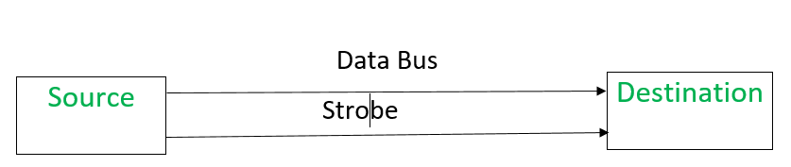
Data is transferred from source to destination through data bus in between. 1. Strobe Mechanism:
Source initiated Strobe – When source initiates the process of data transfer. Strobe is just a signal

Slide 23
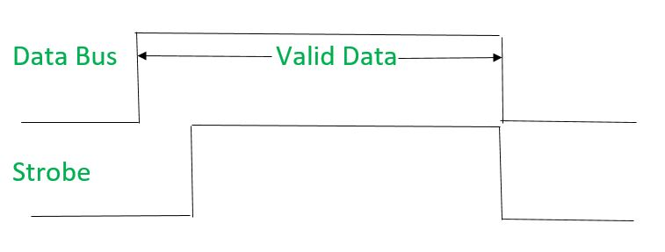
(i) First, source puts data on the data bus and ON the strobe signal. (ii) Destination on seeing the ON signal of strobe, read data from the data bus. (iii) After reading data from the data bus by destination, strobe gets OFF. Signals can be seen as:
It shows that first data is put on the data bus and then strobe signal gets active.

Slide 24
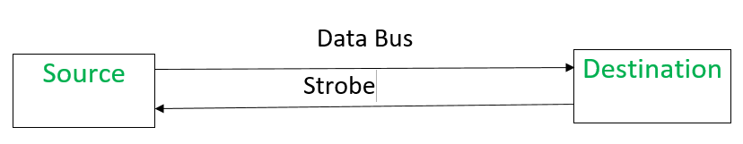
Destination initiated signal – When destination initiates the process of data transfer.
Notes:
(i) First, the destination ON the strobe signal to ensure the source to put the fresh data on the data bus. (ii) Source on seeing the ON signal puts fresh data on the data bus. (iii) Destination reads the data from the data bus and strobe gets OFF signal. Signals can be seen as:

Slide 25
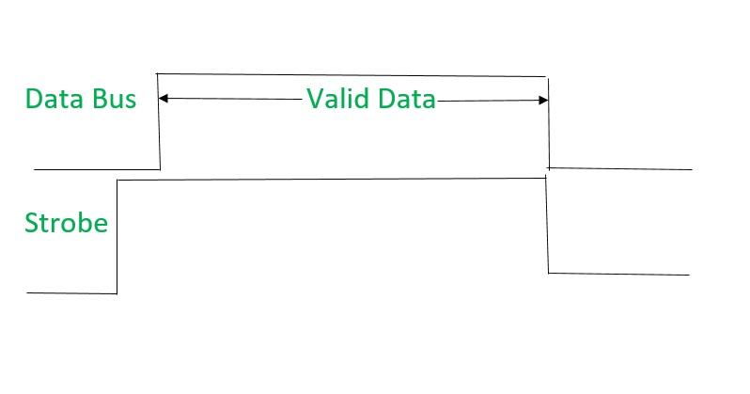
t shows that first strobe signal gets active then data is put on the data bus.

Slide 26
Problems faced in Strobe based asynchronous input output –
In Source initiated Strobe, it is assumed that destination has read the data from the data bus but there is no surety.
In Destination initiated Strobe, it is assumed that source has put the data on the data bus but there is no surety.

Slide 27
Problems faced in Strobe based asynchronous input output –
In Source initiated Strobe, it is assumed that destination has read the data from the data bus but there is no surety.
In Destination initiated Strobe, it is assumed that source has put the data on the data bus but there is no surety.

Slide 28
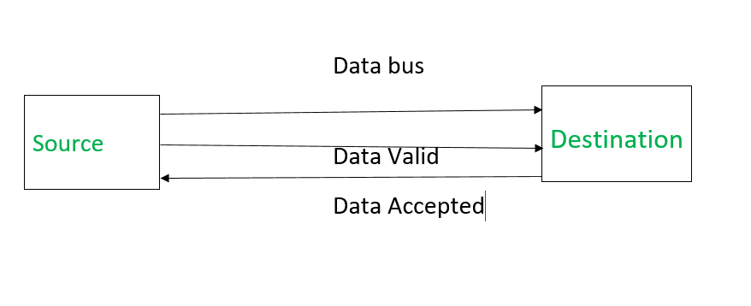
Notes:
(i) Source places data on the data bus and enable Data valid signal. (ii) Destination accepts data from the data bus and enable Data accepted signal. (iii) After this, disable Data valid signal means data on data bus is invalid now. (iv) Disable Data accepted signal and the process ends. Now there is surety that destination has read the data from the data bus through data accepted signal. Signals can be seen as:

Slide 29
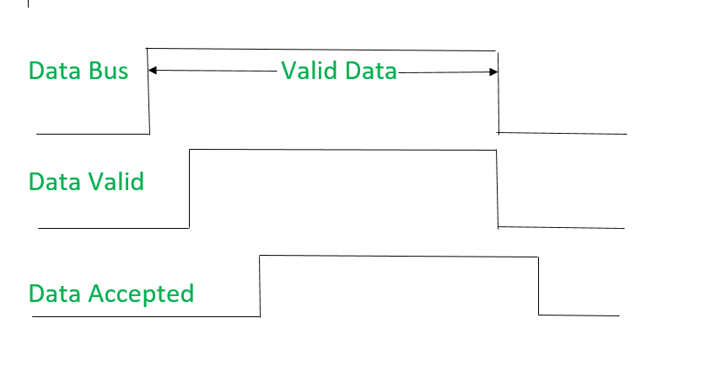
It shows that first data is put on the data bus then data valid signal gets active and then data accepted signal gets active. After accepting the data, first data valid signal gets off then data accepted signal gets off.

Slide 30
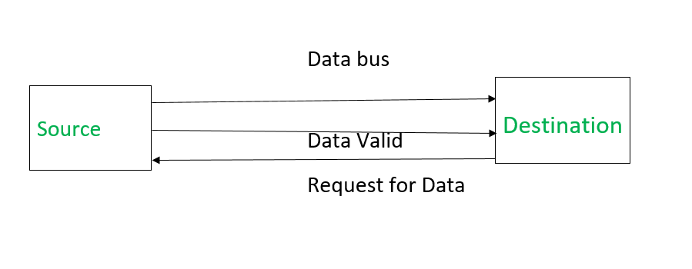
Destination initiated Handshaking – When destination initiates the process of data transfer. REQUEST FOR DATA: if ON requests for putting data on the data bus. DATA VALID: if ON tells data is valid on the data bus otherwise invalid data.
Notes:
(i) When destination is ready to receive data, Request for Data signal gets activated. (ii) source in response puts data on the data bus and enabled Data valid signal. (iii) Destination then accepts data from the data bus and after accepting data, disabled Request for Data signal. (iv) At last, Data valid signal gets disabled means data on the data bus is no more valid data. Now there is surety that source has put the data on the data bus through data valid signal. Signals can be seen as:

Slide 31
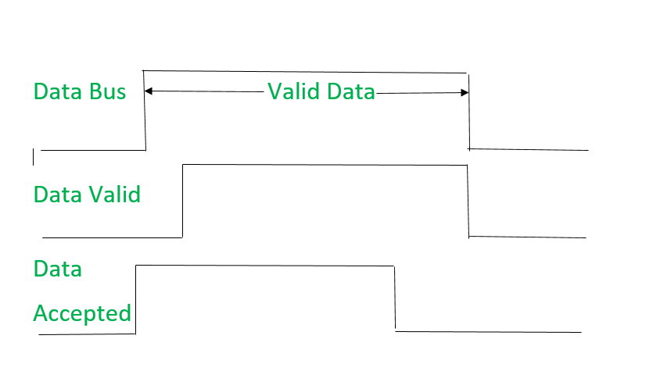
It shows that first Request for Data signal gets active then data is put on data bus then Data valid signal gets active. After reading data, first Request for Data signal gets off then Data valid signal.

Slide 32
Advantages of Asynchronous input output synchronization :
Some advantages of asynchronous input/output (I/O) synchronization include:
Flexibility: Asynchronous I/O synchronization allows for flexible data transfer rates and can adapt to varying transfer speeds without the need for synchronization. This is particularly useful when dealing with slow or intermittent devices.
Resource efficiency: Because data transfer is not synchronized to a clock signal, asynchronous I/O synchronization can be more resource-efficient than synchronous I/O synchronization. It can reduce the overhead of synchronization and improve the utilization of system resources.
Reduced latency: Asynchronous I/O synchronization can help reduce latency, or the delay between the initiation of a data transfer and its completion. This can improve the responsiveness and overall performance of the system.
Better error handling: Asynchronous I/O synchronization can provide better error handling, as it allows for the detection and handling of errors during data transfer. This can help ensure that data is transferred accurately and reliably.
Compatibility: Asynchronous I/O synchronization is compatible with a wide range of devices and systems, making it a flexible and widely used technique for managing data transfer.

Slide 33
Disadvantages of Asynchronous input output synchronization :
Some disadvantages of asynchronous input/output (I/O) synchronization include:
Complexity: Asynchronous I/O synchronization can be more complex to implement than synchronous I/O synchronization, as it requires interrupt-driven I/O and other techniques to manage data transfer.
Overhead: Asynchronous I/O synchronization can result in higher overhead than synchronous I/O synchronization, as the CPU must constantly monitor for interrupt signals and initiate data transfer when necessary.
Latency: Although asynchronous I/O synchronization can help reduce latency in some cases, it can also introduce additional latency when waiting for interrupt signals from devices.
Synchronization issues: Asynchronous I/O synchronization can introduce synchronization issues, particularly when dealing with multiple devices or large data transfers. It can be difficult to ensure that data is transferred in the correct order and that all devices are properly synchronized.
Compatibility issues: Asynchronous I/O synchronization may not be compatible with all devices and systems, particularly those that require fixed data transfer rates or specific synchronization protocols.

