Slide 1
AL-FARABI KAZAKH NATIONAL UNIVERSITY
Department of Recreational geography and tourism
Transportation in Tourism
Assipova Zhanna
PhD, associate professor

Slide 2
Lecture 5
Buses and Motor Coaches

Slide 3
Buses and Motor Coaches
bus: passenger road motor vehicle designed to carry more than 24 persons (including the driver), and with provision to carry seated as well as standing passengers (Glossary of Transport Statistics, 2009)
motor coach: passenger road motor vehicle designed to seat 24 or more persons (including the driver) and constructed exclusively for the carriage of seated passengers (Glossary of Transport Statistics, 2009)
minibus: passenger road motor vehicle designed to carry 10–23 seated or standing persons (including the driver) (Glossary of Transport Statistics, 2009)
trolleybus: a mode of transit service using vehicles propelled by a motor drawing current from overhead wires via connecting poles called a trolley poles from a central power source not on board the vehicle (APTA, 2011)

Slide 4
Types of Bus Service and the North American Industrial Classification (NAICS)
Types of bus service
Regular services
Special regular services
Occasional services
- urban transit systems
- interurban and rural bus transportation
- school and employee bus transportation
- other ground passenger transportation (shuttle)
- charter bus industry
- scenic/sightseeing transportation
Source: compiled by the author

Slide 5
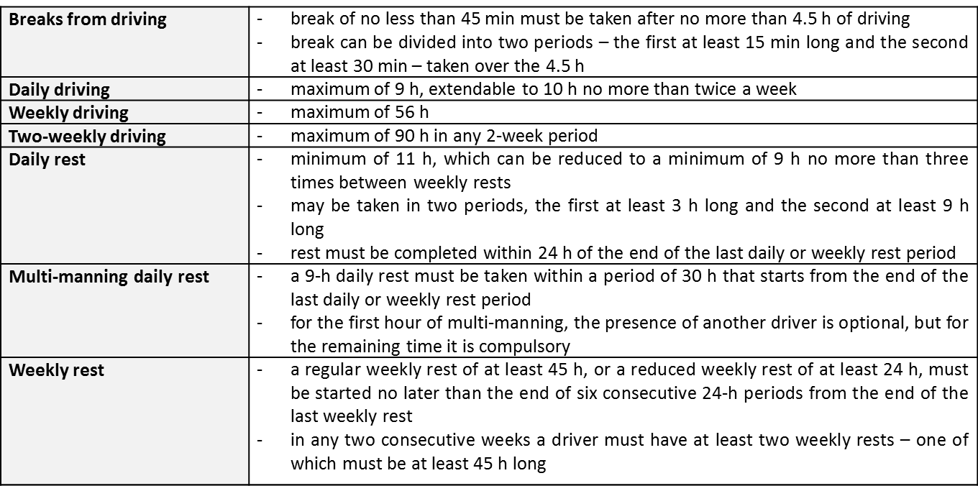
Institutional Framework
Current limits on drivers' hours as specified by EU rules as of 2011
Source: Vehicle & Operator Services Agency, 2011

Slide 6
Institutional Framework
Federal regulations regarding the maximum hours for bus and coach drivers in the USA
No motor carrier shall permit or require any driver used by it to drive a passenger-carrying commercial motor vehicle, nor shall any such driver drive a passenger-carrying commercial motor vehicle:
More than 10 hours following 8 consecutive hours off duty; or
For any period after having been on duty 15 hours following 8 consecutive hours off duty.
No motor carrier shall permit or require a driver of a passenger-carrying commercial motor vehicle to drive, nor shall any driver drive a passenger-carrying commercial motor vehicle, regardless of the number of motor carriers using the driver's services, for any period after
having been on duty 60 hours in any 7 consecutive days if the employing motor carrier does not operate commercial motor vehicles every day of the week; or
having been on duty 70 hours in any period of 8 consecutive days if the employing motor carrier operates commercial motor vehicles every day of the week

Slide 7
Demand
Passenger Transport by Bus and Coach
Source: OECD, 2011

Slide 8
Demand
EU-27 performance by mode for passenger transport
Source: Eurostat, 2012

Slide 9
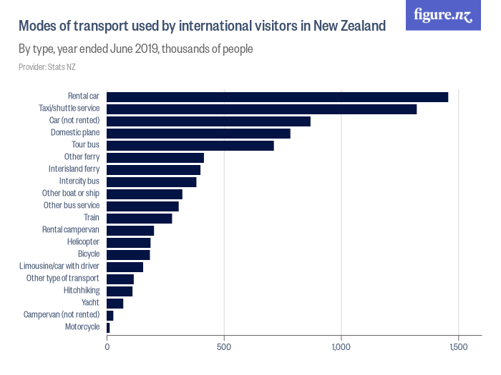

Slide 10
Supply
Suppliers of coach tourism
Suppliers of coach tourism
Tour operators
Traditional tour operators
e.g. TUI, Thomas Cook
Special tour operators, e.g. for study trips (Studiosus, STA Travel)
Original suppliers of coach tourism products
Bus companies
e.g. Greyhound
DB AG
Other suppliers (non-touristic)
Bus tour operators
e.g. Diamond Tours
Sales companies (promotional trips)
Trade chains
Associations
Source: Adapted from Pompl, 1997

Slide 11
Supply
Percentage of service provided by coach operators
Source: Nathan Associates Inc., 2008

Slide 12
Thank you for your attention!

