Slide 1
AL-FARABI KAZAKH NATIONAL UNIVERSITY
Department of Recreational geography and tourism
Transportation in Tourism
Assipova Zhanna
PhD, associate professor

Slide 2
Lecture 11
Urban Mobility

Slide 3
The Rationale of a Ring Road
Spatial Structure
Accessibility
Before
Avoiding the congested
central area
5
A
10
5
10
10
5
B
10
5
City
Center
A to B = 30
Secondary
Center
After
5
10
10
A
10
Structuring
Suburban
development
5
10
10
5
B
10
10
10
5
A to B = 20

Slide 4
Street Network Types
Conventional Grid
Pattern (c 1900)
Curvilinear Loop Pattern &
Beginning of Cul-de-Sacs (1930-1950)
Conventional
Cul-de-Sac Pattern
(since 1950)
Arterial road
Local street
Notes:
Source: adapted from Marshall, W.E. and N.W. Garrick (2010) “Street Network Types and Road Safety,” Urban Design International, 10.1057/udi.2009.31, April 21 2010

Slide 5
Scale and Urban Spatial Structure
Community
Streets
Basic services
Residences
District
Community
Main roads
Employment zones
Scale
Components of the spatial structure
City
District
Highway and transit systems
Major transport terminals (ports and airports)

Slide 6
Suburban Development along an Highway Interchange
Retail
Office
Industrial
Residential
Highway
Railway
Core

Slide 7
Transportation, Activity Systems and Land Use
Spatial
imprint
Infrastructures
Modes
Users
Transportation
Urban Form
Spatial
interaction
Labor
Customers
Suppliers
Activity
Urban Spatial Structure
Spatial
location
Land Use Pattern

Slide 8
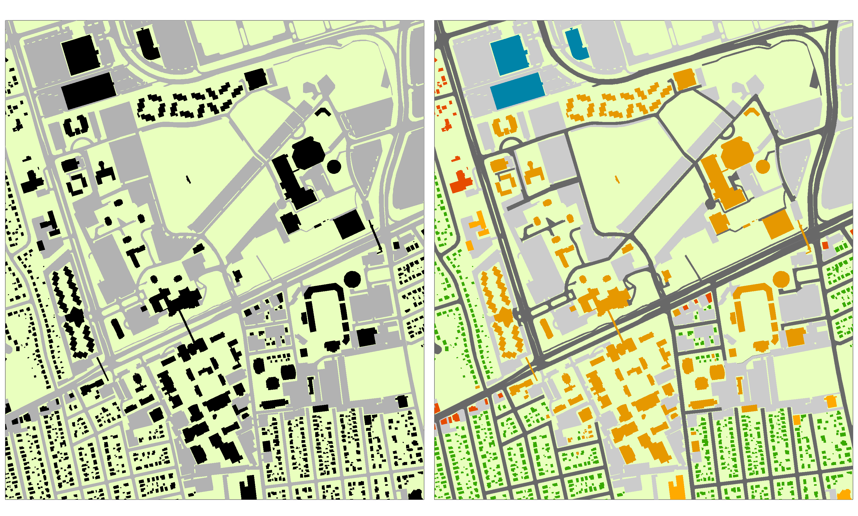
Formal and Functional Land Use
Formal Land Use
Built up
Paved
Other
Functional
Land Use
Institutional
Commercial
Light industrial
Residential
Roadway
Parking

Slide 9
Land Use Footprint in Selected Central Areas
Notes:
Source: Adapted from C. Gardener (2011) Old Urbanist, http://oldurbanist.blogspot.it/2011/06/density-on-ground-cities-and-building.html.
Refer to density within city limits. Includes open parking areas.

Slide 10
Transportation / Land Use Interactions
Transportation
Landscape
Economic processes
Demographic processes
Activity Patterns
Accessibility
Technological changes
Public policy
Land Use
Notes:
Source: adapted from. Giuliano, G. (1995) “Land Use Impacts of Transportation Investments: Highway and Transit”, in S. Hanson (ed) The Geography of Urban Transportation, New York: The Guilford Press, p. 307.

Slide 11
Von Thunen's Regional Land Use Model
Isolated State
Modified Conditions
Sub-center
Central city
Navigable river
Market gardening and
milk production
Firewood and lumber
production
Crop farming without
fallow
Crop framing, fallow
and pasture
Three-field system
Livestock farming

Slide 12
Inference of Von Thunen’s Model to the Continental United States
Forest
Dairy
Wheat
Dairy
Forest
Wheat
Corn and
Soybeans
Vegetables
Beef Cattle
and Sheep
Vegetables
Beef Cattle
and Sheep
Corn and
Soybeans
Cotton and
Tobacco
Specialty
Crops
Cotton and
Tobacco
Assumptions
1. New York City the only market
2. Crops ranked by rent paying ability
3. No terrain variation
4. Climatic variation considered
Specialty
Crops
Assumptions
1. New York City the only market
2. Crops ranked by rent paying ability
3. No terrain or climatic variation
A
B
Notes:
Stutz, R. and A. de Souza (1998), "The World Economy: Resources, Location, Trade and Development." Third Edition, Toronto: Prentice Hall. P. 268.

Slide 13
Burgess’ Urban Land Use Model
Chicago, 1920s
Model
Single Family Dwellings
I - Loop (downtown)
Second Immigrant
Settlement
II - Factory zone
Little
Sicily
III - Zone of transition
Ghetto
LOOP
IV - Working class zone
Two Plan
Area
V - Residential zone
Apartment Houses
VI - Commuter zone
Black Belt
Residential District
Bungalow
Section

Slide 14
Sector and Nuclei Urban Land Use Models
Sector
Nuclei
2
3
3
4
2
1
3
3
4
5
3
1
3
5
3
7
3
6
2
3
4
9
8
1 CBD
2 Wholesale and light manufacturing
3 Lower-class residential
4 Middle-class residential
5 Upper-class residential
6 Heavy manufacturing
7 Sub business district
8 Residential suburb
9 Industrial suburb
Notes:
Source: adapted from H. Carter (1995) The Study of Urban Geography, Fourth Edition, London: Arnold, p. 126.

Slide 15
The Hybrid Land Use Model: Transportation and the Formation of Urban Landscapes
Pre Industrial (Concentric)
Streetcar (Sector)
Bicycle (Concentric)
Centers
CBD
Walking
Horsecar
Railways
Automobile (Concentric)
Highway (Concentric and Nodal)
Suburb Towns
Roads
Main roads
Highways
Suburb
New suburb
Notes:
Adapted from: Taaffe E.J., Gauthier H.L. and O'Kelly M.E. (1996) Geography of Transportation (second edition).

Slide 16
Suitability of Travel Modes
Mode | Limitations | Most Appropriate Uses
Walking | Requires physical ability. Limited distance and carrying capacity. Difficult or unsafe in some areas. | Short trips by physically able people.
Bicycle | Requires bicycle and physical ability. Limited distance and carrying capacity. | Short to medium length trips by physically able people on suitable routes.
Taxi | Relatively high cost per mile. | Infrequent trips over short and medium distance.
Fixed Route Transit | Destinations and times limited. | Short to medium distance trips along busy corridors.
Paratransit | High cost and limited service. | Travel for disabled people.
Auto driver | Requires driving ability and automobile. High fixed costs. | Travel by people who can drive and afford an automobile.
Ridesharing | Requires cooperative automobile driver. Consumes driver’s time for deviations. | Trips that the driver would take anyway (commuting).
Vehicle Rentals | Requires convenient and affordable vehicle rentals services. | Occasional use by drivers who do not own an automobile.
Motorcycle | Requires riding ability and motorcycle. Average fixed costs. | Travel by people who can ride and afford a motorcycle.
Telecommuting | Requires IT equipment and skills. | Alternative to some types of trips.
Notes:
Source: adapted from Transportation Demand Management Encyclopedia, Victoria Transport Policy Institute.

Slide 17
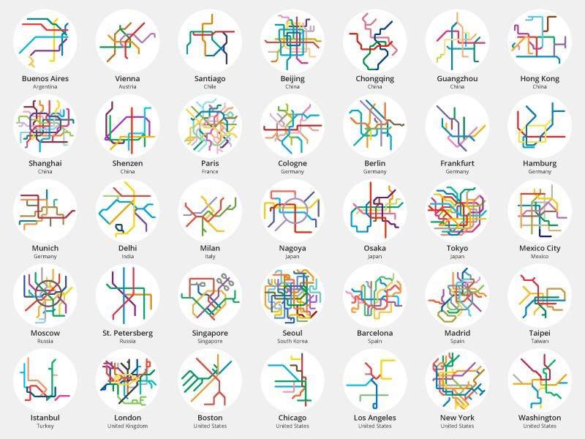

Slide 18
Distance between Access Points to Public Transit

Slide 19
Typical Activity Space of an Urban Working Adult
1:30 AM
Delivery
10:45 PM
Return
10:30 PM
Delivery
Shopping mall
2:30 AM
Return
8:30 PM
Carpool
7:00 PM
Carpool
1:30 PM
Walk
Restaurant
5:30 PM
Drive alone
Home
Work
7:00 AM
Garbage
pickup
12:30 PM
Walk
8:00 AM
Carpool
8:15 AM
Drive alone
10:00 AM
Parcel
Drop off
School
(drop off child)
10:05 AM
Parcel
Pickup
Passenger
Home-based
Trip
Freight
Work-based

Slide 20
Weekly Distribution of Transit Scheduled Trips and Uber Pickups, Los Angeles
Monday
Tuesday
Wednesday
Thursday
Friday
Saturday
Sunday
Uber Pickups
Transit Trips
Midnight
Noon
Midnight
Noon
Midnight
Noon
Midnight
Noon
Midnight
Noon
Midnight
Noon
Midnight
Noon
Midnight
Notes:
Source: LA Metro, General Transit Feed Specification GTFS Data.

Slide 21
Generic Planning Process
1
Problem Statement, Vision and Goals
Safety, health, mobility, equity, economic development
2
Objectives
Improve safety, improve roadway and trail facilities, increase non-motorized travel
3
Evaluation Criteria
Accident / injury rates, Bicycle Compatibility Index, non-motorized travel rate
4
Program Evaluation
Did program achieve its stated objectives? What is the program’s acceptance? What are its costs and benefits?

Slide 23
Sustainable Urban Mobility Plan
(SUMP) is a planning concept applied by local and regional authorities for strategic mobility planning. It encourages a shift towards more sustainable transport modes and supports the integration and balanced development of all modes. A SUMP is instrumental in solving urban transport problems and reaching local and higher-level environmental, social, and economic objectives.

Slide 26
Transposrt in Almaty
Law legacy basis of planning in transportation of Almaty
Устойчивый транспорт г. Алматы
Программа развития г. Алматы 2020
Smart Сity Almaty
Notes:
Для теоретического обоснования совершенствования системы управления городского транспортного потока нужно провести анализ и узнать что же происходит в Г Алматы с точки зрения транспорта

Slide 28
Statistics
Год | Number of cars (тыс.ед)
2003 | 218,200
2004 | 199,500
2005 | 254,800
2006 | 341,100
2007 | 450,200
2008 | 453,500
2009 | 463,600
2010 | 447,600
2011 | 525,700
2012 | 498,900
2013 | 505,200
2014 | 514,300
2015 | 468,300
2016 | 459,500
2017 | 462,500
2018 | 471, 082

Slide 29
Public transportation
Наименование/ годы | Ед. изм. | 2015 | 2016 | 2017 | 2018
Кол-во общественного транспорта | ед. | 1 848 | 1421 | 1 567 | 1764
В том числе:
Автобусы | ед. | 1 609 | 1 239 | 1 400 | 1600
Троллейбусы | ед. | 215 | 175 | 160 | 154
Трамваи | ед. | 17 | 0 | 0 | 0
Метрополитен | ед. | 7 | 7 | 7 | 7

Slide 30
Availability of registered passenger cars by year of manufacture in the Almaty on January 1, 2019
бензин | дизель | газ | смеш-ное | электрич.
437 991 93% | 18 104 | 633 0,13% | 13 350 | 89 0,018%
менее 3 лет | 3 - 7 лет | 7 - 10 лет | более 10 лет | прочие
72 216 15% | 87 094 | 47 597 | 245 933 52,2% | 18 242

Slide 31
The ratio of cars and public vehicles on Raiymbek and Abay ave.
Перегон (от-до) | Время | Легковой транспорт | Микро автобус | Автобус средней вместимости | Автобус большой вместимости | Соот-нош-ние
ул. Тургута Озала -ул. Брусиловского | 7:00 - 8:00 | 1455 | 66 | 7 | 87 | 9/1
ул. Розыбакиева - ул. Байзакова | 7:00 - 8:00 | 2996 | 83 | 13 | 69 | 18/1
Перегон (от-до) | Время | Легковой транспорт | Микро автобус | Автобус средней вместимости | Автобус большой вместимости | Троллейбус | Соотношение
ул. Фурманова - ул. Достык | 7:00 - 8:00 | 320 | 11 | 2 | 38 | 0 | 6/1
ул. Достык - ул. Фурманова | 7:00 - 8:00 | 245 | 6 | 0 | 32 | 0 | 6/1
ул. Байтурсынова - ул. Сейфулина | 7:00 - 8:00 | 1195 | 35 | 6 | 67 | 0 | 11/1
ул. Тургут Озала - ул. Розыбакиева | 7:00 - 8:00 | 1969 | 22 | 1 | 57 | 23 | 18/1
ул. Розыбакиева - ул. Гагарина | 8:00 - 9:00 | 2037 | 29 | 3 | 47 | 27 | 20/1

Slide 32
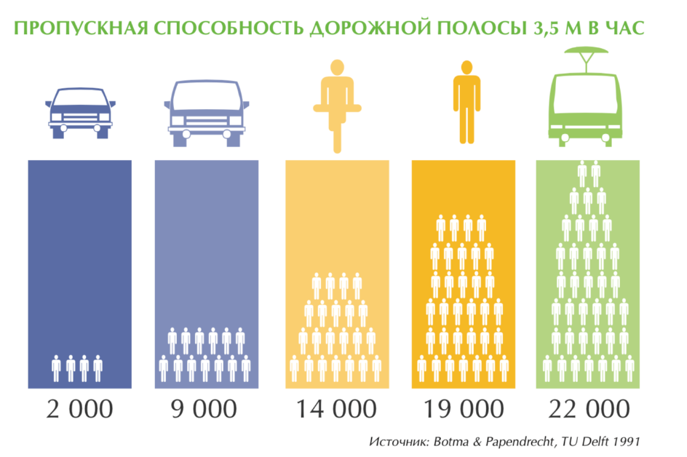
Using different transportation modes and capacity

Slide 33
The traffic intensity of urban traffic in the city of Almaty during the day and seasons
Notes:
Мадина добавь верхний график не как картинку, а как график

Slide 35
Conclusion
The traffic flow during the day is unevenly distributed over the hours, two peak periods are distinguished: in the morning from 08.00-10.00 and in the afternoon from 16.00-20.00.
The traffic flow during the week is directly dependent on weekdays and weekends.
During the year, traffic flow depends on the vacation period.
The ratio of cars and public vehicles = 18/1.
The increase in the number of vehicles does not correlate with an increase in road surface.
The number of passenger traffic is increasing, and the number of public transport is decreasing, and for some items the number of public transport remains unchanged.
Less than 1% of cars use gas and electric motors.
52% of registered cars are older than 10 years.

