Slide 1
Lecture 9
Virtual memory
Lecturer: Aidana Karibayeva

Slide 2
Introduction
Virtual memory is a technique that allows the execution of processes that are not completely in memory. One major advantage of this scheme is that programs can be larger than physical memory.

Slide 3
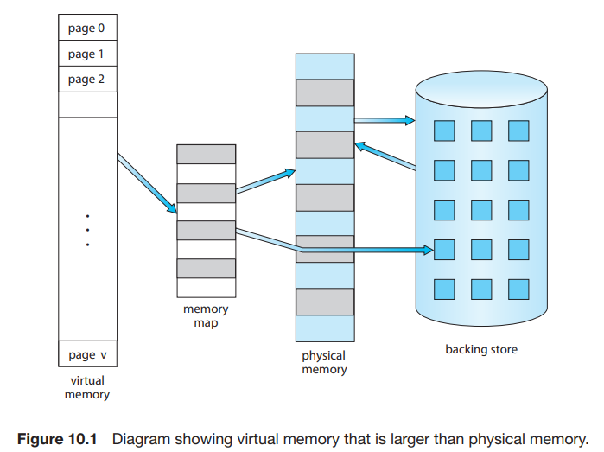

Slide 4
Virtual memory – separation of user logical memory from physical memory
  Only part of the program needs to be in memory for execution
  Logical address space can therefore be much larger than physical address space
  Allows address spaces to be shared by several processes
  Allows for more efficient process creation
  More programs running concurrently
  Less I/O needed to load or swap processes

Slide 5
Virtual address space – logical view of how process is stored in memory
  Usually start at address 0, contiguous addresses until end of space
  Meanwhile, physical memory organized in page frames
  MMU must map logical to physical
Virtual memory can be implemented via:
  Demand paging
  Demand segmentation

Slide 6
Demand Paging
An alternative strategy is to load pages only as they are needed. This technique is known as demand paging and is commonly used in virtual memory systems. With demand-paged virtual memory, pages are loaded only when they are demanded during program execution. Pages that are never accessed are thus never loaded into physical memory

Slide 7
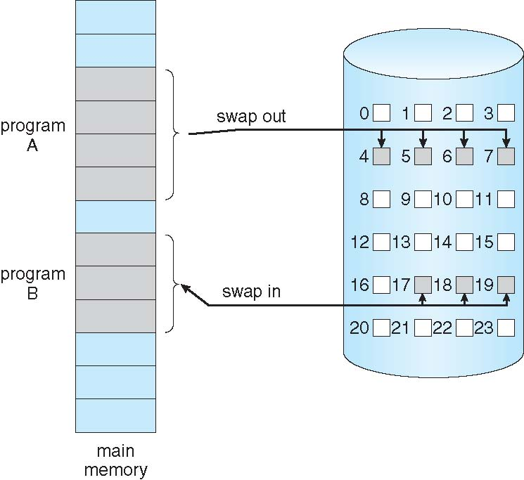
Demand Paging
Could bring entire process into memory at load time
Or bring a page into memory only when it is needed
  Less I/O needed, no unnecessary I/O
  Less memory needed
  Faster response
  More users
Similar to paging system with swapping (diagram on right)
Page is needed ⇒ reference to it
  invalid reference ⇒ abort
  not-in-memory ⇒ bring to memory
Lazy swapper – never swaps a page into memory unless page will be needed
  Swapper that deals with pages is a pager

Slide 8
The hardware to support demand paging is the same as the hardware for paging and swapping:
Page table. This table has the ability to mark an entry invalid through a valid –invalid bit or a special value of protection bits.
Secondary memory. This memory holds those pages that are not present in main memory. The secondary memory is usually a high-speed disk or NVM device. It is known as the swap device, and the section of storage used for this purpose is known as swap space.

Slide 9
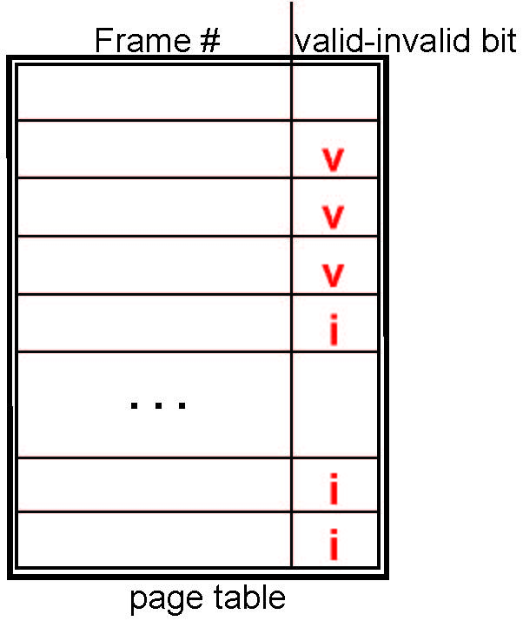
Valid-Invalid Bit
With each page table entry a valid–invalid bit is associated
(v ⇒ in-memory – memory resident, i ⇒ not-in-memory)
Initially valid–invalid bit is set to i on all entries
Example of a page table snapshot:
During MMU address translation, if valid–invalid bit in page table entry is i ⇒ page fault

Slide 10
Page Fault
If there is a reference to a page, first reference to that page will trap to operating system:
page fault
Operating system looks at another table to decide:
  Invalid reference ⇒ abort
  Just not in memory
Find free frame
Swap page into frame via scheduled disk operation
Reset tables to indicate page now in memory
Set validation bit = v
Restart the instruction that caused the page fault

Slide 11
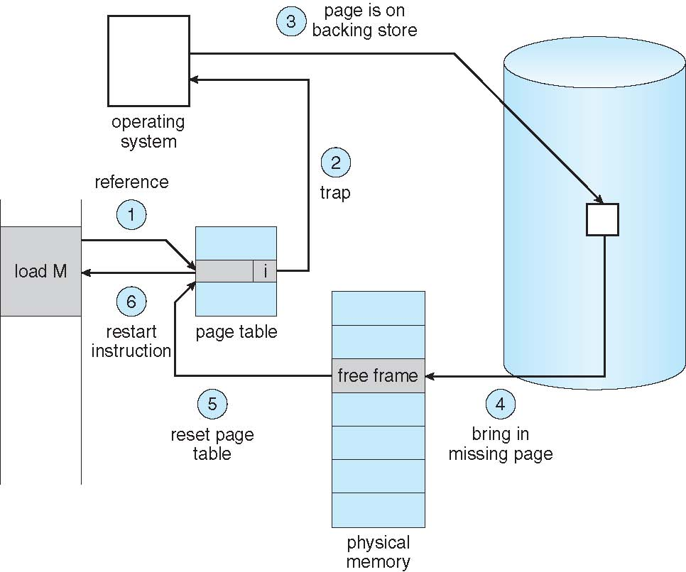
Steps in Handling a Page Fault
Notes:
.

Slide 12
Copy-on-Write
Copy-on-Write (COW) allows both parent and child processes to initially share the same pages in memory
  If either process modifies a shared page, only then is the page copied
COW allows more efficient process creation as only modified pages are copied
In general, free pages are allocated from a pool of zero-fill-on-demand pages
  Pool should always have free frames for fast demand page execution
    Don’t want to have to free a frame as well as other processing on page fault
  Why zero-out a page before allocating it?
vfork() variation on fork() system call has parent suspend and child using copy-on-write address space of parent
  Designed to have child call exec()
  Very efficient

Slide 13
Basic Page Replacement
Find the location of the desired page on disk
Find a free frame:
- If there is a free frame, use it
- If there is no free frame, use a page replacement algorithm to select a victim frame
- Write victim frame to disk if dirty
Bring the desired page into the (newly) free frame; update the page and frame tables
Continue the process by restarting the instruction that caused the trap
Note now potentially 2 page transfers for page fault – increasing EAT

Slide 14
Page and Frame Replacement Algorithms
Frame-allocation algorithm determines
  How many frames to give each process
  Which frames to replace
Page-replacement algorithm
  Want lowest page-fault rate on both first access and re-access
Evaluate algorithm by running it on a particular string of memory references (reference string) and computing the number of page faults on that string
  String is just page numbers, not full addresses
  Repeated access to the same page does not cause a page fault
  Results depend on number of frames available
In all our examples, the reference string of referenced page numbers is
7,0,1,2,0,3,0,4,2,3,0,3,0,3,2,1,2,0,1,7,0,1

Slide 15
Global vs. Local Allocation
Global replacement – process selects a replacement frame from the set of all frames; one process can take a frame from another
  But then process execution time can vary greatly
  But greater throughput so more common
Local replacement – each process selects from only its own set of allocated frames
  More consistent per-process performance
  But possibly underutilized memory

Slide 16
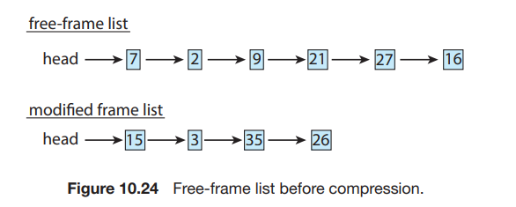
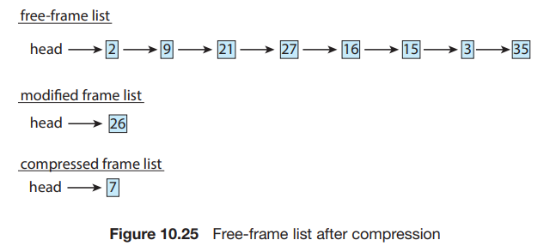
An alternative to paging is memory compression. Here, rather than paging out modified frames to swap space, we compress several frames into a single frame, enabling the system to reduce memory usage without resorting to swapping pages.

Slide 17
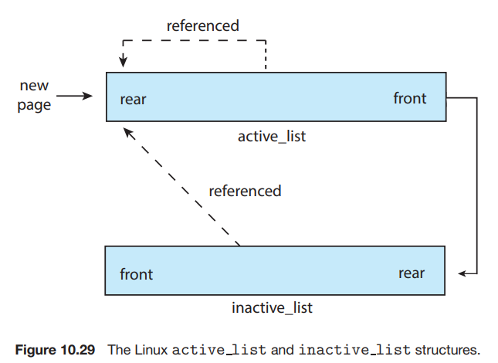
Linux
Linux manages kernel memory using slab allocation. We now cover how Linux manages virtual memory. Linux uses demand paging, allocating pages from a list of free frames.

Slide 18
Windows
Windows 10 implements virtual memory using demand paging with clustering, a strategy that recognizes locality of memory references and therefore handles page faults by bringing in not only the faulting page but also several pages immediately preceding and following the faulting page. The size of a cluster varies by page type. For a data page, a cluster contains three pages(the page before and the page after the faulting page); all other page faults have a cluster size of seven.

