Slide 1
Lecture 14-15
OS security and protection. Software threats.

Slide 2
Introduction
The process of ensuring OS availability, confidentiality, integrity is known as operating system security. OS security refers to the processes or measures taken to protect the operating system from dangers, including viruses, worms, malware, and remote hacker intrusions

Slide 3
Security refers to providing safety for computer system resources like software, CPU, memory, disks, etc. It can protect against all threats, including viruses and unauthorized access. It can be enforced by assuring the operating system's integrity, confidentiality, and availability. If an illegal user runs a computer application, the computer or data stored may be seriously damaged.

Slide 4
One common attack is masquerading, in which the attacker pretends to be a trusted third party. A variation of this is the man-in-the-middle, in which the attacker masquerades as both ends of the conversation to two targets.
A replay attack involves repeating a valid transmission. Sometimes this can be the entire attack, ( such as repeating a request for a money transfer ), or other times the content of the original message is replaced with malicious content.

Slide 5
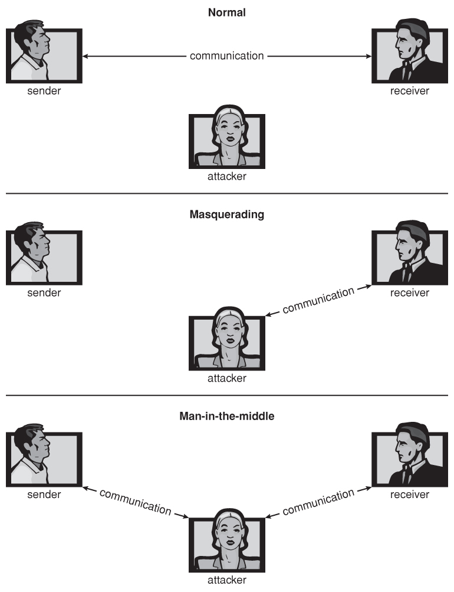

Slide 6
There are four levels at which a system must be protected:
Physical
Human
Operating System
Network

Slide 7
System security may be threatened through two violations, and these are as follows:
1. Threat
A program that has the potential to harm the system seriously.
2. Attack
A breach of security that allows unauthorized access to a resource.
There are two types of security breaches that can harm the system: malicious and accidental. Malicious threats are a type of destructive computer code or web script that is designed to cause system vulnerabilities that lead to back doors and security breaches. On the other hand, Accidental Threats are comparatively easier to protect against.

Slide 8
Security may be compromised through the breaches. Some of the breaches are as follows:
1. Breach of integrity
This violation has unauthorized data modification.
2. Theft of service
It involves the unauthorized use of resources.
3. Breach of confidentiality
It involves the unauthorized reading of data.
4. Breach of availability
It involves the unauthorized destruction of data.
5. Denial of service
It includes preventing legitimate use of the system. Some attacks may be accidental.

Slide 9
The goal of Security System
There are several goals of system security. Some of them are as follows:
1. Integrity
Unauthorized users must not be allowed to access the system's objects, and users with insufficient rights should not modify the system's critical files and resources.
2. Secrecy
The system's objects must only be available to a small number of authorized users. The system files should not be accessible to everyone.
3. Availability
All system resources must be accessible to all authorized users, i.e., no single user/process should be able to consume all system resources. If such a situation arises, service denial may occur. In this case, malware may restrict system resources and preventing legitimate processes from accessing them.

Slide 10
Program threats
The operating system's processes and kernel carry out the specified task as directed. Program Threats occur when a user program causes these processes to do malicious operations. The common example of a program threat is that when a program is installed on a computer, it could store and transfer user credentials to a hacker. There are various program threats. Some of them are as follows:
1.Virus
A virus may replicate itself on the system. Viruses are extremely dangerous and can modify/delete user files as well as crash computers. A virus is a little piece of code that is implemented on the system program. As the user interacts with the program, the virus becomes embedded in other files and programs, potentially rendering the system inoperable.

Slide 11
2. Trojan Horse
This type of application captures user login credentials. It stores them to transfer them to a malicious user who can then log in to the computer and access system resources.
3. Logic Bomb
A logic bomb is a situation in which software only misbehaves when particular criteria are met; otherwise, it functions normally.
4. Trap Door
A trap door is when a program that is supposed to work as expected has a security weakness in its code that allows it to do illegal actions without the user's knowledge.

Slide 12
Virus
A virus is a fragment of code embedded in an otherwise legitimate program, designed to replicate itself ( by infecting other programs ), and ( eventually ) wreaking havoc.

Slide 13
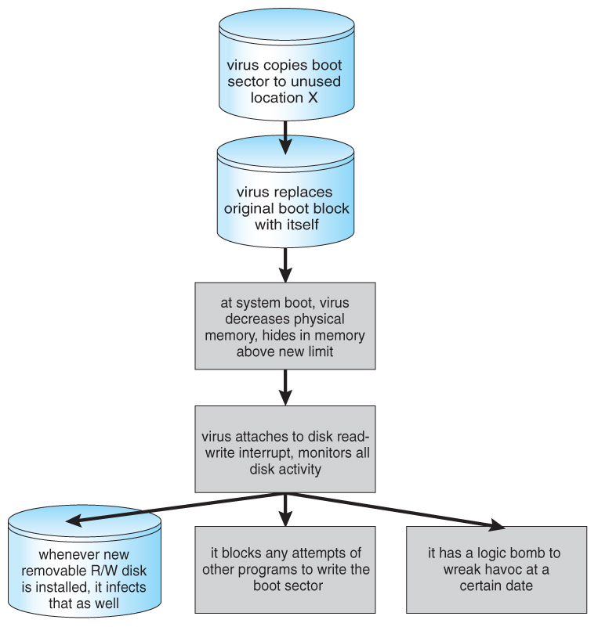

Slide 14
Trojan Horse
A Trojan Horse is a program that secretly performs some maliciousness in addition to its visible actions.
Some Trojan horses are deliberately written as such, and others are the result of legitimate programs that have become infected with viruses, ( see below. )
One dangerous opening for Trojan horses is long search paths, and in particular paths which include the current directory ( "." ) as part of the path. If a dangerous program having the same name as a legitimate program ( or a common mis-spelling, such as "sl" instead of "ls" ) is placed anywhere on the path, then an unsuspecting user may be fooled into running the wrong program by mistake.

Slide 15
Trap Door
A Trap Door is when a designer or a programmer ( or hacker ) deliberately inserts a security hole that they can use later to access the system.
Because of the possibility of trap doors, once a system has been in an untrustworthy state, that system can never be trusted again. Even the backup tapes may contain a copy of some cleverly hidden back door.
A clever trap door could be inserted into a compiler, so that any programs compiled with that compiler would contain a security hole. This is especially dangerous, because inspection of the code being compiled would not reveal any problems.

Slide 16
Logic bomb
A Logic Bomb is code that is not designed to cause havoc all the time, but only when a certain set of circumstances occurs, such as when a particular date or time is reached or some other noticeable event.
A classic example is the Dead-Man Switch, which is designed to check whether a certain person ( e.g. the author ) is logging in every day, and if they don't log in for a long time ( presumably because they've been fired ), then the logic bomb goes off and either opens up security holes or causes other problems.

Slide 17
The forms of viruses
Some of the forms of viruses include:
File - A file virus attaches itself to an executable file, causing it to run the virus code first and then jump to the start of the original program. These viruses are termed parasitic, because they do not leave any new files on the system, and the original program is still fully functional.
Boot - A boot virus occupies the boot sector, and runs before the OS is loaded. These are also known as memory viruses, because in operation they reside in memory, and do not appear in the file system.
Macro - These viruses exist as a macro ( script ) that are run automatically by certain macro-capable programs such as MS Word or Excel. These viruses can exist in word processing documents or spreadsheet files.
Source code viruses look for source code and infect it in order to spread.
Polymorphic viruses change every time they spread - Not their underlying functionality, but just their signature, by which virus checkers recognize them.
Encrypted viruses travel in encrypted form to escape detection. In practice they are self-decrypting, which then allows them to infect other files.
Stealth viruses try to avoid detection by modifying parts of the system that could be used to detect it. For example the read( ) system call could be modified so that if an infected file is read the infected part gets skipped and the reader would see the original unadulterated file.
Tunneling viruses attempt to avoid detection by inserting themselves into the interrupt handler chain, or into device drivers.
Multipartite viruses attack multiple parts of the system, such as files, boot sector, and memory.
Armored viruses are coded to make them hard for anti-virus researchers to decode and understand. In addition many files associated with viruses are hidden, protected, or given innocuous looking names such as "...".

Slide 18
System Threats
1. Port Scanning
It is a method by which the cracker determines the system's vulnerabilities for an attack. It is a fully automated process that includes connecting to a specific port via TCP/IP. To protect the attacker's identity, port scanning attacks are launched through Zombie Systems, which previously independent systems now serve their owners while being utilized for such terrible purposes.
2. Worm
The worm is a process that can choke a system's performance by exhausting all system resources. A Worm process makes several clones, each consuming system resources and preventing all other processes from getting essential resources. Worm processes can even bring a network to a halt.
3. Denial of Service
Denial of service attacks usually prevents users from legitimately using the system. For example, if a denial-of-service attack is executed against the browser's content settings, a user may be unable to access the internet.

Slide 19
Port Scanning
Port Scanning is technically not an attack, but rather a search for vulnerabilities to attack. The basic idea is to systematically attempt to connect to every known ( or common or possible ) network port on some remote machine, and to attempt to make contact. Once it is determined that a particular computer is listening to a particular port, then the next step is to determine what daemon is listening, and whether or not it is a version containing a known security flaw that can be exploited.
Because port scanning is easily detected and traced, it is usually launched from zombie systems, i.e. previously hacked systems that are being used without the knowledge or permission of their rightful owner. For this reason it is important to protect "innocuous" systems and accounts as well as those that contain sensitive information or special privileges.
There are also port scanners available that administrators can use to check their own systems, which report any weaknesses found but which do not exploit the weaknesses or cause any problems. Two such systems are nmap ( http://www.insecure.org/nmap ) and nessus ( http://www.nessus.org ). The former identifies what OS is found, what firewalls are in place, and what services are listening to what ports. The latter also contains a database of known security holes, and identifies any that it finds.

Slide 20
Worm
A worm is a process that uses the fork / spawn process to make copies of itself in order to wreak havoc on a system. Worms consume system resources, often blocking out other, legitimate processes. Worms that propagate over networks can be especially problematic, as they can tie up vast amounts of network resources and bring down large-scale systems.
One of the most well-known worms was launched by Robert Morris, a graduate student at Cornell, in November 1988. Targeting Sun and VAX computers running BSD UNIX version 4, the worm spanned the Internet in a matter of a few hours, and consumed enough resources to bring down many systems.
This worm consisted of two parts:
A small program called a grappling hook, which was deposited on the target system through one of three vulnerabilities, and
The main worm program, which was transferred onto the target system and launched by the grappling hook program.

Slide 21
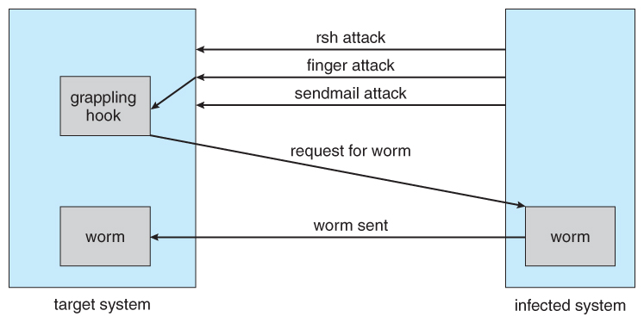
Figure 15.6 - The Morris Internet worm.

Slide 22
Morris Internet worm
The three vulnerabilities exploited by the Morris Internet worm were as follows:
rsh ( remote shell ) is a utility that was in common use at that time for accessing remote systems without having to provide a password. If a user had an account on two different computers ( with the same account name on both systems ), then the system could be configured to allow that user to remotely connect from one system to the other without having to provide a password. Many systems were configured so that any user ( except root ) on system A could access the same account on system B without providing a password.
finger is a utility that allows one to remotely query a user database, to find the true name and other information for a given account name on a given system. For example "finger joeUser@somemachine.edu" would access the finger daemon at somemachine.edu and return information regarding joeUser. Unfortunately the finger daemon ( which ran with system privileges ) had the buffer overflow problem, so by sending a special 536-character user name the worm was able to fork a shell on the remote system running with root privileges.
sendmail is a routine for sending and forwarding mail that also included a debugging option for verifying and testing the system. The debug feature was convenient for administrators, and was often left turned on. The Morris worm exploited the debugger to mail and execute a copy of the grappling hook program on the remote system.

Slide 23
Denial of Service ( DOS )
Denial of Service ( DOS ) attacks do not attempt to actually access or damage systems, but merely to clog them up so badly that they cannot be used for any useful work. Tight loops that repeatedly request system services are an obvious form of this attack.
DOS attacks can also involve social engineering, such as the Internet chain letters that say "send this immediately to 10 of your friends, and then go to a certain URL", which clogs up not only the Internet mail system but also the web server to which everyone is directed. ( Note: Sending a "reply all" to such a message notifying everyone that it was just a hoax also clogs up the Internet mail service, just as effectively as if you had forwarded the thing. )
Security systems that lock accounts after a certain number of failed login attempts are subject to DOS attacks which repeatedly attempt logins to all accounts with invalid passwords strictly in order to lock up all accounts.
Sometimes DOS is not the result of deliberate maliciousness. Consider for example:
A web site that sees a huge volume of hits as a result of a successful advertising campaign.
CNN.com occasionally gets overwhelmed on big news days, such as Sept 11, 2001.
CS students given their first programming assignment involving fork( ) often quickly fill up process tables or otherwise completely consume system resources. :-)
( Please use ipcs and ipcrm when working on the inter-process communications assignment ! )

Slide 24
Threats to Operating System
There are various threats to the operating system. Some of them are as follows:
Malware
It contains viruses, worms, trojan horses, and other dangerous software. These are generally short code snippets that may corrupt files, delete the data, replicate to propagate further, and even crash a system. The malware frequently goes unnoticed by the victim user while criminals silently extract important data.
Network Intrusion
Network intruders are classified as masqueraders, misfeasors, and unauthorized users. A masquerader is an unauthorized person who gains access to a system and uses an authorized person's account. A misfeasor is a legitimate user who gains unauthorized access to and misuses programs, data, or resources. A rogue user takes supervisory authority and tries to evade access constraints and audit collection.
Buffer Overflow
It is also known as buffer overrun. It is the most common and dangerous security issue of the operating system. It is defined as a condition at an interface under which more input may be placed into a buffer and a data holding area than the allotted capacity, and it may overwrite other information. Attackers use such a situation to crash a system or insert specially created malware that allows them to take control of the system.

Slide 25
How to ensure Operating System Security?
There are various ways to ensure operating system security. These are as follows:
Authentication
The process of identifying every system user and associating the programs executing with those users is known as authentication. The operating system is responsible for implementing a security system that ensures the authenticity of a user who is executing a specific program. In general, operating systems identify and authenticate users in three ways.
1. Username/Password
Every user contains a unique username and password that should be input correctly before accessing a system.
2. User Attribution
These techniques usually include biometric verification, such as fingerprints, retina scans, etc. This authentication is based on user uniqueness and is compared to database samples already in the system. Users can only allow access if there is a match.
3. User card and Key
To login into the system, the user must punch a card into a card slot or enter a key produced by a key generator into an option provided by the operating system.

Slide 26
One Time passwords
Along with standard authentication, one-time passwords give an extra layer of security. Every time a user attempts to log into the One-Time Password system, a unique password is needed. Once a one-time password has been used, it cannot be reused. One-time passwords may be implemented in several ways.
1. Secret Key
The user is given a hardware device that can generate a secret id that is linked to the user's id. The system prompts for such a secret id, which must be generated each time you log in.
2. Random numbers
Users are given cards that have alphabets and numbers printed on them. The system requests numbers that correspond to a few alphabets chosen at random.
3. Network password
Some commercial applications issue one-time passwords to registered mobile/email addresses, which must be input before logging in.

Slide 27
Biometrics
Biometrics involve a physical characteristic of the user that is not easily forged or duplicated and not likely to be identical between multiple users.
Fingerprint scanners are getting faster, more accurate, and more economical.
Palm readers can check thermal properties, finger length, etc.
Retinal scanners examine the back of the users' eyes.
Voiceprint analyzers distinguish particular voices.
Difficulties may arise in the event of colds, injuries, or other physiological changes.

Slide 28
Firewalls
Firewalls are essential for monitoring all incoming and outgoing traffic. It imposes local security, defining the traffic that may travel through it. Firewalls are an efficient way of protecting network systems or local systems from any network-based security threat.
Physical Security
The most important method of maintaining operating system security is physical security. An attacker with physical access to a system may edit, remove, or steal important files since operating system code and configuration files are stored on the hard drive.

Slide 29
Firewalling to Protect Systems and Networks
Firewalls are devices ( or sometimes software ) that sit on the border between two security domains and monitor/log activity between them, sometimes restricting the traffic that can pass between them based on certain criteria.
For example a firewall router may allow HTTP: requests to pass through to a web server inside a company domain while not allowing telnet, ssh, or other traffic to pass through.
A common architecture is to establish a de-militarized zone, DMZ, which sort of sits "between" the company domain and the outside world, as shown below. Company computers can reach either the DMZ or the outside world, but outside computers can only reach the DMZ. Perhaps most importantly, the DMZ cannot reach any of the other company computers, so even if the DMZ is breached, the attacker cannot get to the rest of the company network. ( In some cases the DMZ may have limited access to company computers, such as a web server on the DMZ that needs to query a database on one of the other company computers. )

Slide 30
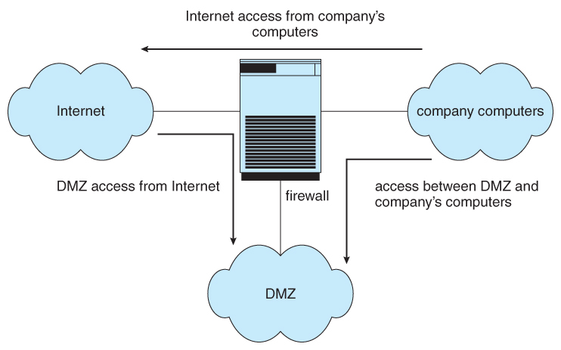
Domain separation via firewall.

Slide 31
Firewalls themselves need to be resistant to attacks, and unfortunately have several vulnerabilities:
Tunneling, which involves encapsulating forbidden traffic inside of packets that are allowed.
Denial of service attacks addressed at the firewall itself.
Spoofing, in which an unauthorized host sends packets to the firewall with the return address of an authorized host.
In addition to the common firewalls protecting a company internal network from the outside world, there are also some specialized forms of firewalls that have been recently developed:
A personal firewall is a software layer that protects an individual computer. It may be a part of the operating system or a separate software package.
An application proxy firewall understands the protocols of a particular service and acts as a stand-in ( and relay ) for the particular service. For example, and SMTP proxy firewall would accept SMTP requests from the outside world, examine them for security concerns, and forward only the "safe" ones on to the real SMTP server behind the firewall.
XML firewalls examine XML packets only, and reject ill-formed packets. Similar firewalls exist for other specific protocols.
System call firewalls guard the boundary between user mode and system mode, and reject any system calls that violate security policies.

Slide 32
Operating System Security Policies and Procedures
As OS security policies and procedures cover a large area, there are various techniques to addressing them. Some of them are as follows:
Installing and updating anti-virus software
Ensure the systems are patched or updated regularly
Implementing user management policies to protect user accounts and privileges.
Installing a firewall and ensuring that it is properly set to monitor all incoming and outgoing traffic.
OS security policies and procedures are developed and implemented to ensure that you must first determine which assets, systems, hardware, and date are the most vital to your organization. Once that is completed, a policy can be developed to secure and safeguard them properly.

Slide 33
Computer-Security Classifications ( Optional
No computer system can be 100% secure, and attempts to make it so can quickly make it unusable.
However one can establish a level of trust to which one feels "safe" using a given computer system for particular security needs.
The U.S. Department of Defense's "Trusted Computer System Evaluation Criteria" defines four broad levels of trust, and sub-levels in some cases:
Level D is the least trustworthy, and encompasses all systems that do not meet any of the more stringent criteria. DOS and Windows 3.1 fall into level D, which has no user identification or authorization, and anyone who sits down has full access and control over the machine.
Level C1 includes user identification and authorization, and some means of controlling what users are allowed to access what files. It is designed for use by a group of mostly cooperating users, and describes most common UNIX systems.
Level C2 adds individual-level control and monitoring. For example file access control can be allowed or denied on a per-individual basis, and the system administrator can monitor and log the activities of specific individuals. Another restriction is that when one user uses a system resource and then returns it back to the system, another user who uses the same resource later cannot read any of the information that the first user stored there. ( I.e. buffers, etc. are wiped out between users, and are not left full of old contents. ) Some special secure versions of UNIX have been certified for C2 security levels, such as SCO.
Level B adds sensitivity labels on each object in the system, such as "secret", "top secret", and "confidential". Individual users have different clearance levels, which controls which objects they are able to access. All human-readable documents are labeled at both the top and bottom with the sensitivity level of the file.
Level B2 extends sensitivity labels to all system resources, including devices. B2 also supports covert channels and the auditing of events that could exploit covert channels.
B3 allows creation of access-control lists that denote users NOT given access to specific objects.
Class A is the highest level of security. Architecturally it is the same as B3, but it is developed using formal methods which can be used to prove that the system meets all requirements and cannot have any possible bugs or other vulnerabilities. Systems in class A and higher may be developed by trusted personnel in secure facilities.
These classifications determine what a system can implement, but it is up to security policy to determine how they are implemented in practice. These systems and policies can be reviewed and certified by trusted organizations, such as the National Computer Security Center. Other standards may dictate physical protections and other issues.

