Slide 1
VIRTUAL MACHINES

Slide 2
Virtual Machine
A Virtual Machine is a software that creates a virtualized environment between the computer platform and the end user in which the end user can operate software.

Slide 3
Description
A virtual machine provides an interface identical to the underlying bare hardware.
The operating system creates the illusion of multiple processes, each executing on its own processor with its own (virtual) memory.

Slide 4
Virtualization
Virtualization is an abstraction layer that decouples the physical hardware from the operating system to deliver greater IT resource utilization and flexibility.
It allows multiple virtual machines, with heterogeneous operating systems to run in isolation, side-by-side on the same physical machine.

Slide 5
Virtualization contd..
Each virtual machine has its own set of virtual hardware (e.g., RAM, CPU, NIC, etc.) upon which an operating system and applications are loaded.
The operating system creates the illusion of multiple processes, each executing on its own processor with its own (virtual) memory.

Slide 6
Types of virtualization
Types of virtualization include:
Data virtualization, which allows organizations to consolidate data sources into a single dynamic supply.
Desktop virtualization, which allows multiple simulated desktop environments to be deployed and controlled through a central administrator.

Slide 7
Server virtualization, which allows administrators to partition servers into configurations meant to to serve specific functions.
Operating system virtualization, which makes it possible to run multiple operating systems on a single computer.
Network functions virtualization, which separates a network's functions (like directory services, file sharing, and IP configuration) so they can be distributed among environments.

Slide 8
History
Virtualization was first introduced in the 1960s to allow partitioning of large, mainframe hardware.
In the 1990s, researchers began to see how virtualization could solve some of the problems associated with the proliferation of less expensive hardware, including underutilization, escalating management costs and vulnerability.

Slide 9
Virtual Machine Monitor
The host software that provides virtualization is often referred to as a virtual machine monitor (VMM) or hypervisor.
The VMM gives each virtual machine an illusion of a complete computer to itself.

Slide 10
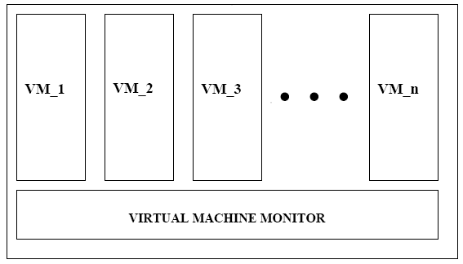

Slide 11
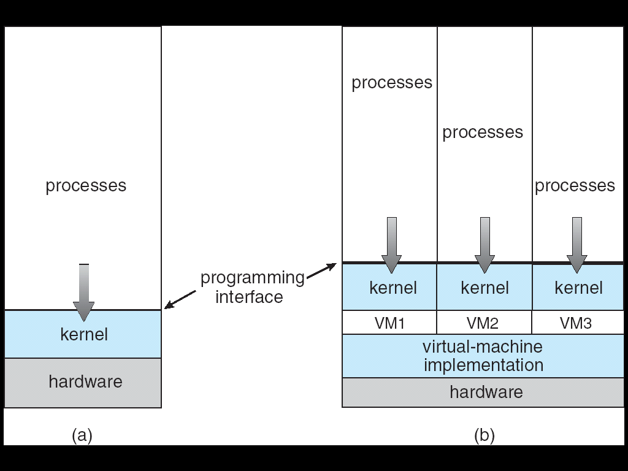
Architecture

Slide 12
Features
Each virtual machine has its own set of virtual hardware (e.g., RAM, CPU, NIC, etc.) upon which an operating system and applications are loaded.
The operating system sees a consistent, normalized set of hardware regardless of the actual physical hardware components.

Slide 13
Benefits
1. Partitioning
- Multiple applications and operating systems can be supported within a single physical system.
- There is no overlap amongst memory as each Virtual Memory has its own memory space.

Slide 14
Benefits
2.Isolation
-Virtual machines are completely isolated from the host machine and other virtual machines. If a virtual machine crashes, all others are unaffected.
-Data does not leak across virtual machines.

Slide 15
A VM can be defined in a single data file, which can be moved from one computer to another, opened in either one, and be expected to work the same. A hypervisor manages the hardware and separates the physical resources from the virtual environments. Resources are partitioned as needed from the physical environment to the VMs. The physical hardware still does the execution, so the CPU is still executing CPU instructions as requested by the VMs, for example, while the hypervisor manages the schedule.
In Linux® environments, the built-in hypervisor is called the Kernel-based Virtual Machine (KVM). Other options include Xen, which is open source, and Microsoft Hyper-V.
Notes:
When the VM is running and a user or program issues an instruction that requires additional resources from the physical environment, the hypervisor schedules the request to the physical system’s resources so that the virtual machine’s operating system and applications can access the shared pool of physical resources.

Slide 16
There are 2 different types of hypervisors that can be used for virtualization.
Type 1
A type 1 hypervisor is on bare metal. VM resources are scheduled directly to the hardware by the hypervisor. KVM is an example of a type 1 hypervisor.
Type 2
A type 2 hypervisor is hosted. VM resources are scheduled against a host operating system, which is then executed against the hardware. VMware Workstation and Oracle VirtualBox are examples of type 2 hypervisors.

Slide 17
Advantages of VMs
VMs offer several benefits over traditional physical hardware:
Resource utilization and improved ROI: Because multiple VMs run on a single physical computer, customers don’t have to buy a new server every time they want to run another OS. And they can get more return from each piece of hardware they already own. Scale: With cloud computing, it’s easy to deploy multiple copies of the same virtual machine to better serve increases in load. Portability: VMs can be relocated as needed among the physical computers in a network. This makes it possible to allocate workloads to servers that have spare computing power. VMs can even move between on-premises and cloud environments, making them useful for hybrid cloud scenarios in which you share computing resources between your data center and a cloud service provider.

Slide 18
Flexibility: Creating a VM is faster and easier than installing an OS on a physical server because you can clone a VM with the OS already installed. Developers and software testers can create new environments on demand to handle new tasks as they arise. Security: VMs improve security in several ways when compared to operating systems running directly on hardware. A VM is a file that can be scanned for malicious software by an external program. You can create an entire snapshot of the VM at any point in time. And then restore it to that state if it becomes infected with malware, effectively taking the VM back in time. The fast, easy creation of VMs also makes it possible to completely delete a compromised VM and then re-create it quickly, hastening recovery from malware infections.

Slide 19
Summary
Virtual machines are a number of discrete identical execution environments on a single computer, each of which runs an operating system. This can allow applications written for one OS to be executed on a machine which runs a different OS which provide a greater level of isolation between processes than is achieved when running multiple processes on the same instance of an OS.

