Slide 1
AL-FARABI KAZAKH NATIONAL UNIVERSITY
Department of Recreational geography and tourism
Transportation in Tourism
Assipova Zhanna
PhD, associate professor

Slide 2
Lecture 6
Rail transportation

Slide 3
Rail
Rail in amusement sector
Cog railways
Specific
Land-based cableways
Aerial cableways
Funiculars
Adhesion railways
Mountain railways
More rail
Other rail traffic
Inter-urban rail services
Rapid transit
Railway transportation
Rail traffic

Slide 4
Rail
train: one or more railway vehicles hauled by one or more locomotives or railcars, or one railcar travelling alone, running under a given number or specific designation from an initial fixed point to a terminal fixed point. A light engine, i.e. a locomotive travelling on its own, is not considered to be a train (Glossary of Transport Statistics, 2009)
high-speed rail: designed to travel at a speed between 250 and 300 km/h on special lines, or around 200 km/h on existing older but upgraded lines (UIC, 2010a)
rapid transit: an electric rail line mainly for urban transport with the capacity for heavy volumes of traffic involving very frequent train movements. Metro lines are also characterized by closely spaced stations, normally with around 1000 m between the stations (Glossary of Transport Statistics, 2009)
light rail: a rail line mainly for urban transport of passengers often electrified. Stations/halts are generally less than 1200 m apart (Glossary of Transport Statistics, 2009)

Slide 5
Institutional Framework
no internationally uniform legal or regulatory framework regarding rail infrastructure or operations
rail networks: governed and regulated at many levels
national laws
regional agreements
international agreements
railroad governance of the USA, Canada and Mexico: several institutions and organizations involved
federal departments and agencies
provinces or states
railway companies
labour unions

Slide 6
Demand
World passenger traffic 2010 - pkm (billions)
Source: UIC, 2011

Slide 7
Supply
Worldwide track infrastructure (in km)
Source: Adapted from UIC, 2009; VDB, 2011, p. 8; VDB, 2012, p. 8; EUROSTAT, 2013

Slide 8
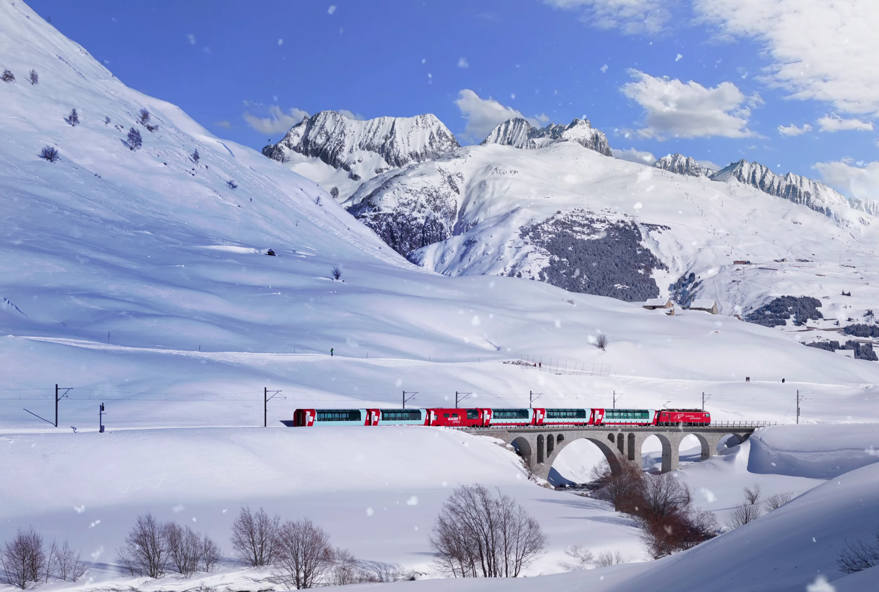

Slide 9
The world’s slowest express train takes travellers across the Alps within roughly eight hours, passing through 91 tunnels and over 291 bridges.
Facts Glacier Express
Route: Zermatt – St. Moritz or vice versa
Distance: 291 km
Duration: 8 h 03 min
Excursion tips
Matterhorn Glacier Paradise – a view of French, Italian and Swiss mountain giants from a vantage point of almost 4000 m
Gornergrat – a view onto the Matterhorn and 28 other four-thousand-meter-peaks from a vantage point of 3131 m
Rhine Gorge – Exploring the «Grand Canyon» of Switzerland between Ilanz and Reichenau on foot, by bike or by rafting boat
Lake Sils – at 1800 m, Europe’s highest altitude regular scheduled passenger boat service
Corvatsch – the eastern Alpine region’s highest altitude summit station at 3303 m. A paradise for skiers and hikers
Food & Beverages
1st and 2nd class: lunch served at the seat, three-course meal CHF 49, daily menu CHF 36, à la carte options
Excellence Class: Champagne and aperitif platter, 5-course-menu with wine accompaniment, soft drinks, mineral and coffee included

Slide 10
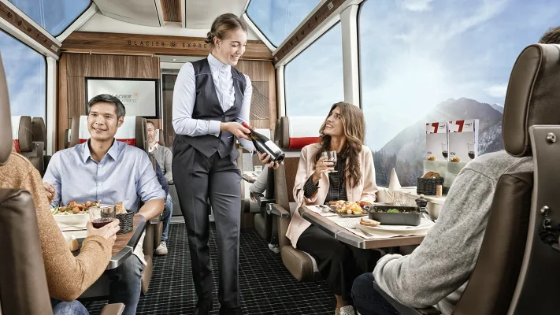
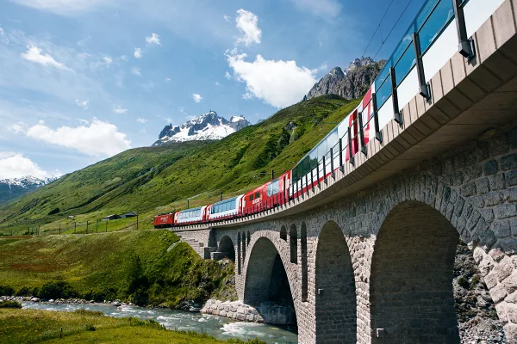

Slide 11
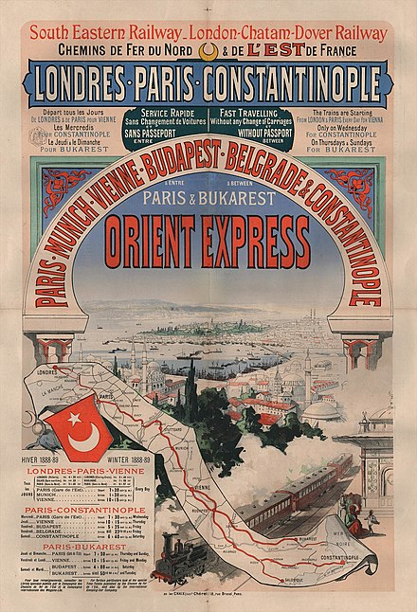
Orient express

Slide 12
Venice Simplon-Orient-Express
This once-a-year, week-long voyage from Paris to Istanbul on the VSOE is one of the most iconic train journeys in the world
€21,800.00 - price

Slide 13
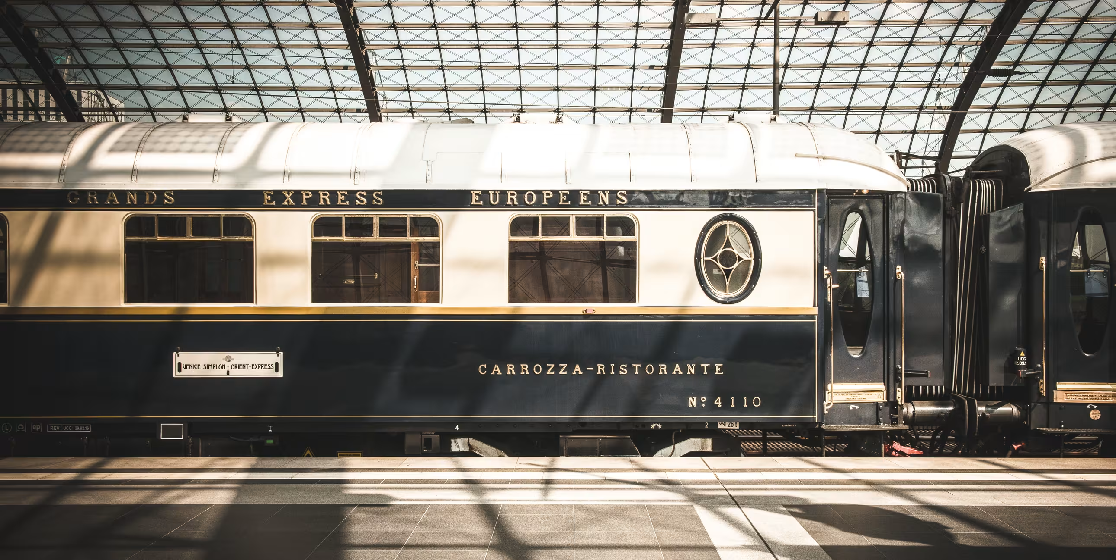

Slide 14
Thank you for your attention!

