Slide 1
AL-FARABI KAZAKH NATIONAL UNIVERSITY
Department of Recreational geography and tourism
Transportation in Tourism
Assipova Zhanna
PhD, associate professor

Slide 2
Lecture 3
Speciality Air Transportation

Slide 3
Speciality Air Transportation
Speciality air transportation
Ballooning
Airships
Gliding
Space transportation
Helicopters

Slide 5
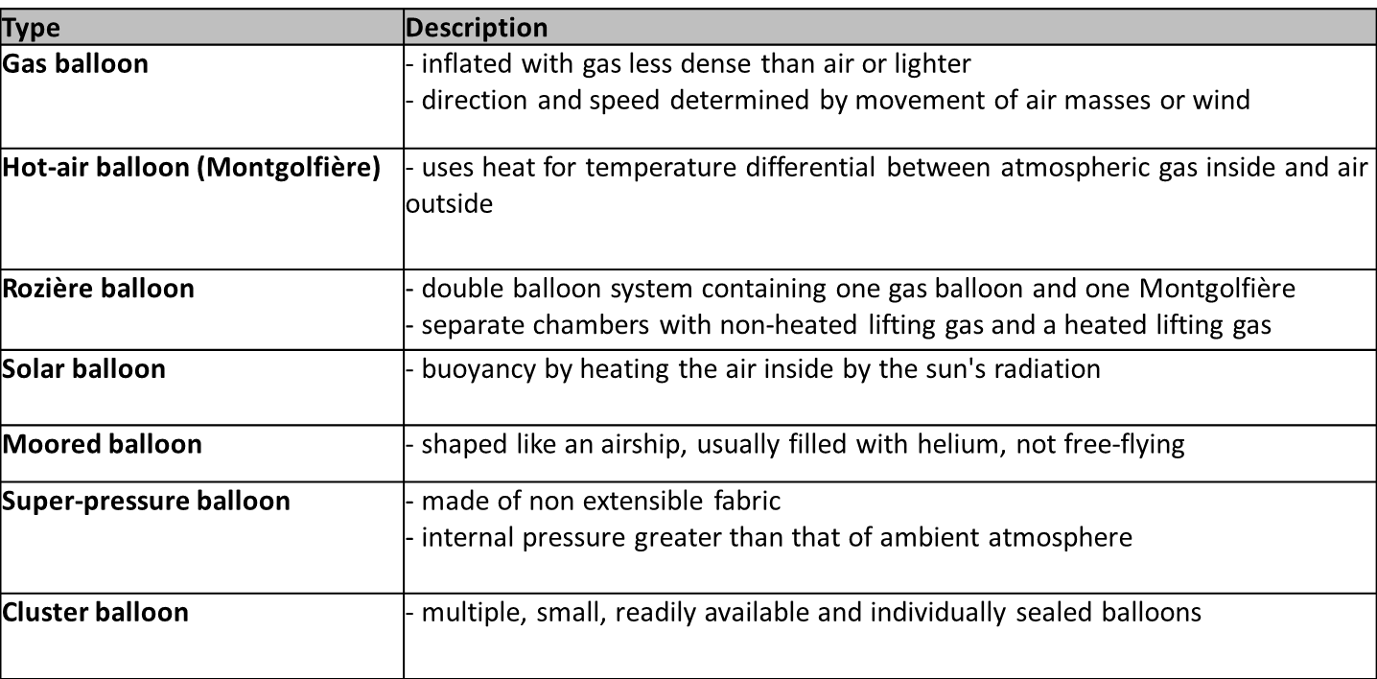
Ballooning

Slide 6
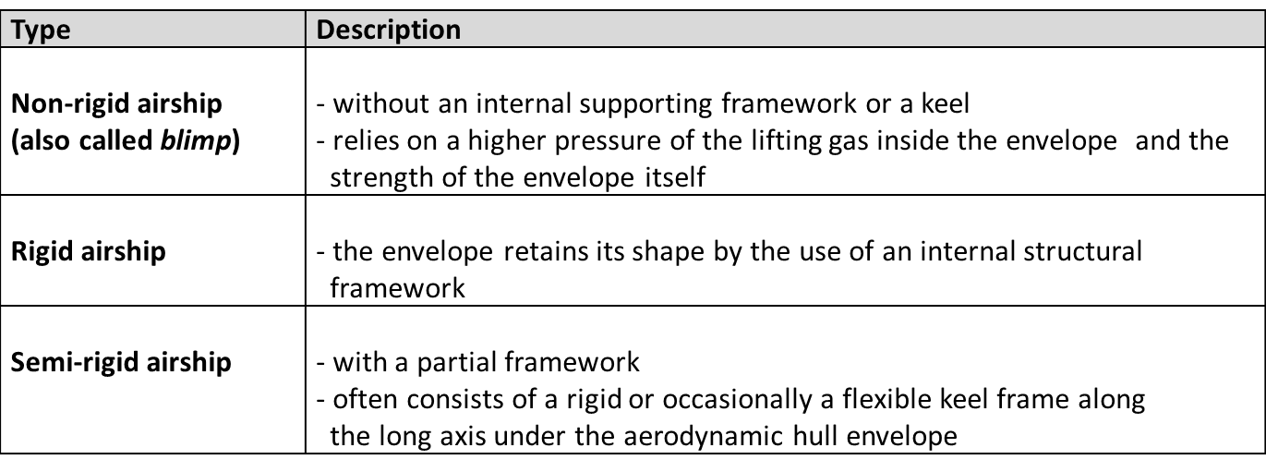
Airships

Slide 7
Helicopter
= a type of rotorcraft that derives its lift and thrust from rotors
single rotor helicopter: one main and rear rotor
helicopter with coaxial rotors: two main rotors counter-rotating, one upon the other
helicopter with a tandem rotor: two tandem main rotors counter-rotating
Use in tourism industry:
taxi service
part of a special event (e.g. weddings)
flight experience
sightseeing flight
heli-skiing
virtual 3D helicopter journey

Slide 8
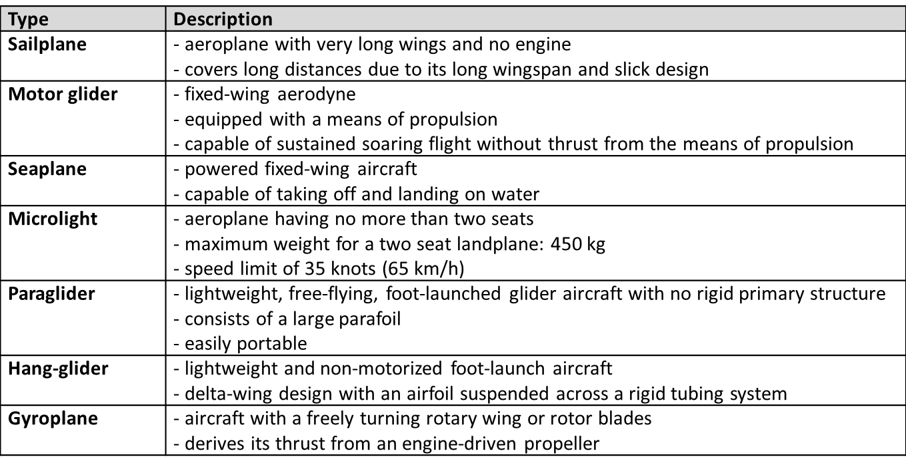
Gliding

Slide 9
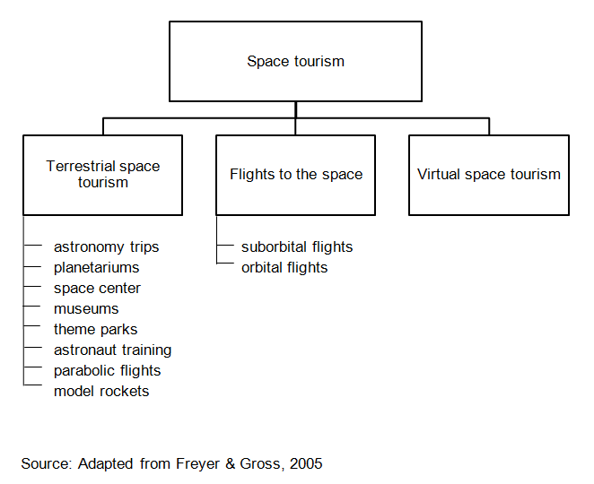
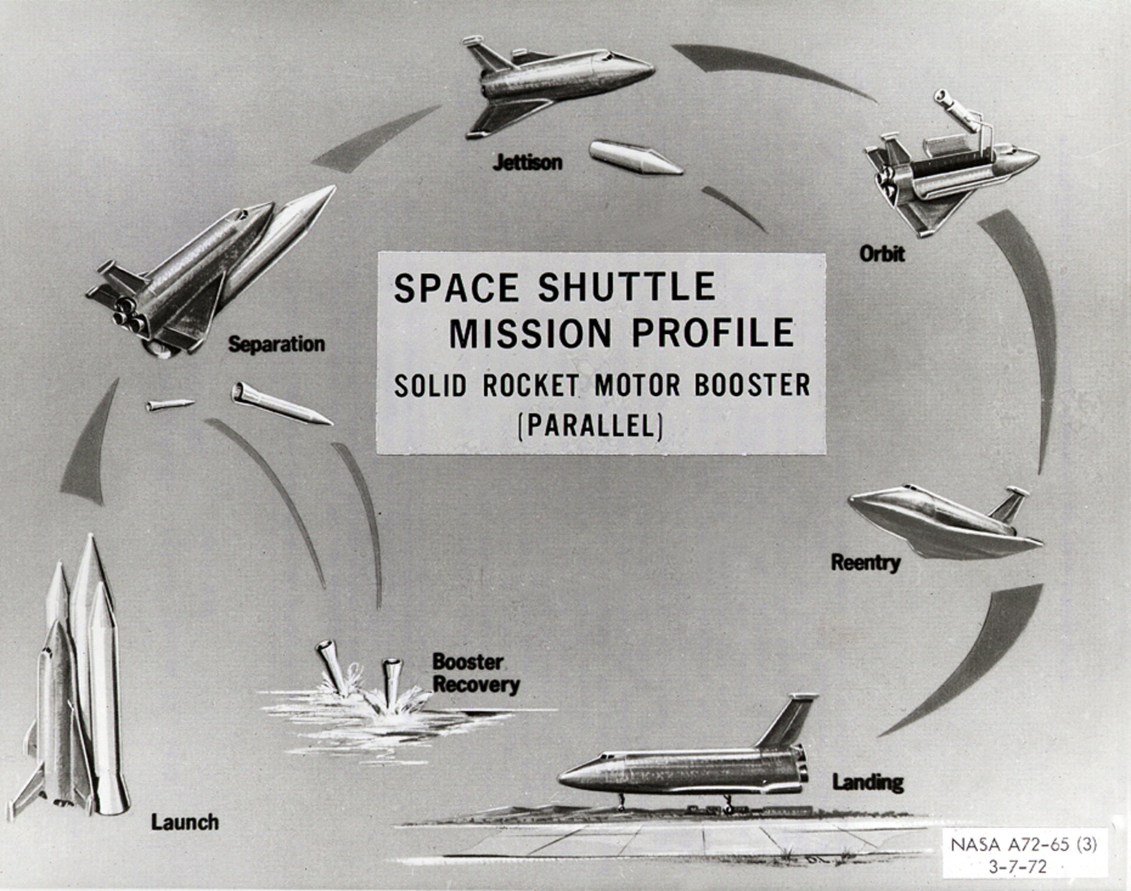
Space Transportation

Slide 10
Space Transportation
Prognosis of Demand for Suborbital and Orbital Flights

Slide 11
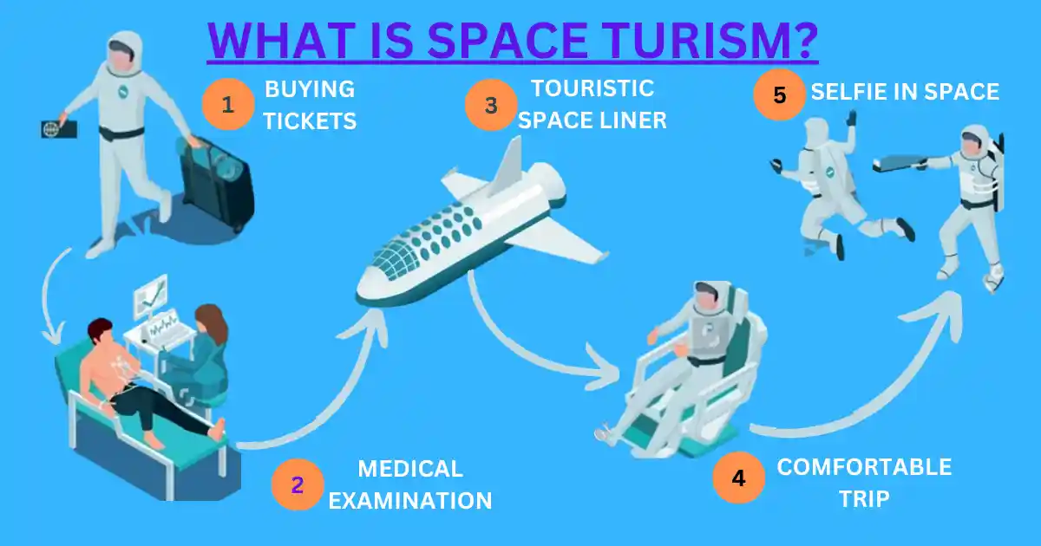

Slide 12
Thank you for your attention!

